Slide 1
Tutorial3: NEMO5 Models
Jean Michel D. Sellier,
Tillmann Kubis, Michael Povolotskyi,
Jim Fonseca, Gerhard Klimeck
Network for Computational Nanotechnology (NCN)
Electrical and Computer Engineering

Slide 2
A short introduction
A short introduction…

Slide 3
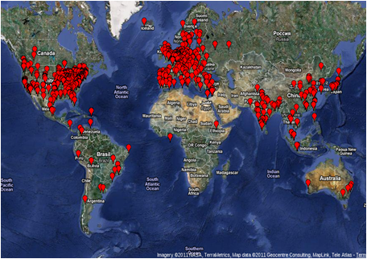
A short introduction
18 years development
Texas Instruments
NASA JPL
Purdue
Peta-scale Engineering
Gordon Bell
Science, Nature Nano

Slide 4
…in this tutorial
…in this tutorial

Slide 5
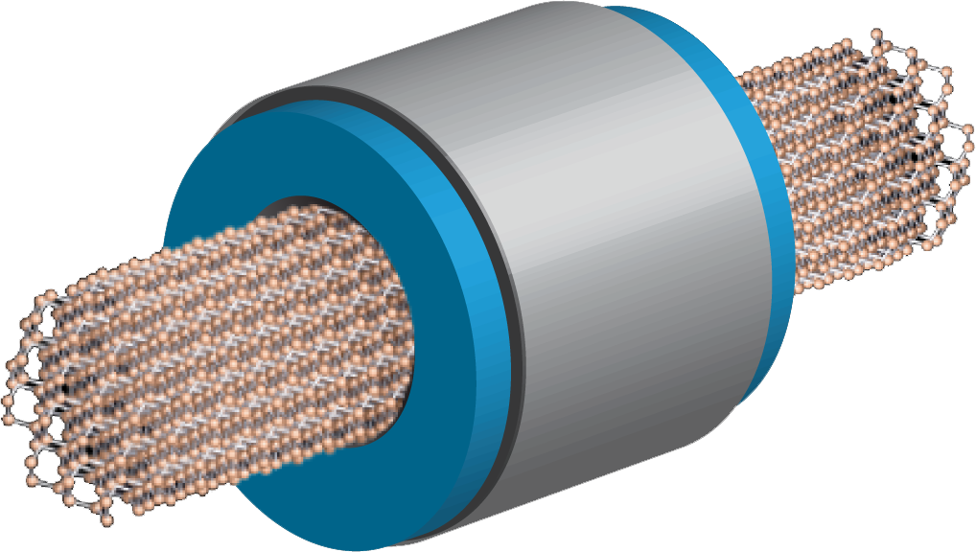
…in this tutorial
Why should one use a atomistic approach today?
Why should one use a atomistic approach today?
What are the models implemented?
How to prototype a new solver?
Example of simulations
Exercises

Slide 6
…in this tutorial
Why should one use a atomistic approach today?
What are the models implemented?
Why should one use a atomistic approach today?
What are the models implemented?
How to prototype a new solver?
Example of simulations
Exercises

Slide 7
…in this tutorial
Why should one use a atomistic approach today?
What are the models implemented?
How to prototype a new solver?
Why should one use a atomistic approach today?
What are the models implemented?
How to prototype a new solver?
Example of simulations
Exercises

Slide 8
…in this tutorial
Why should one use a atomistic approach today?
What are the models implemented?
How to prototype a new solver?
Example of simulations
Why should one use a atomistic approach today?
What are the models implemented?
How to prototype a new solver?
Example of simulations
Exercises

Slide 9
…in this tutorial
Why should one use a atomistic approach today?
What are the models implemented?
How to prototype a new solver?
Example of simulations
Exercises
Why should one use a atomistic approach today?
What are the models implemented?
How to prototype a new solver?
Example of simulations
Exercises

Slide 10
Why an Atomistic approach?

Slide 11
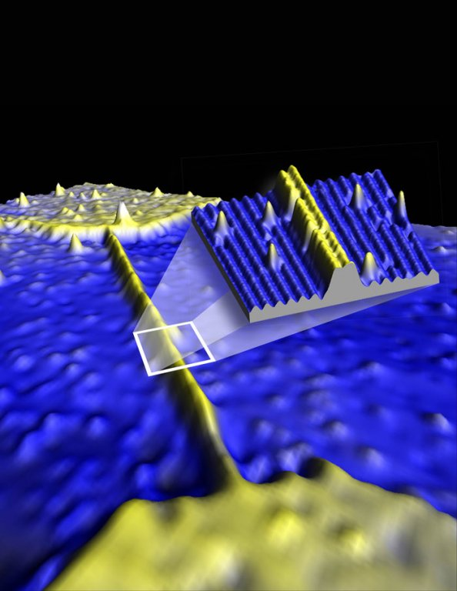
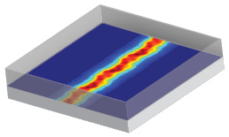
Why an atomistic approach?
The miniaturization of devices has reached the point where the number of atoms is countable.
Simulation and STM image of a Silicon wire, only 1 atom tall, 4 atoms wide!!
[1] B. Weber, et al. “Ohm’s Law Survives to the Atomic Scale”, Science 6 January 2012, Vol. 335 no. 6064 pp. 64-67 DOI: 10.1126/science.1214319
[2] http://physicsforme.wordpress.com/2012/01/07/ohms-law-survives-to-the-atomic-scale/

Slide 12
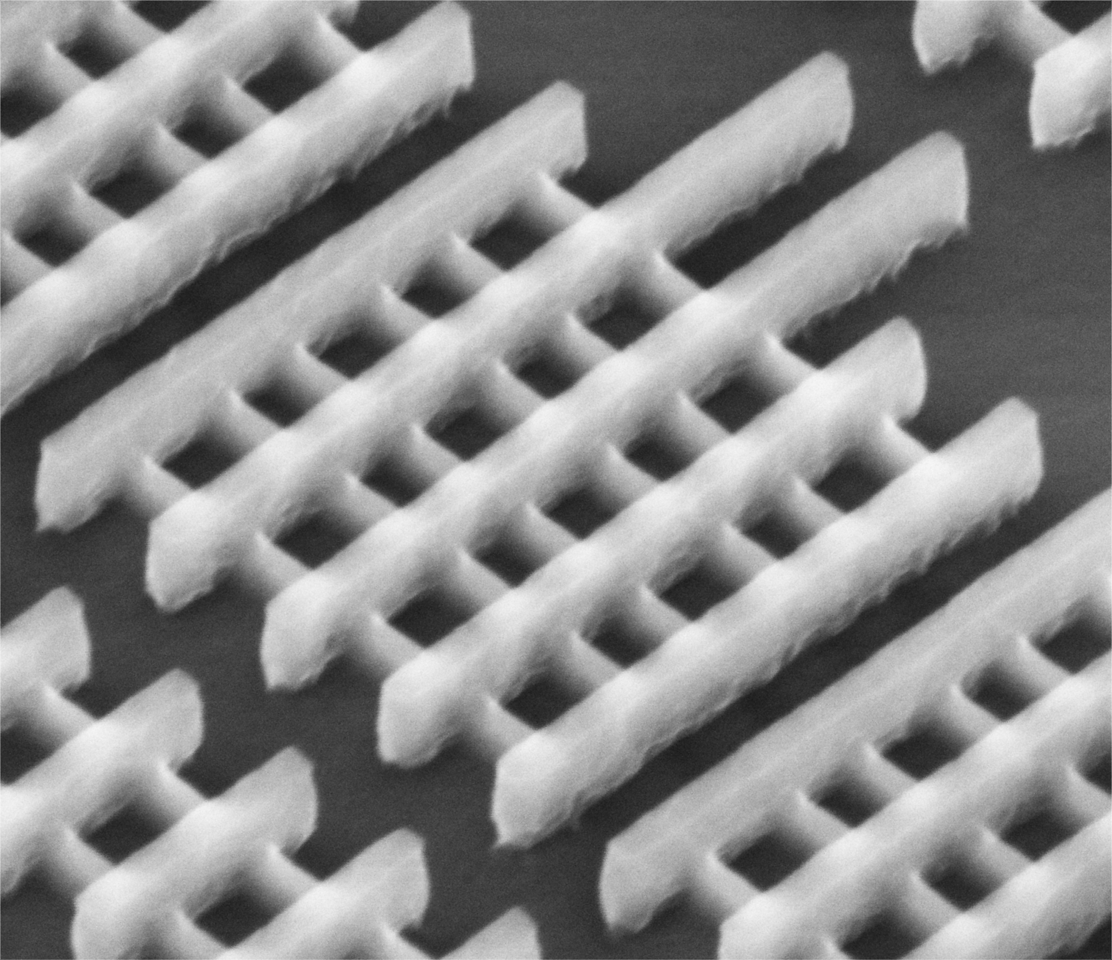
Why an atomistic approach?
The miniaturization of devices has reached the point where geometries are in 3 dimensions.
[3] www.intel.com

Slide 13
Multi-scale and Multi-Physics approaches
Multi-Scale approach

Slide 14
Multi-scale and Multi-Physics approaches
Many modern devices can be considered as constituted of a fully quantum active (small) area and a fully semi-classical (big) area.
[10] http://purdue.academia.edu/GerhardKlimeck/Papers/1238240/Quantum_and_semi-classical_transport_in_NEMO_1-D
Many modern devices can be considered as constituted of a fully quantum active (small) area and a fully semi-classical (big) area.

Slide 15
Multi-scale and Multi-Physics approaches
Multi-Physics approach

Slide 16
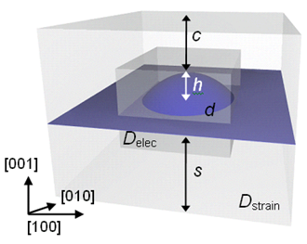
Multi-scale and Multi-Physics approaches
Several modern device need a multi-physics approach.
[13] M. Usman et al., “Moving Toward Nano-TCAD Through Multimillion-Atom Quantum-Dot Simulations Matching Experimental Data”, IEEE Transactions on Nanotechnology, Vol. 8, No. 3, May 2009.

Slide 17
Multi-scale and Multi-Physics approaches
Long range calculations Strain experienced by an InAs dot inside a GaAs structure.
Short range calculations Wavefunctions inside a InAs dot or in a small area surrounding the InAs dot.
Strain experienced by an InAs dot inside a GaAs structure.
Wavefunctions inside a InAs dot or in a small area surrounding the InAs dot.

Slide 18
What are the models implemented in NEMO5?
What are the models implemented in NEMO5?

Slide 19
What are the models implemented in NEMO5?
Note:
NEMO5 can be seen as a general framework so it can virtually contain any number of model (solver).
The real question to ask is: What are the model implemented so far..
Note:
NEMO5 can be seen as a general framework so it can virtually contain any number of model (solver).
The real question to ask is: What are the model implemented so far..

Slide 20
What are the models implemented in NEMO5?
InAs
D1
1. Strain
2. Schroedinger
3. Poisson
4. NEGF
D2
GaAs
AlSb
InP
D3
Si
Ge
Materials
definition
Domain definition
Simulation
Domains consist of regions
Every region has a material
Domains go to solvers
Solvers interaction
Definition of solver input/output

Slide 21
What are the models implemented in NEMO5?
The models/methods so far implemented in NEMO5 are divided in categories: Strain models Phonons Tight Binding method Electronic Structure Transport
The models/methods so far implemented in NEMO5 are divided in categories:

Slide 22
What are the models implemented in NEMO5?
The models/methods so far implemented in NEMO5 are divided in categories: Strain models Phonons Tight Binding method Electronic Structure Transport
The models/methods so far implemented in NEMO5 are divided in categories: Strain models

Slide 23
What are the models implemented in NEMO5?
The models/methods so far implemented in NEMO5 are divided in categories: Strain models Phonons Tight Binding method Electronic Structure Transport
The models/methods so far implemented in NEMO5 are divided in categories: Strain models Phonons

Slide 24
What are the models implemented in NEMO5?
The models/methods so far implemented in NEMO5 are divided in categories: Strain models Phonons Tight Binding method Electronic Structure Transport
The models/methods so far implemented in NEMO5 are divided in categories: Strain models Phonons Electronic Structure

Slide 25
What are the models implemented in NEMO5?
The models/methods so far implemented in NEMO5 are divided in categories: Strain models Phonons Tight Binding method Electronic Structure Transport
The models/methods so far implemented in NEMO5 are divided in categories: Strain models Phonons Electronic Structure Transport

Slide 26
What are the models implemented in NEMO5?
Strain Models

Slide 27
Strain Models
What is a strain? A crystal experiences strain when it undergoes some stress which raises its internal energy in comparison to its strain-free reference compound.

Slide 28
Strain Models
What is a strain? A crystal experiences strain when it undergoes some stress which raises its internal energy in comparison to its strain-free reference compound.
When does a crystal experience it? Nanostructures composed of materials with different lattice constants always exhibit strain.

Slide 29
Stranski-Krastanow Growth
Strain Models
Self-Assembly Process ➔ InAs deposition on GaAs substrate
InAs (0.60583 nm)
First Layer (wetting layer) ~ 1ML
GaAs (0.56532 nm)
GaAs
InAs
InAs
GaAs
GaAs

Slide 30
Strain Models
Valence Force Field
Harmonic
Anharmonic
Keating
Several flavors

Slide 31
Strain Models
The strain calculations is an optimization problem. Strategy: We calculate the total energy of the crystal and find the atoms position that minimize the total energy. Method: The minimization is done by means of a Newton optimization method that is based on the calculation of the Jacobian and the Hessian of the total elastic energy.
Strategy: We calculate the total energy of the crystal and find the atoms position that minimize the total energy.

Slide 32
Strain Models
The strain calculations is an optimization problem. Strategy: We calculate the total energy of the crystal and find the atoms position that minimize the total energy. Method: The minimization is done by means of a Newton optimization method that is based on the calculation of the Jacobian and the Hessian of the total elastic energy.
Strategy: We calculate the total energy of the crystal and find the atoms position that minimize the total energy. Method: The minimization is done by means of a Newton optimization method that is based on the calculation of the Jacobian and the Hessian of the total elastic energy.

Slide 33
Strain Models

Slide 34
Strain Solver Options

Slide 35
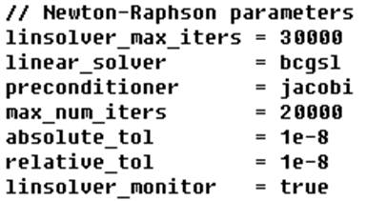
Strain Solver Options

Slide 36
Strain Solver Options
models
linear_solver
preconditioner

Slide 37
Strain Solver Options
max_num_iters
absolute_tol
relative_tol

Slide 38
Strain Solver Options
More options in the manual…

Slide 39
Electronic Structure
Electronic Structure

Slide 40
Electronic Structure
Electronic structure of a device can be studied by means of Schroedinger-Poisson systems in tight-binding formalism. The Schroedinger equation is rewritten using the tight-binding method. The Schroedinger equation is solved on a atomistic mesh The Poisson equation is solved on a Finite Element Mesh (FEM).
Electronic structure of a device can be studied by means of Schroedinger-Poisson systems in tight-binding formalism.

Slide 41
Electronic Structure
Electronic structure of a device can be studied by means of Schroedinger-Poisson systems in tight-binding formalism. The Schroedinger equation is rewritten using the tight-binding method. The Schroedinger equation is solved on a atomistic mesh The Poisson equation is solved on a Finite Element Mesh (FEM).
Electronic structure of a device can be studied by means of Schroedinger-Poisson systems in tight-binding formalism. Schroedinger equation - tight-binding. Poisson equation - Finite Element Mesh (FEM).

Slide 42
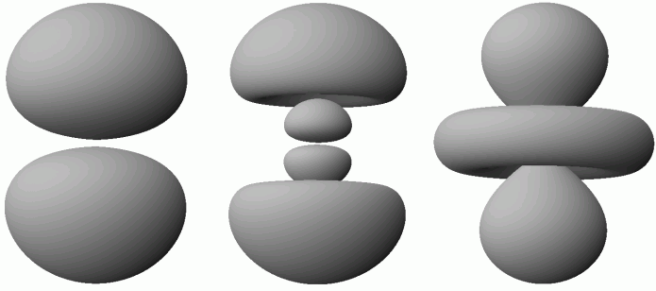
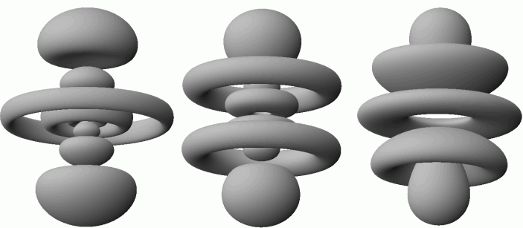
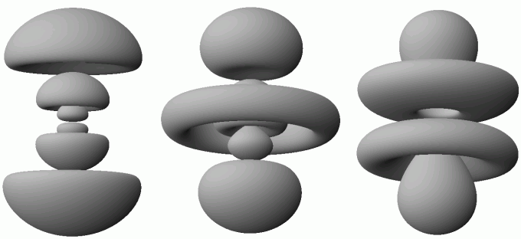
Tight-Binding Method
The underlying ideas of the tight-binding approach are: electrons are considered to be tight binded to the potential core. selection of a basis consisting of atomic orbitals (such as s, p, d, f, and s*) centered on each atom.
[12] http://thisquantumworld.com/wp/the-technique-of-quantum-mechanics/the-hydrogen-atom/

Slide 43
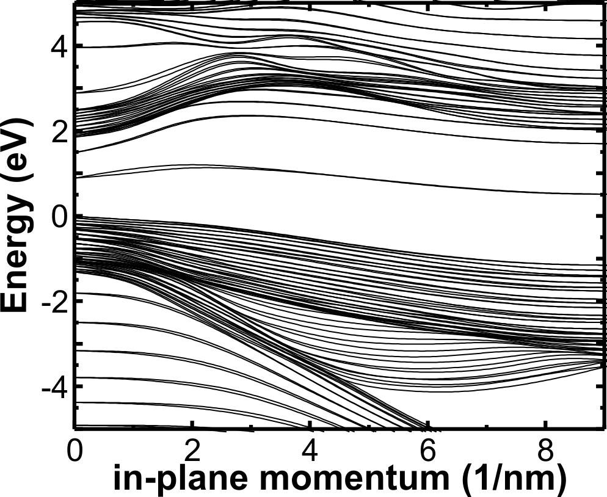
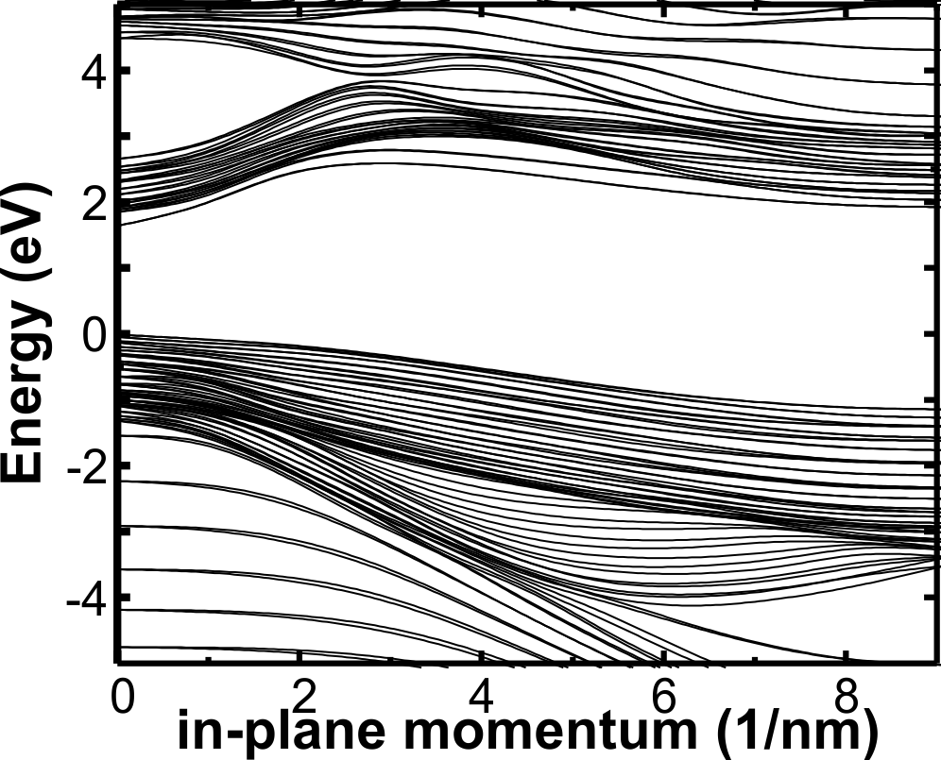
A few words on passivation
In-plane quantum well bandstructure
Bare surfaces
Passivated surfaces
Bulk band gap
Bulk band gap
Result:
Surface states successfully shifted to high energies

Slide 44
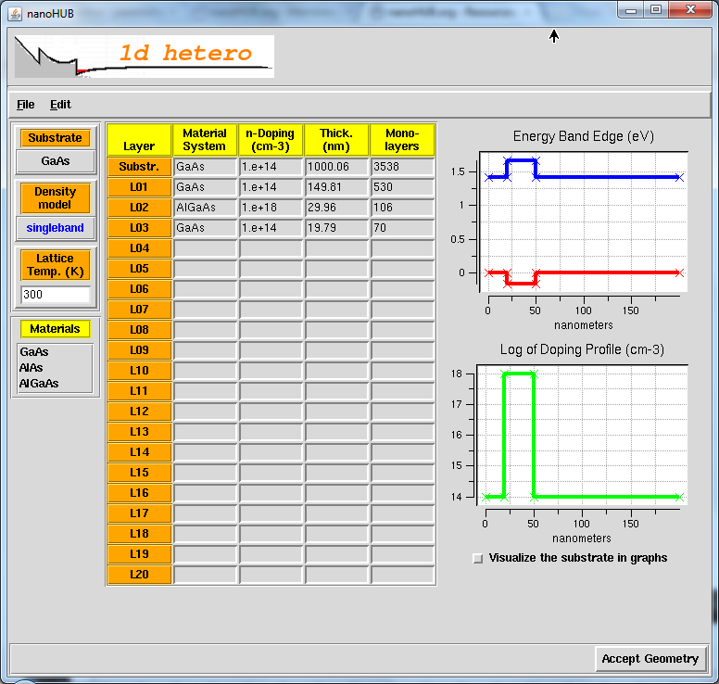
Example: 1Dhetero

Slide 45
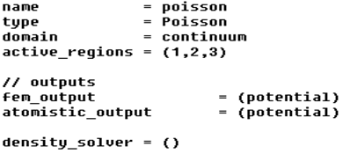
Poisson Solver Options

Slide 46
Poisson Solver Options

Slide 47
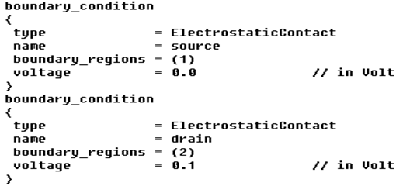
Poisson Solver Options

Slide 48
Poisson Solver Options
atomistic_output

Slide 49
Poisson Solver Options
node_potential_output

Slide 50
Poisson Solver Options
one_dim_output

Slide 51
Poisson Solver Options
one_dim_output_average

Slide 52
Poisson Solver Options
ksp_type

Slide 53
Poisson Solver Options
pc_type

Slide 54
Poisson Solver Options
linear_solver_maxit

Slide 55
Poisson Solver Options
max_iterations
max_nonlinear_steps
max_function_evals
rel_tolerance

Slide 56
Poisson Solver Options
step_abs_tolerance
step_rel_tolerance

Slide 57
Poisson Solver Options
More options in the manual…

Slide 58
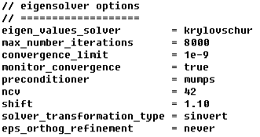
Schroedinger Solver Options

Slide 59
Schroedinger Solver Options

Slide 60
Schroedinger Solver Options
tb_basis
job_list

Slide 61
Schroedinger Solver Options
eigen_values_solver

Slide 62
Schroedinger Solver Options
eigen_values_solver
New!
Lanczos Solver

Slide 63
Schroedinger Solver Options
output
output_precision

Slide 64
Schroedinger Solver Options
potential_solver
k_points
number_of_k_points

Slide 65
Schroedinger Solver Options
linear_solver
preconditioner
shift
monitor_convergence

Slide 66
Schroedinger Solver Options
More options in the manual…

Slide 67
Transport
Transport

Slide 68
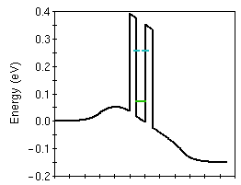
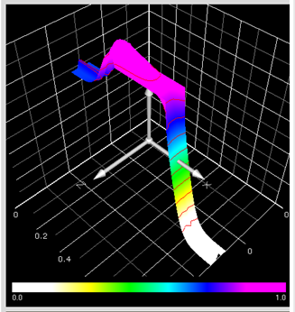
Transport
[16] https://nanohub.org/tools/nanoMOS
[15] https://engineering.purdue.edu/gekcogrp/software-projects/nemo1D/

Slide 69
Transport
Non-equilibrium Green functions (NEGF) formalism is a very powerful way for the simulation of charge transport from a quantum perspective. It easily includes: Fully quantum transport (not just quantum corrections) Open boundary conditions (contacts) Atomistic approach (using tight-binding formalism) Inclusion of realistic scattering
Non-equilibrium Green functions (NEGF) formalism is a very powerful way for the simulation of charge transport from a quantum perspective. It easily includes:

Slide 70
Transport
Non-equilibrium Green functions (NEGF) formalism is a very powerful way for the simulation of charge transport from a quantum perspective. It easily includes: Fully quantum transport (not just quantum corrections) Open boundary conditions (contacts) Atomistic approach (using tight-binding formalism) Inclusion of realistic scattering
Non-equilibrium Green functions (NEGF) formalism is a very powerful way for the simulation of charge transport from a quantum perspective. It easily includes:
Fully quantum transport (not just quantum corrections) Open boundary conditions (contacts) Inclusion of realistic scattering

Slide 71
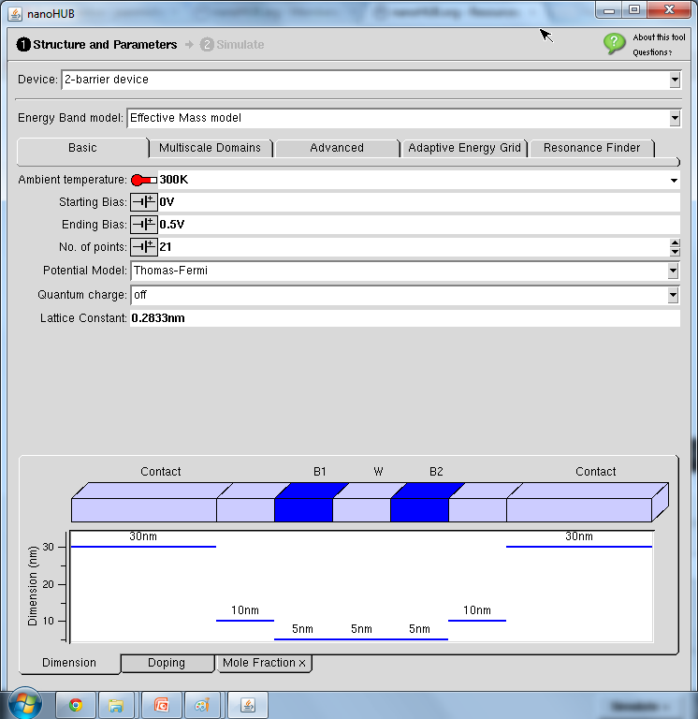
Example: RTDNEGF
exact

Slide 72
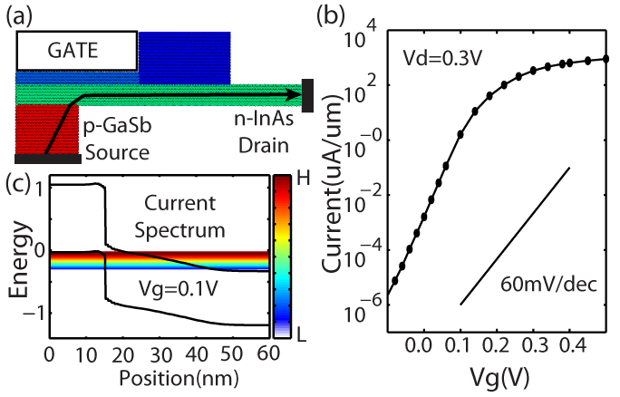
Transport
Semiclassical density calculations Poisson Equation
faster NEGF calculations!
Continuum
Effective mass
Parabolic band
Fermi-Dirac Integral
exact
[17] Z. Jiang, et al., “Quantum Transport in GaSb/InAs nanowire TFET with semiclassical charge density”, Poster at IWCE 2012.

Slide 73
Semi-classical Solver Options

Slide 74
Semi-classical Solver Options
potential_solver
self_consistent
output

Slide 75
Semi-classical Solver Options
More options in the manual…

Slide 76
Example and Exercises
Example and Exercises

Slide 77
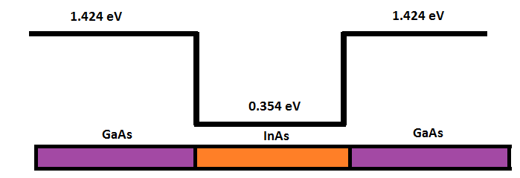
Example and Exercises
Let us see a simple example:
calculate the wavefunctions of a very small quantum well GaAs-InAs-GaAs with strain and applied potential.

Slide 78
Example and Exercises
The solver needed for this exercise will be: 1) Strain solver 2) Poisson solver 3) Schroedinger solver

Slide 79
Example and Exercises
www.nanohub.org
Login in
Click on “MyHUB”
www.nanohub.org
Login in
Click on “MyHUB”

Slide 80
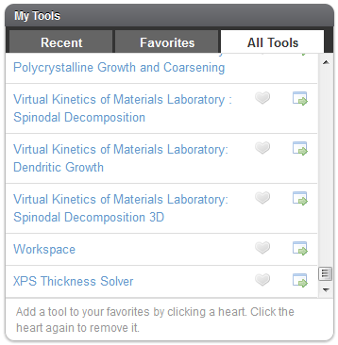
Example and Exercises

Slide 81
Example and Exercises

Slide 82
Run the simulation
The command is (in a shell) > submit -v coates -i ./all.mat nemo-r7962 Sellier_summer_school_example.in

Slide 83
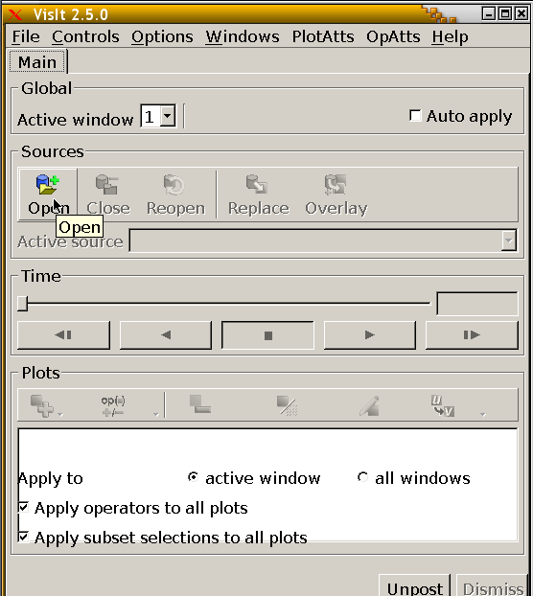
Visualization: VisIt
Click here

Slide 84
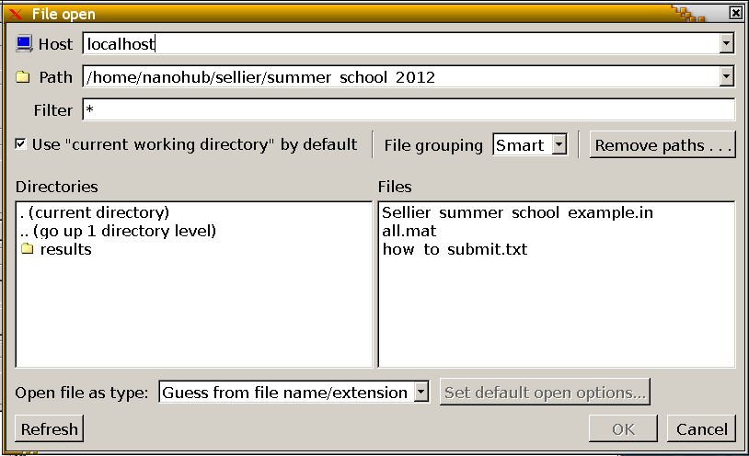
Visualization: VisIt

Slide 85
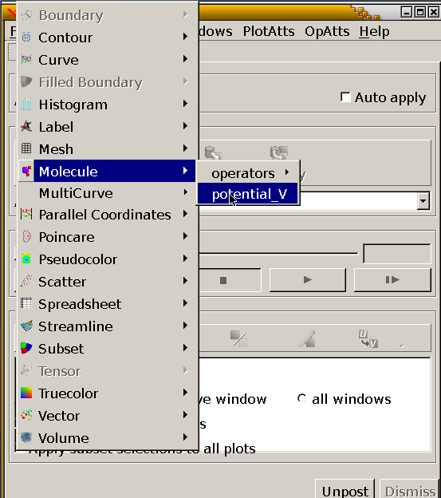
Visualization: VisIt

Slide 86
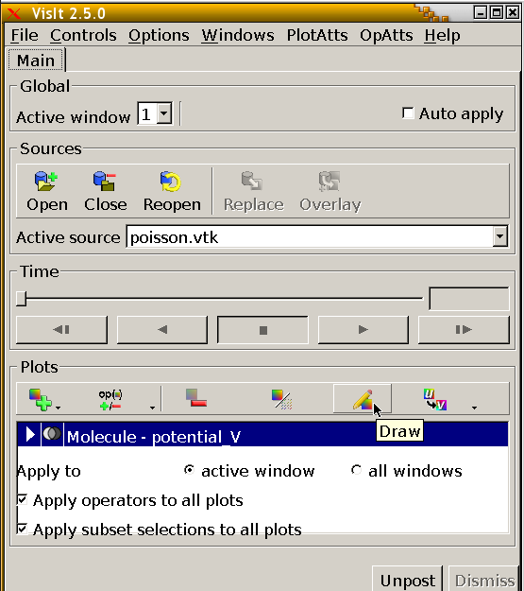
Visualization: VisIt
Click here

Slide 87
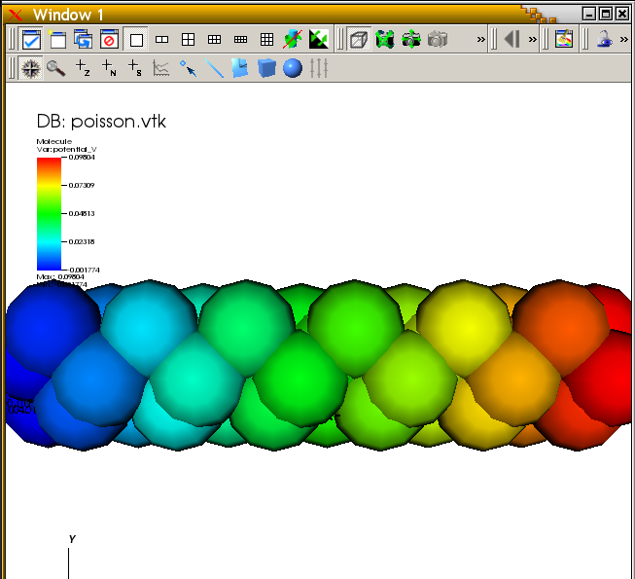
Visualization: Potential

Slide 88
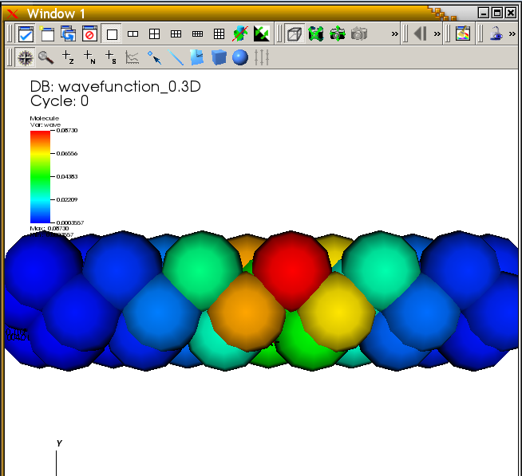
Visualization: Wavefunctions

Slide 89
Thanks!
THANKS!

Slide 90
References
[1] B. Weber, et al. “Ohm’s Law Survives to the Atomic Scale”, Science 6 January 2012, Vol. 335 no. 6064 pp. 64-67 DOI: 10.1126/science.1214319
[2] http://physicsforme.wordpress.com/2012/01/07/ohms-law-survives-to-the-atomic-scale/
[3] www.intel.com
[4] S. Steiger, et al. “NEMO5: A parallel multiscale nanoelectronics modeling tool”, IEEE Transactions on Nanotechnology, Vol. 10, No. 6, November 2011.
[5] P.N. Keating, Phys. Rev. 145 (2) (1966) 637.
[6] M. Musgrave and J. Pople, “A general valence force field for diamond”, Proc. R. Soc. Lond. Series A, Math. Phys. Sci., vol. 268, no. 1335, pp. 474-484, 1962.
[7] O. Lazarenkova, et al. “An atomistic model for the simulation of acoustic phonons, strain distribution, and Gruneisen coefficients in zinc-blende semiconductors”, Superlattices and Microstructures, vol. 34 (2005), p. 553-556.
[8] G. Klimeck et al., “sp3s* tight-binding parameters for transport simulations in compound semiconductors”, SIMD99 Proceeding.
[9] G. Klimeck et al., “Valence band effective-mass expressions in the sp3d5s* empirical tight-binding model applied to a Si and Ge parametrization”, Phys. Rev. B 69, (2004).
[10] http://purdue.academia.edu/GerhardKlimeck/Papers/1238240/Quantum_and_semi-classical_transport_in_NEMO_1-D
[11] G. Klimeck, “Si tight-binding parameters from genetic algorithm fitting”, Superlattices And Microstructures, Vol. 27, No. 2/3, 2000.
[12] http://thisquantumworld.com/wp/the-technique-of-quantum-mechanics/the-hydrogen-atom/
[13] M. Usman et al., “Moving Toward Nano-TCAD Through Multimillion-Atom Quantum-Dot Simulations Matching Experimental Data”, IEEE Transactions on Nanotechnology, Vol. 8, No. 3, May 2009.
[14] S. Steiger, et al., “NEMO5: A Parallel Multiscale Nanoelectronics Modeling Tool”, IEEE Transactions on Nanotechnology,, Nov. 2011, Vol. 10, Issue 6, 1464-1474.
[15] https://engineering.purdue.edu/gekcogrp/software-projects/nemo1D/
[16] https://nanohub.org/tools/nanoMOS
[17] Z. Jiang, et al., “Quantum Transport in GaSb/InAs nanowire TFET with semiclassical charge density”, Poster at IWCE 2012.

