Slide 1
Lecture 14: NEMO5 Introduction
Tillmann Kubis, Michael Povolotskyi, Jean Michel Sellier, Jim Fonseca, Gerhard Klimeck
Network for Computational Nanotechnology (NCN)
Electrical and Computer Engineering

Slide 2
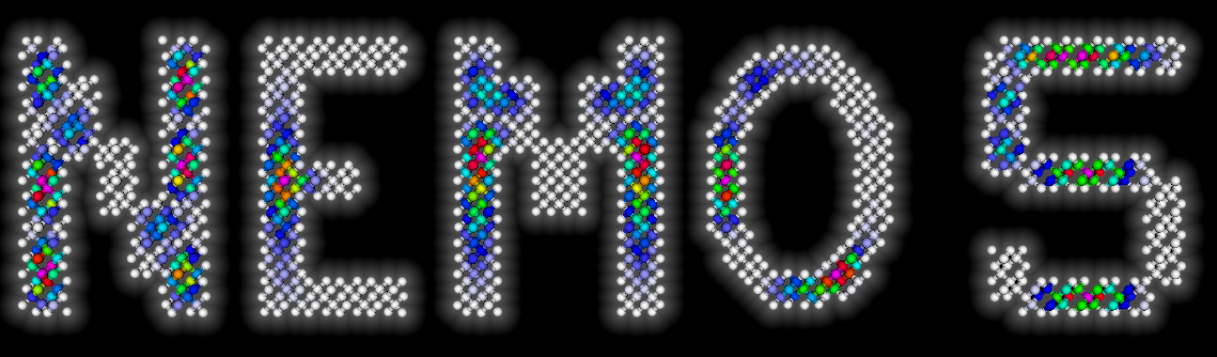
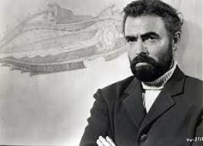

This lecture is about
What is NEMO?
What can NEMO do?
Why NEMO and not something else?
Where can you find NEMO?

Slide 3
A change in the view of the world
20th century point of view:
Isolated
Atom
Gas
s
p
x
p
y
p
z
Quantum Mechanics
Optical Transitions
Coulomb Repulsion
Fundamental physics
Multiple
Separated
Atoms
Regularly
Ordered
Atoms
Solid
Device engineering
Transport
conductivity, mobility
Today:
Devices enter the realm of countable atoms
Distinction of individual bands (e.g. CB, VB) becomes artificial

Slide 4
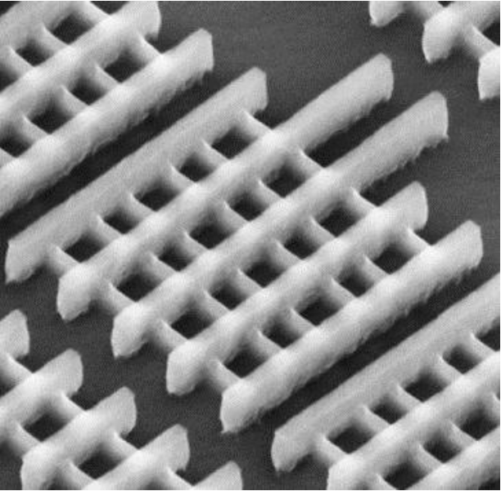
Today’s simulation requirements: industry
Example: Intel’s 22 nm Tri-Gate Transistor
Real world effects:
Strained structures
Imperfect growth
Impurities
Alloy disorder
Surface and interface roughness
3D geometry affects electrons
Scattering on lattice vibrations
Gate leakage
Contact resistance
Joule heating
…
http://newsroom.intel.com/docs/DOC-2035

Slide 5
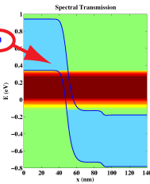
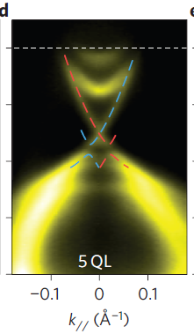
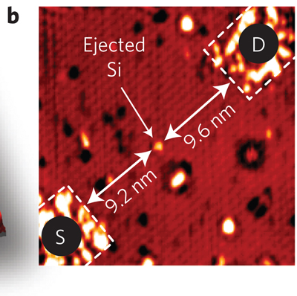
Today’s simulation requirements: research
Single atom transistor
Band-to-band tunneling
Topological insulators
Nature Nanotechnology 7, 242 (2012)
IEEE Elec. Dev. Lett. 30, 602 (2009)
Nature Physics 6, 584 (2010)
Countable device atoms suggest atomistic descriptions
Modern device concepts, e.g.
  Band to band tunneling
  Topological insulators (gap less materials)
  Band/Valley mixing etc.
require multi band representations
Academic and industrial research&development is and has been the driver of NEMO

Slide 6
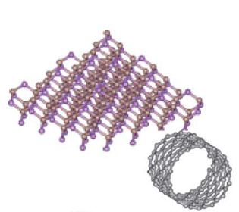
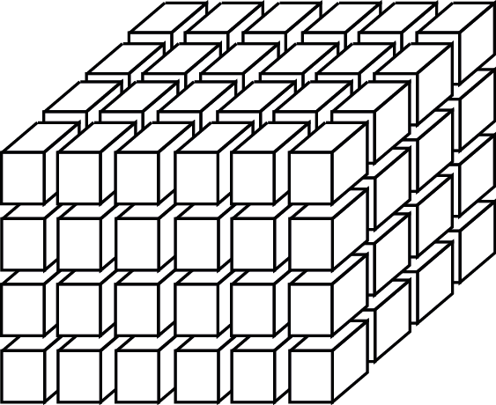
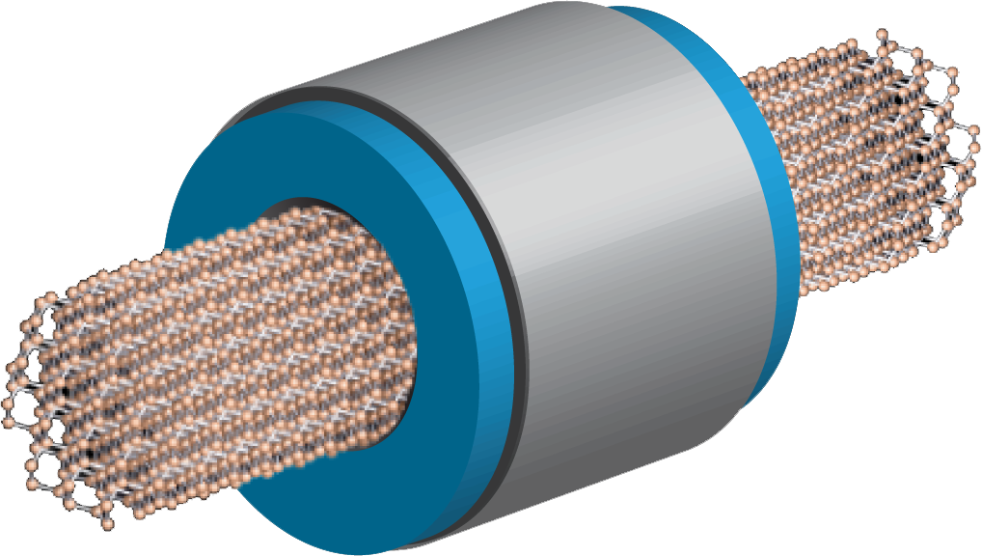
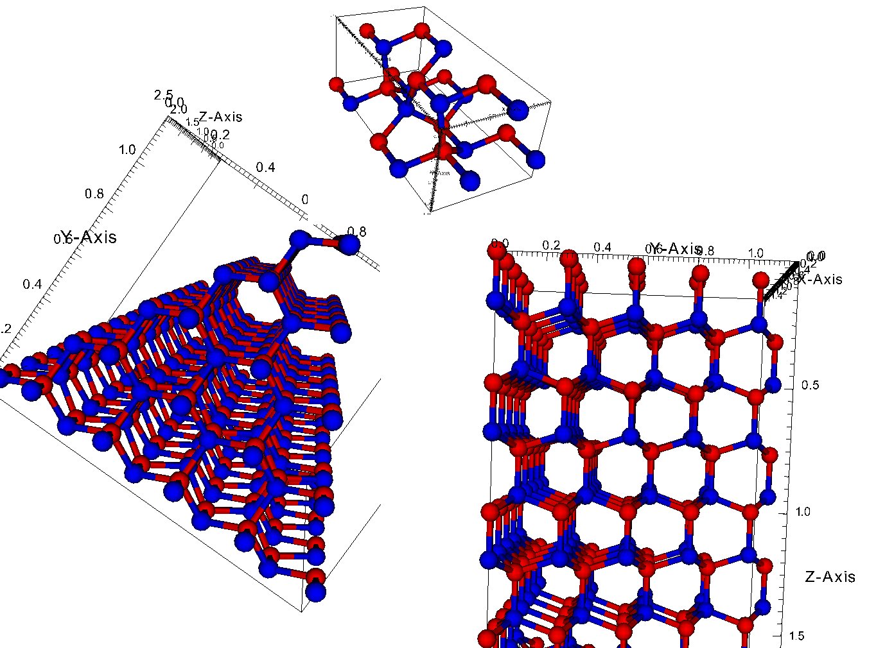
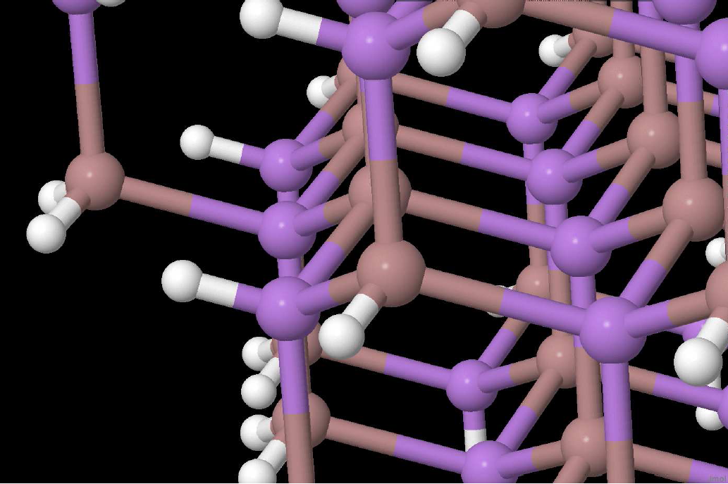
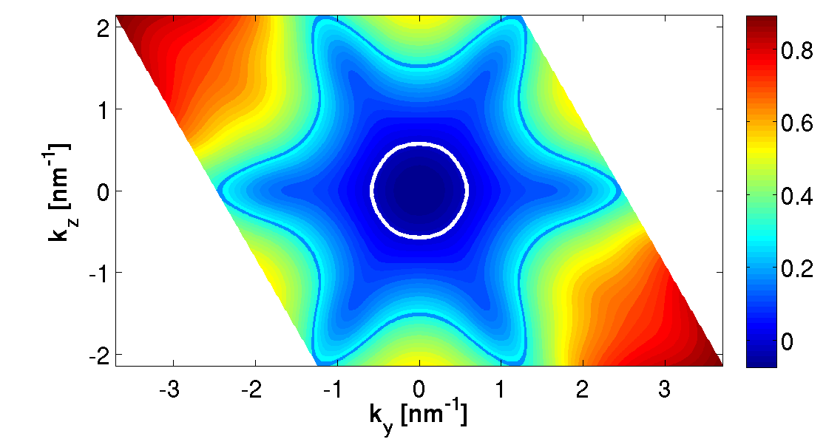

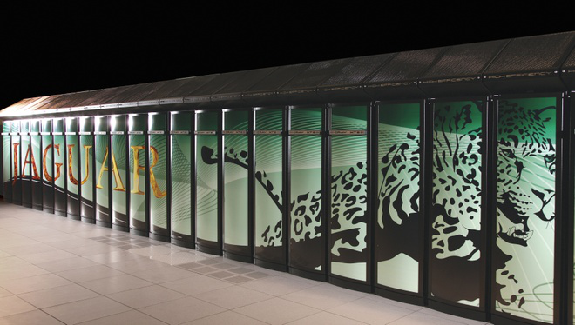
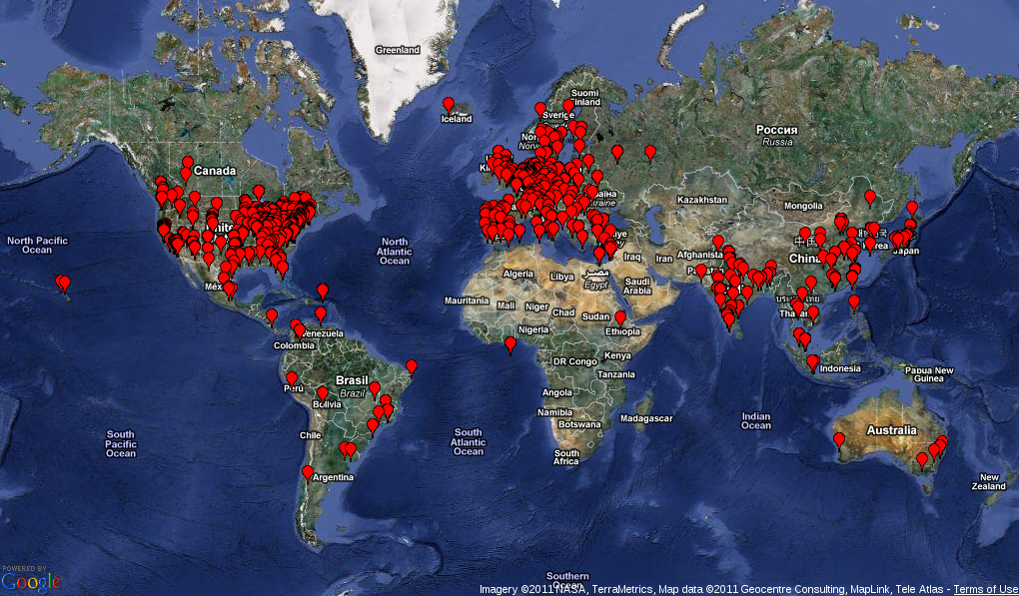
NEMO5 lecture – overview
NEMO5 origins + history
NEMO5 and atomic representations
NEMO5 solvers + physics
NEMO5 expandability + flexibility
NEMO5 on supercomputers (scalability and compatibility)
NEMO5 support (for output and users)

Slide 7
Evolution of Nanoelectronics Tools
NEMO and OMEN
 | NEMO-1D | NEMO-3D | NEMO3Dpeta | OMEN | NEMO5
Transport | Yes | - | - | Yes | Yes
Dim. | 1D | any | any | any | any
Atoms | ~1,000 | 50 Million | 100 Million | ~140,000 | 100 Million
Crystal | [100] Cubic, ZB | [100] Cubic, ZB | [100], Cubic,ZB, WU | Any Any | Any Any
Strain | - | VFF | VFF | - | MVFF
Multi-physics | - |  |  |  | Spin, Classical
Parallel Comp. | 3 levels 23,000 cores | 1 level 80 cores | 3 levels 30,000 cores | 4 levels 220,000 co | 4 levels 100,000 cores

Slide 8
Evolution of Nanoelectronics Tools
NEMO and OMEN
 | NEMO-1D | NEMO-3D | NEMO3Dpeta | OMEN | NEMO5
Transport | Yes | - | - | Yes | Yes
Dim. | 1D | any | any | any | any
Atoms | ~1,000 | 50 Million | 100 Million | ~140,000 | 100 Million
Crystal | [100] Cubic, ZB | [100] Cubic, ZB | [100], Cubic,ZB, WU | Any Any | Any Any
Strain | - | VFF | VFF | - | MVFF
Multi-physics | - |  |  |  | Spin, Classical
Parallel Comp. | 3 levels 23,000 cores | 1 level 80 cores | 3 levels 30,000 cores | 4 levels 220,000 co | 4 levels 100,000 cores

Slide 9
Evolution of Nanoelectronics Tools
NEMO and OMEN
 | NEMO-1D | NEMO-3D | NEMO3Dpeta | OMEN | NEMO5
Transport | Yes | - | - | Yes | Yes
Dim. | 1D | any | any | any | any
Atoms | ~1,000 | 50 Million | 100 Million | ~140,000 | 100 Million
Crystal | [100] Cubic, ZB | [100] Cubic, ZB | [100], Cubic,ZB, WU | Any Any | Any Any
Strain | - | VFF | VFF | - | MVFF
Multi-physics | - |  |  |  | Spin, Classical
Parallel Comp. | 3 levels 23,000 cores | 1 level 80 cores | 3 levels 30,000 cores | 4 levels 220,000 co | 4 levels 100,000 cores

Slide 10
Evolution of Nanoelectronics Tools
NEMO and OMEN
 | NEMO-1D | NEMO-3D | NEMO3Dpeta | OMEN | NEMO5
Transport | Yes | - | - | Yes | Yes
Dim. | 1D | any | any | Almost any | any
Atoms | ~1,000 | 50 Million | 100 Million | ~140,000 | 100 Million
Crystal | [100] Cubic, ZB | [100] Cubic, ZB | [100], Cubic,ZB, WU | Any Any | Any Any
Strain | - | VFF | VFF | - | MVFF
Multi-physics | - |  |  |  | Spin, Classical
Parallel Comp. | 3 levels 23,000 cores | 1 level 80 cores | 3 levels 30,000 cores | 4 levels 220,000 co | 4 levels 100,000 cores

Slide 11
Evolution of Nanoelectronics Tools
NEMO and OMEN
 | NEMO-1D | NEMO-3D | NEMO3Dpeta | OMEN | NEMO5
Transport | Yes | - | - | Yes | Yes
Dim. | 1D | any | any | any | any
Atoms | ~1,000 | 50 Million | 100 Million | ~140,000 | 100 Million
Crystal | [100] Cubic, ZB | [100] Cubic, ZB | [100], Cubic,ZB, WU | Any Any | Any Any
Strain | - | VFF | VFF | - | MVFF
Multi-physics | - |  |  |  | Spin, Classical
Parallel Comp. | 3 levels 23,000 cores | 1 level 80 cores | 3 levels 30,000 cores | 4 levels 220,000 co | 4 levels 100,000 cores

Slide 12
Core Code / Theory Development
NEMO-1D (Texas Instruments ‘94-’98, JPL ‘98-’03)
  Roger Lake, R. Chris Bowen, Dan Blanks, Gerhard Klimeck
NEMO3D (NASA JPL, Purdue, ’98-’07)
  R. Chris Bowen, Fabiano Oyafuso, Seungwon Lee, Gerhard Klimeck
NEMO3D-peta (Purdue, ’06-’11)
  Hoon Ryu, Sunhee Lee, Gerhard Klimeck
OMEN (ETH, Purdue, ‘06-’11)
  Mathieu Luisier, Gerhard Klimeck
NEMO5 (Purdue, ‘09-’12)
  Michael Povolotsky, Hong-Hyun Park, Sebastian Steiger, Tillmann Kubis, Jim Fonseca, Jean Michel Sellier, Gerhard Klimeck
  Zhengping Jiang, Lang Zeng, Daniel Mejia, Yu He
  Sunhee Lee, Mehdi Salmani, Hesam Ilati, Ganesh Hegde

Slide 13
NEMO5 lecture – overview
NEMO5 origins + history
NEMO5 and atomic representations
NEMO5 solvers + physics
NEMO5 expandability + flexibility
NEMO5 on supercomputers (scalability and compatibility)
NEMO5 support (for output and users)

Slide 14
Challenge: large variety of materials
“Is Silicon approaching the end of it’s scalability?”
Ongoing discussions:
III-V materials might outperform Si (higher mobilities), but Silicon has higher density of states
Optically active materials are usually polar (III-V, II-VI)
Graphene provides native 2D transport
Topological insulators offer unique transport properties
“Exotic” materials (e.g. MgO) might replace today’s dielectric barriers
Devices are so small, transport quality in metallic interconnects is important
…

Slide 15
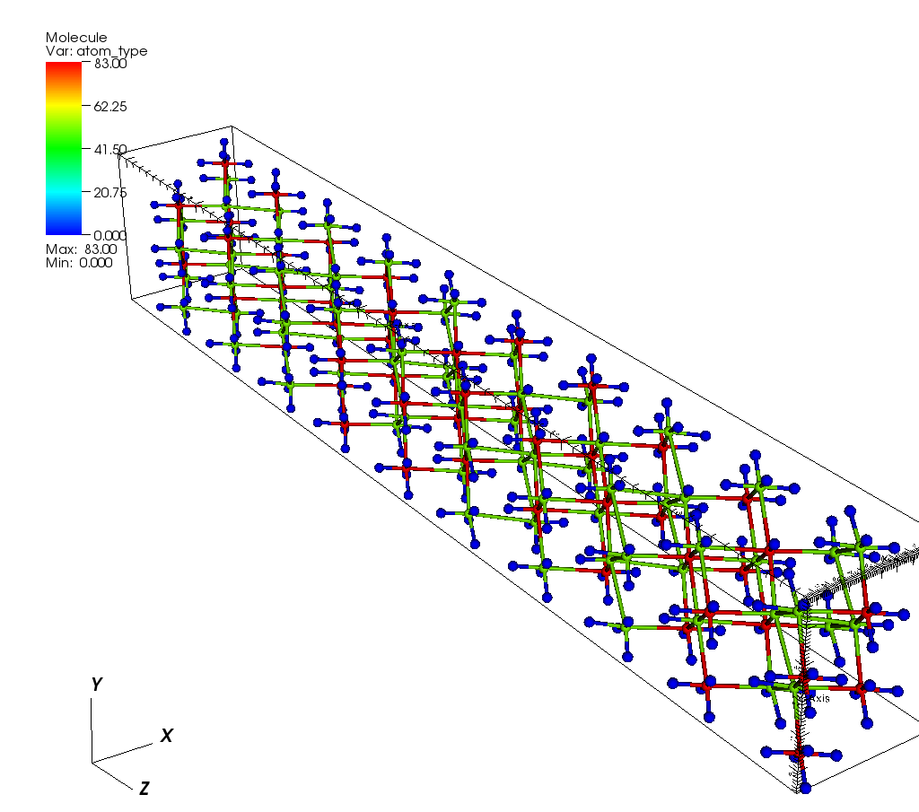
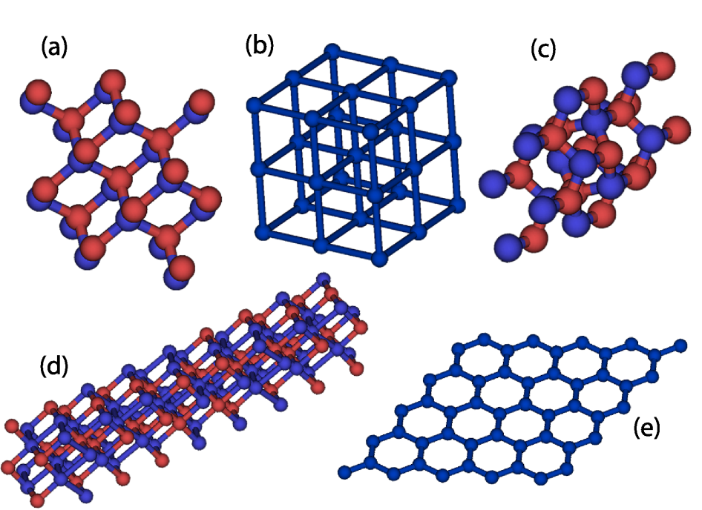
NEMO5 sets up atomistic structures
NEMO5: atomistic representation of devices
Simple-Cubic (for effective-mass band structure)
Diamond (Si, Ge → MOSFETs, UTBs, …)
Zincblende (GaAs, InSb, … → TFETs, HEMTs, QDs)
Wurtzite (nitrides → HEMTs, LEDs)
Rhombohedral (Bi₂Te₃ → thermoelectrics)
Graphene
passivated
Bi₂Te₃ nanowire

Slide 16
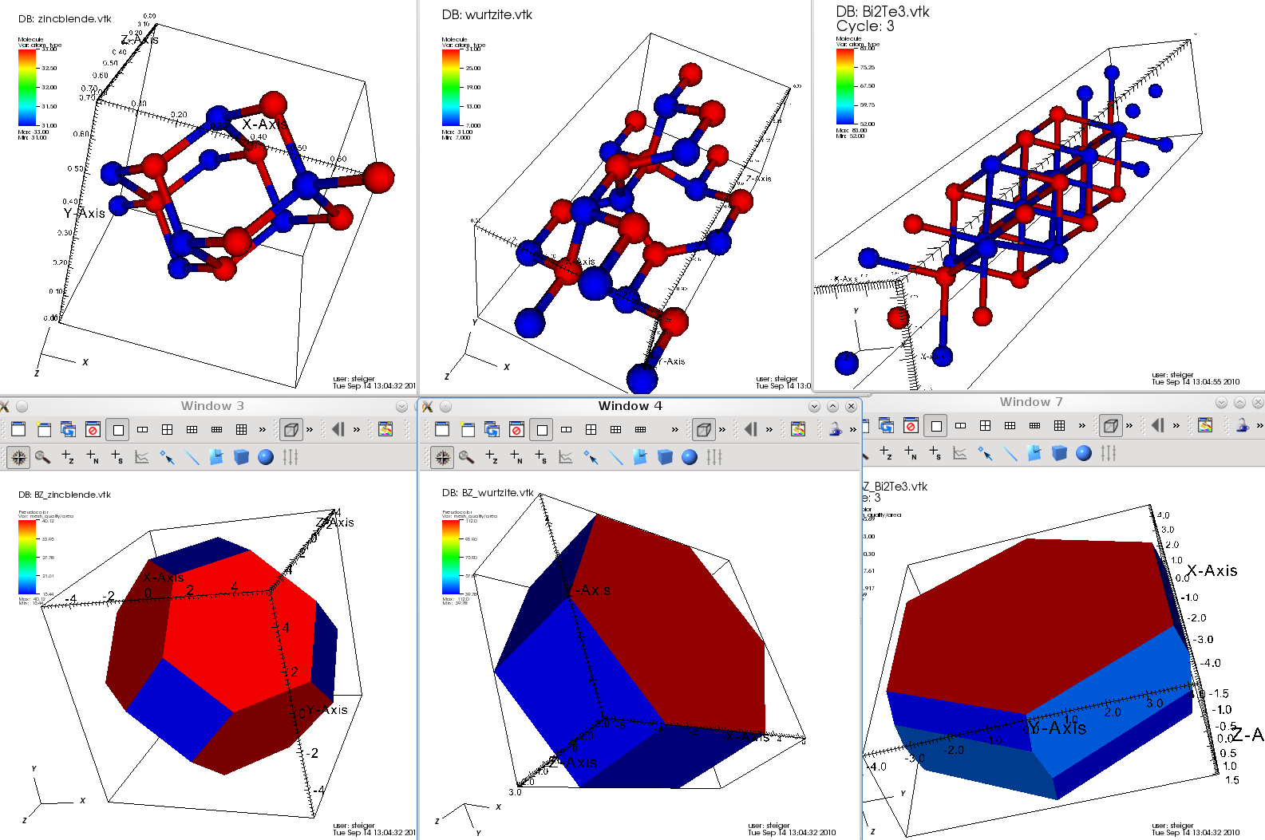
Zincblende, Wurtzite and Rhombohedral Crystals
Some crystal structures in NEMO5:
Corresponding Brillouin zones:

Slide 17
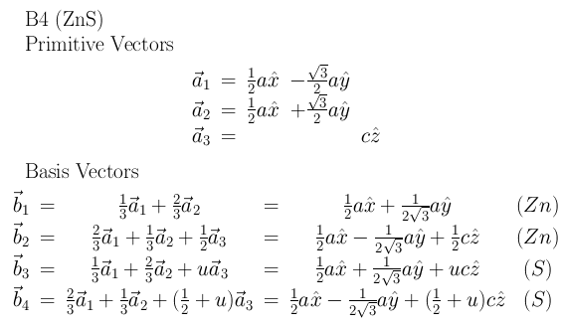
3 steps to add yet another cyrstal structure
How is it done in NEMO5:
Define primitive vectors -> Bravais lattice
Define basis (atoms in 1 unit cells) -> crystal structure
Define bond radius -> connectivity
(optional) Define conventional Miller notation
(e.g. in wurtzite: (0001) = (001) in the primitive basis)

Slide 18
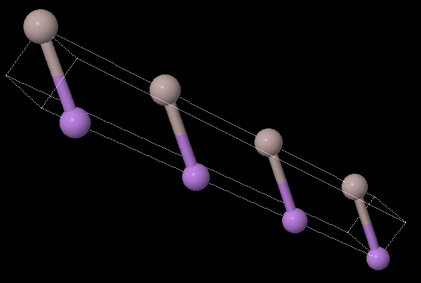
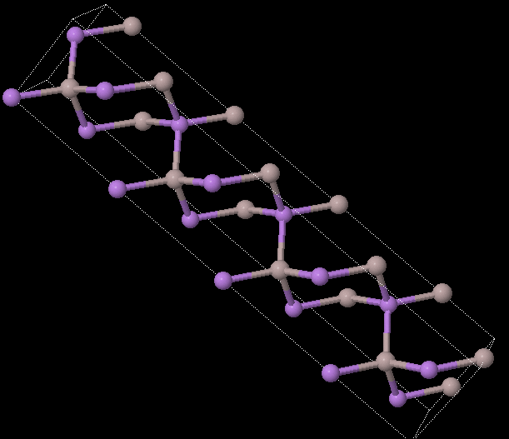
Example: 4 unit cell zincblende material quantum well, [001] growth
NEMO5: Primitive and conventional unit cells
The minimal elementary cell (2 atoms)
b₁= [001] (growth direction)
b₂ = [110]
b₃ = [101]
[001]
The typical conventional cell (8 atoms)
b₁= [001] (growth direction)
b₂ = [010]
b₃ = [100]
[001]
NEMO5 allows to define your conventional unit cell in inputdecks

Slide 19
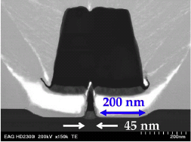
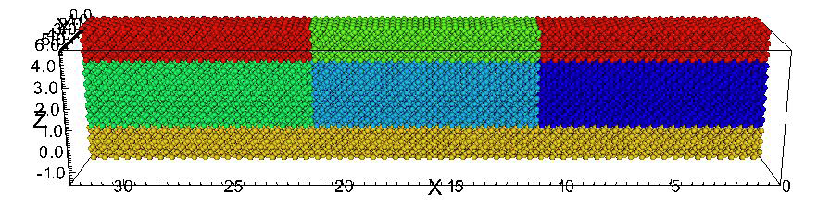
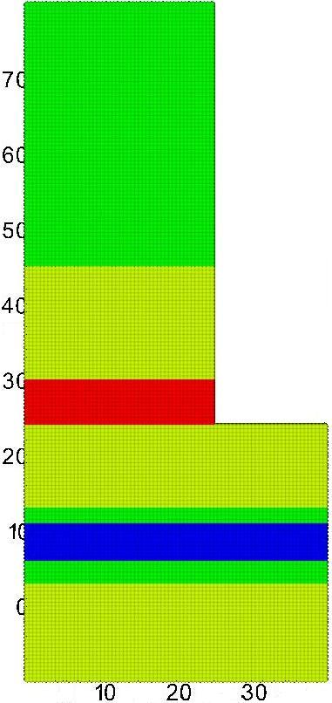
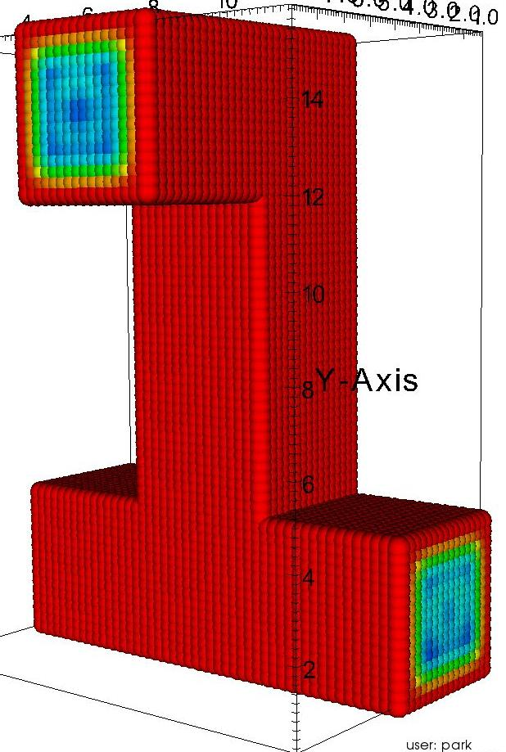
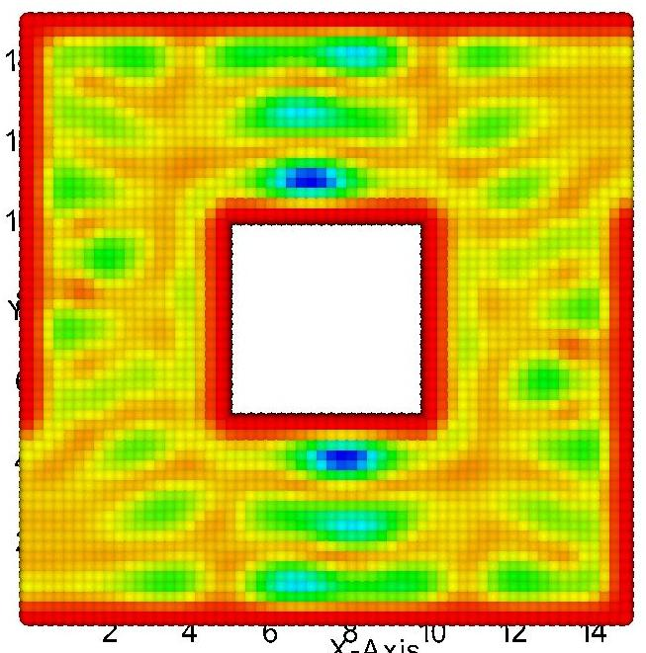
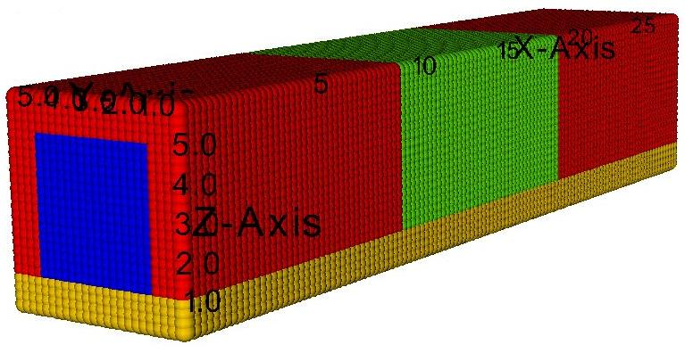
NEMO5: arbitrary geometries
real contact
gate oxide
source
silicon
drain
gate oxide
In₅₃Ga₄₇As
D.-H. Kim, J. D. A. del Alamo, IEEE Trans. Elec. Dev. 57, 1504 (2010)
nm
In₅₂Al₄₈As
Tutorial 2 Input and Visualization
Learn how to set up devices in NEMO5 and how to visualize
InP
In₅₂Al₄₈As
Si δ-doping
Gate
In₅₃Ga₄₇As
Source
Drain
InAs
virtual contact
In₅₃Ga₄₇As
NEMO5 also covers:
Alloy disorder
Random dopants
Ternary alloys
In₅₂Al₄₈As
nm
All models within NEMO5 can handle 1D, 2D, 3D and arbitrary geometries

Slide 20
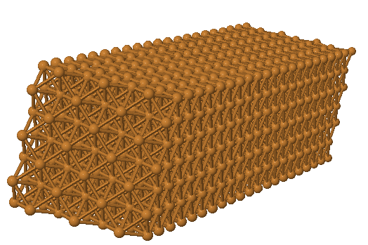
Realistic contact material: Metals in NEMO5
Challenges:
Shrinking semiconductor device dimensions enhance influence of metallic leads
Metals have long range interactions beyond standard 1st nearest neighbor tight binding models
NEMO5:
Extended neighbor interactions included
Bandstructure and transport in ideal metal structures verified (Cu, Ag, Au, Al, Pb)
FCC Copper bandstructure (DFT vs. NEMO5)
Cu nanowire in NEMO5
Tutorial 4B – Metals in NEMO5
Learn how to use the 2nd NN tight binding model in NEMO5 for metals
Ef
Lines: FP-LAPW- DFT*
* Full Potential Linear Augmented Plane Wave Density Functional Theory
Circles: NEMO5 fitted to FP-LAPW-DFT

Slide 21
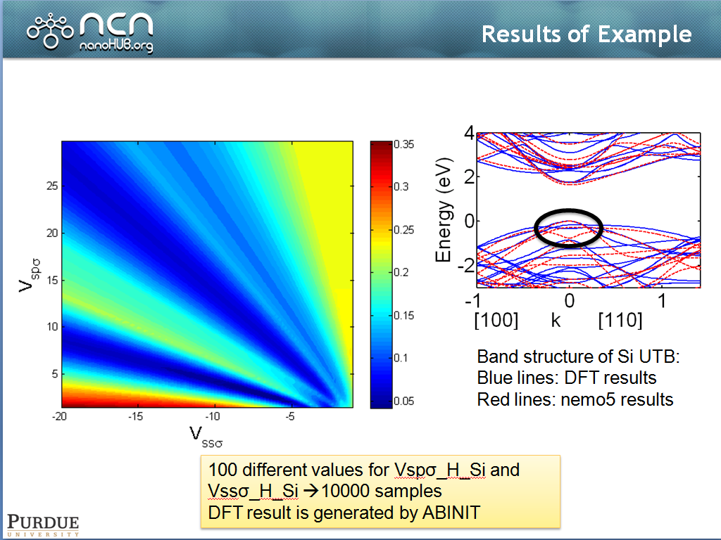
NEMO5: how to do parameter fitting
Tutorial 4D – NEMO5&Python: tight binding parameter fitting
Learn how to use python in conjunction with NEMO5 to fit tight binding parameters

Slide 22
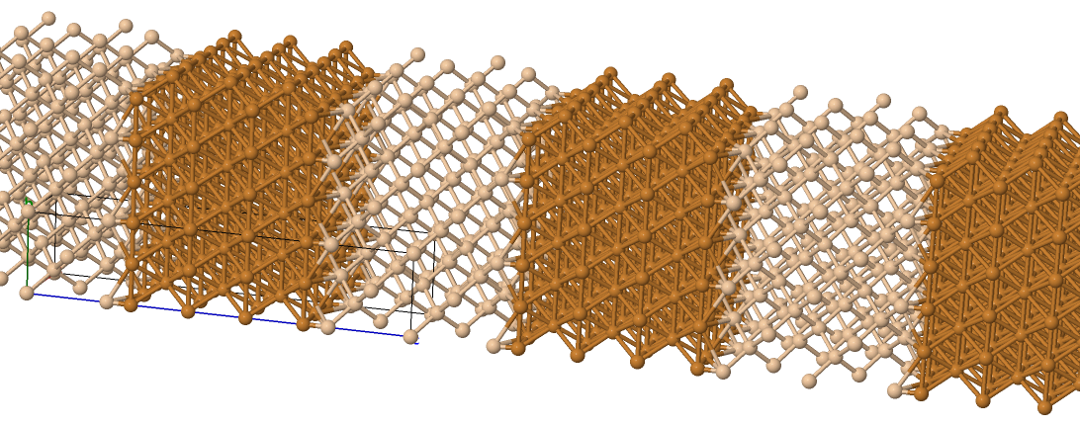
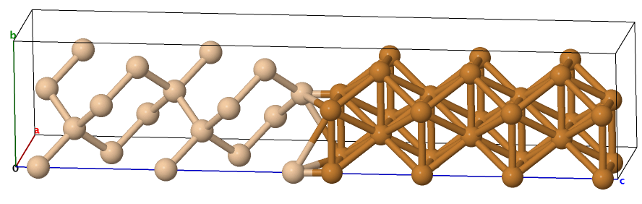
Realistic interfaces: NEMO5 and external solvers
Challenges:
Metals have different crystal structures than typical semiconductors
Si
Cu
Si
Cu
NEMO5:
Pseudomorphic interfaces available
Read in incommensurate heterostructures from external simulators possible (e.g. Reaxff)
Large strain on the surface might require sophisticated molecular dynamics calculations – NEMO5 is compatible to that

Slide 23
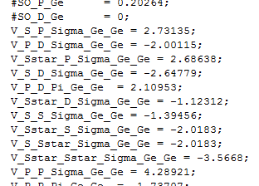
Many materials require a sophisticated database
Semiconductor research spans over a huge variety of materials
Simulators have to provide a database that is…
Universal: many different parameter sets (bandgap, effective mass, strain constants, TB constants…
General: allow different parameters given by different authors
Flexible: expandable to cover new parameter sets (for new models,…)
Editable: easy to read and edit (avoid “getting lost”, no double entries,…)
NEMO5 database:
One ascii file; default: NEMO/prototype/materials/all.mat
Directly editable via inputdecks (convenient for test purposes)

Slide 24
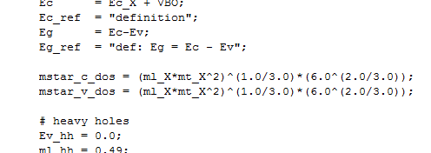
Many materials require a sophisticated database
Joseph Weinbub (http://www.iue.tuwien.ac.at/pdf/ib_2010/CP2010_Weinbub_1.pdf) (ViennaIPD):
“Applications for scientific computing require a powerful control language to satisfy the need of control parameters, e.g. material properties, models to take into account, model parameters, process definitions, simulation modes, iteration schemes, and numerical behavior. As a result, control files grow in size,
which results in decreased maintainability.
Therefore a powerful control language has been developed …” *
(* 2010 ViennaIPD - An Input Control Language for Scientific Computing, Josef Weinbub, Karl Rupp, Siegfried Selberherr, Institute for Microelectronics, Technische Universität Wien)
NEMO5 database:
Capable to handle formulas (control language developed)
Snapshot of all.mat: Simple example for a database formula

Slide 25




NEMO5: Database Rules
NEMO5 database:
Sophisticated formulas/rules are supported
NEMO/prototype/tests/
test_database_regex_nemo/DatabaseTutorial.pdf
Basic Parameters
Complex Parameter
Multiple Parameters
Multiple Complex
Parameters
Si:Bands:TB:sp3d5sstar_SO:param_Boykin (all.mat)
rule[$param$_SiGe_Si] = 0.5 * SiGe:Bands:TB:sp3d5sstar_SO:param_Boykin:$param1$_SiGe_SiGe + 0.5 * Si:Bands:TB:sp3d5sstar_SO:param_Boykin:$param1$_Si_Si;
rule[$param$_SiGe_Ge] = 0.5 * SiGe:Bands:TB:sp3d5sstar_SO:param_Boykin:$param1$_SiGe_SiGe + 0.5 * Ge:Bands:TB:sp3d5sstar_SO:param_Boykin:$param1$_Ge_Ge;
rule[$param$_Si_Ge] = SiGe:Bands:TB:sp3d5sstar_SO:param_unknown:$param1$_Si_Ge;
rule[$param$_Ge_Si] = SiGe:Bands:TB:sp3d5sstar_SO:param_unknown:$param1$_Ge_Si;

Slide 26
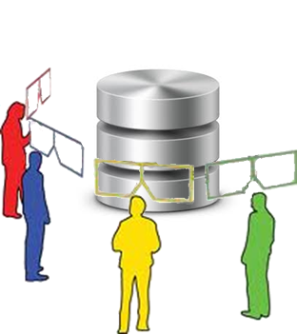
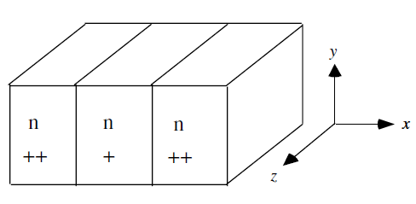
NEMO5: Database Multiple Views
NEMO/prototype/examples/Transport/TEST/datta.in
Material
{
tag = n
name = Si
Lattice:a_lattice = 0.3
…
doping_type = N
doping_density = 1e20
}
Material
{
tag = nplus
name = Si
Lattice:a_lattice = 0.3
…
doping_type = N
doping_density = 5e19
}
Original image from: http://www.imvis-eu.org/
NEMO5 allows to use materials as templates
Change material parameters in the inputdeck to design your own material
Original image from: Datta, Superlatt. and Microstruct. 28, 253 (2000)

Slide 27
NEMO5 lecture – overview
NEMO5 origins + history
NEMO5 and atomic representations
NEMO5 solvers + physics
NEMO5 expandability + flexibility
NEMO5 on supercomputers (scalability and compatibility)
NEMO5 support (for output and users)

Slide 28
Challenge: various physics involved
Original question “What happens in that device?” yields lots of follow-up questions:
What is the atomic structure?
Heterostructures are usually lattice mismatched (strained)
What are the electron and phonon states?
Devices often produce confinement and interference effects (sophisticated bandstructures)
How are the electrons distributed?
Doping and charge distribution require solutions of the electrostatics
How reliable are the device properties?
Imperfect device growth, randomness and finite temperature deteriorate the ideal device performance
How large will be the current density for a given gate and supply voltage?
Concrete transport properties depend on all other questions

Slide 29
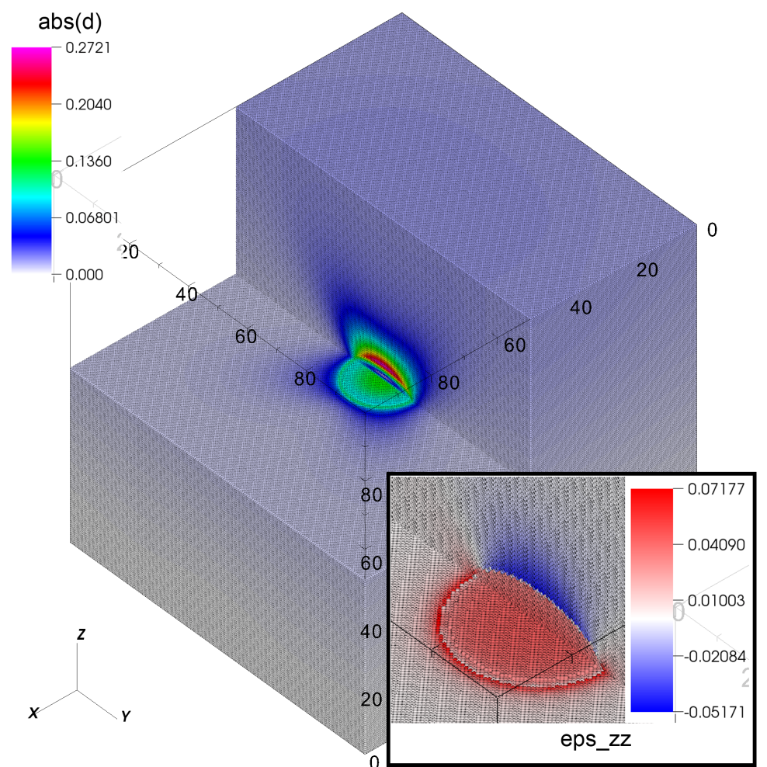
NEMO5: strain in nanostructures
Atomistic description using valence force field (VFF) method
Structure relaxation by minimizing an energy functional that depends on bond angles and bond lengths
Various models for energy
functional available
Tutorial 5B Strain in NEMO5
Learn how to use NEMO5 to relax heterostructures
displacement vector and zz-component of strain tensor in a InAs lens-shaped quantum dot (~50 million InAs atoms)

Slide 30
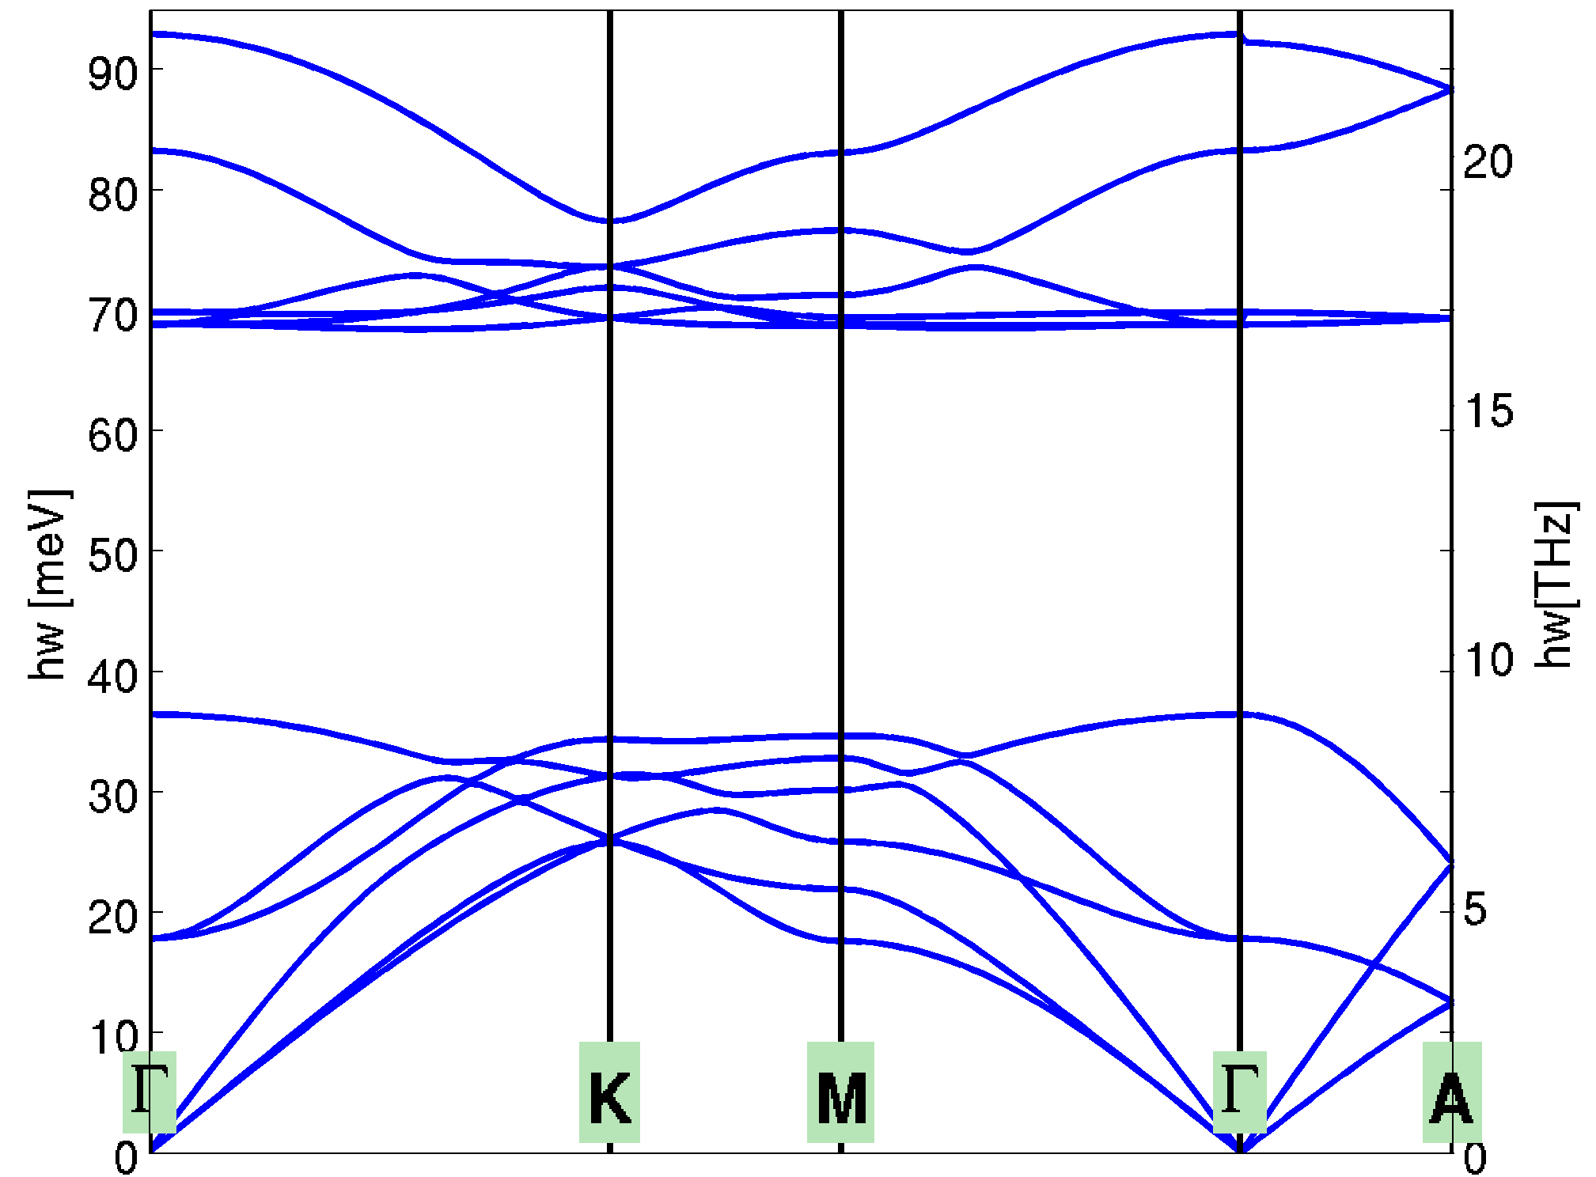
NEMO5: phonon modes
Same physical model as strain relaxation
Hessian of energy functional is reused as dynamical matrix
Bulk phonon dispersion for GaN in wurtzite phase
calculated using Keating VFF model + Coulomb interaction

Slide 31
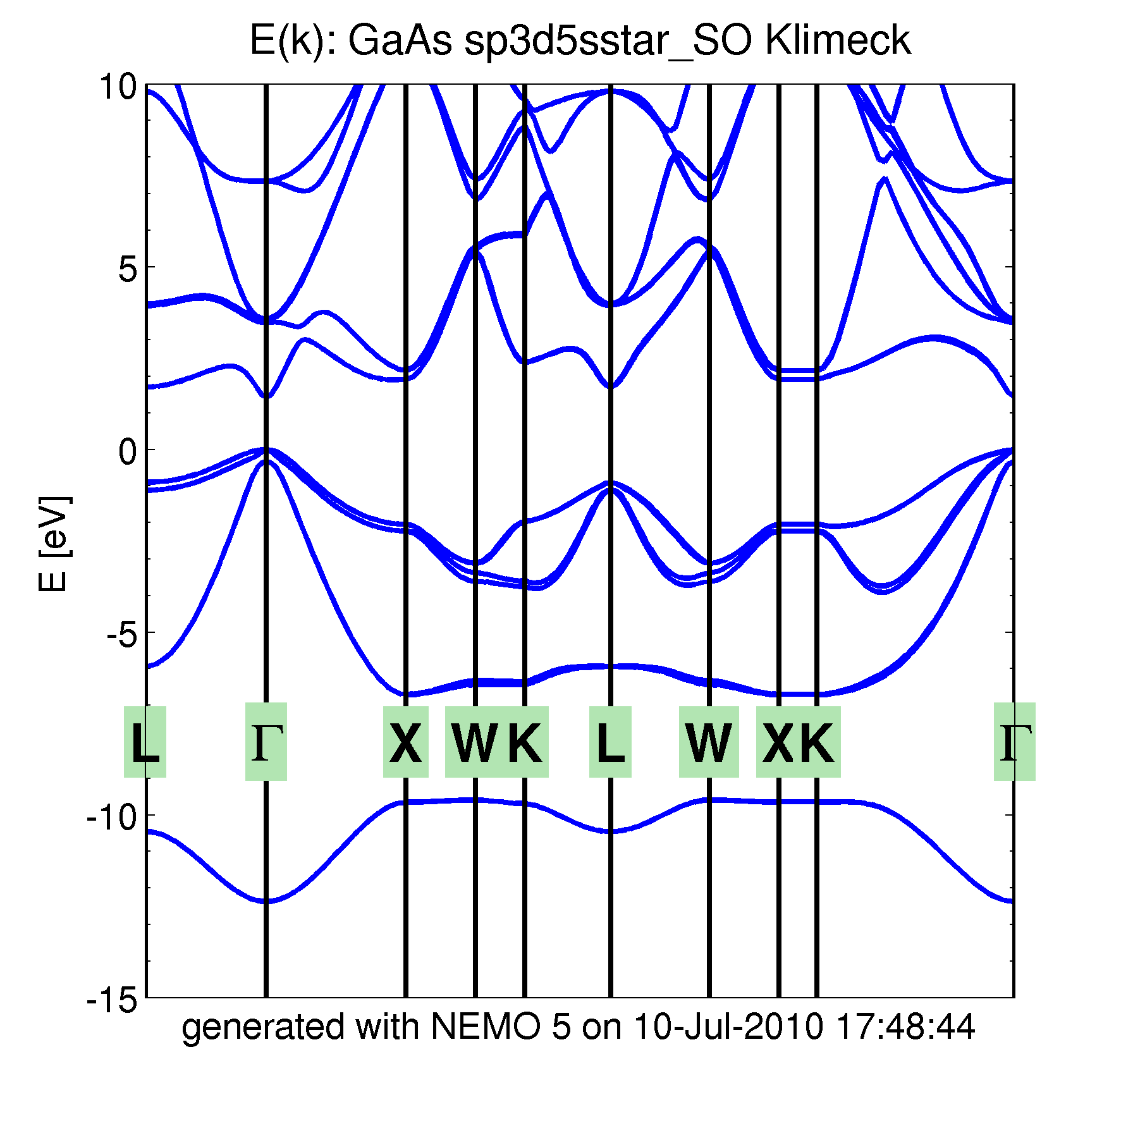
NEMO5: electronic band structures
Any nearest-neighbor tight-binding model available (s,p,d,f,g,…)
Any Nth nearest-neighbor tight-binding model possible
(2nd nearest neighbor TB used for metals)
Many parametersets included in the database
Bi₂Te₃
U
Γ
Z
F
Γ
L
Tutorial 4 – NEMO5 and Schroedinger solver
Learn how to use NEMO5 to calculation eigenstates and bandstructures in Silicon, Graphene, Metals and topological insulators

Slide 32
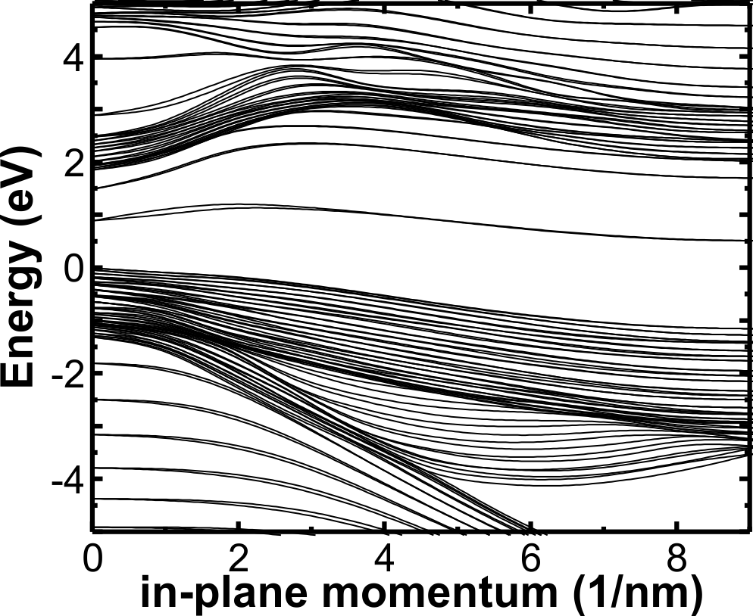
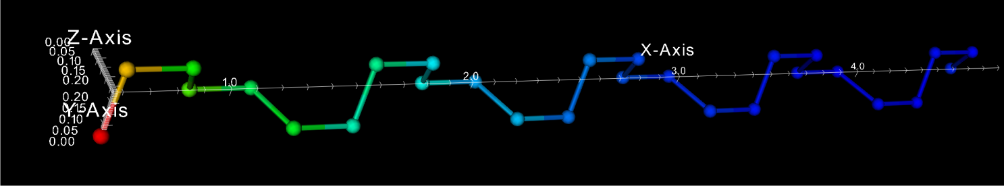
NEMO5: heterostructure band structures
In-plane [111] GaAs quantum well bandstructure
Dangling bonds result in surface states
Without further treatment:
Surface states lie within interesting energy intervals (such as band gap)
Bulk band gap
In reality:
Surface passivation or surface reconstruction shifts surface states out of relevant energy range
|Ψ|² Surface state

Slide 33
NEMO5: Passivation of surfaces
During device construction:
Hydrogen atoms are added half way to the next (missing) semiconductor atom
Only bonding direction is relevant for the passivation model
General and fast:
Allows any kind of surface
No transformation required (surface hybridization is given automatically)
L
L/2

Slide 34
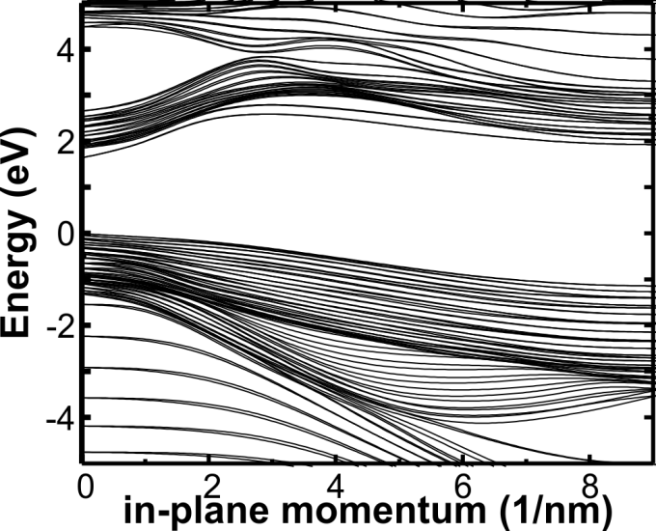
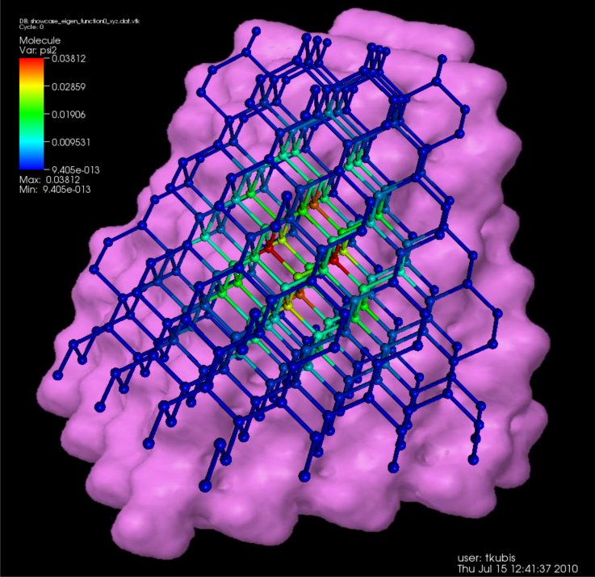
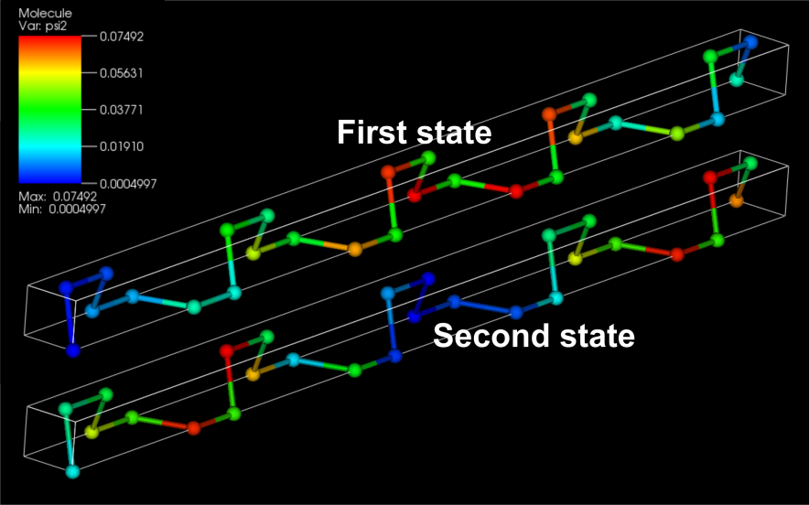
NEMO5: Passivation of general surfaces
GaAs [111] quantum well
GaAs quantum dot
Tutorial 4D – Graphene in NEMO5
Learn how to correctly set up NEMO5 for passivation
Important: Surface passivation
NEMO 5 has general passivation scheme

Slide 35
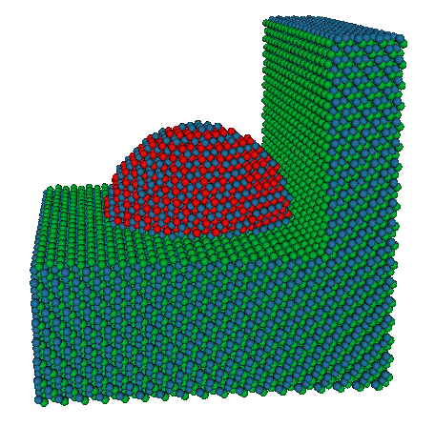
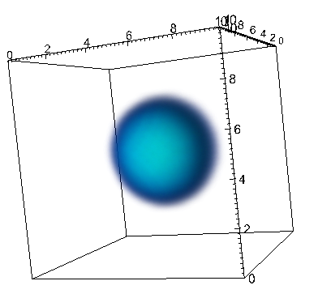
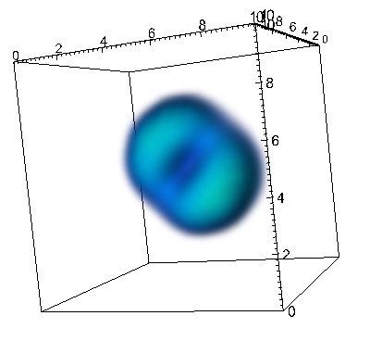
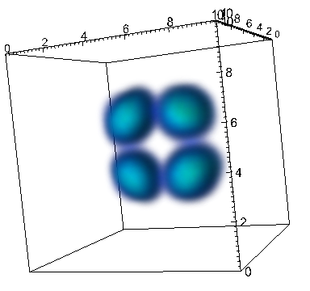

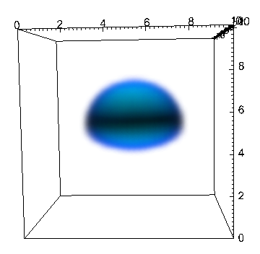
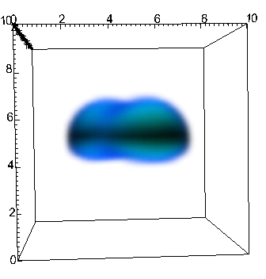

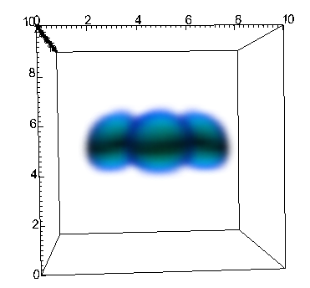
NEMO5: wave functions in quantum dots
NEMO5: InAs quantum dot embedded in GaAs
E=1.123eV 1.354eV 1.523eV 1.587eV
Ground State
1st Excited State
2nd Excited State
3rd Excited State
Tutorial 5 Quantum Dots in NEMO5
Learn how to use NEMO5 on quantum dots

Slide 36
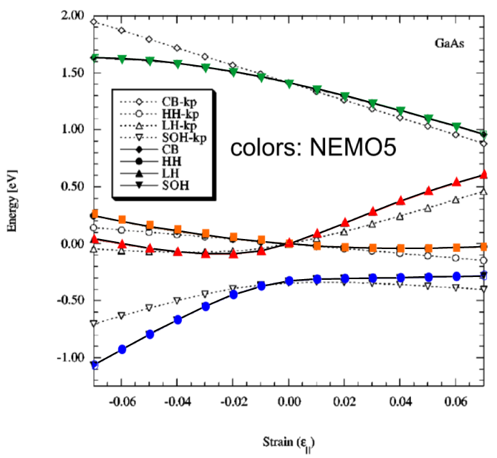

NEMO5: strain corrections to tight-binding
Biaxial strain
Hydrostatic strain
k.p
CB
CB
Colors: tight binding
LH
HH
Colors: tight binding
Tutorial 5C Quantum Dots in NEMO5
Learn how to calculate strain effects on electronic bandstructures
HH/LH
SOH
Lines: Literature
SOH
Symbols: NEMO5
External strain definable in input deck (via full epsilon matrix)
Strain in TB according to Boykin et al. 2002 implemented and tested
Strain in TB according to Boykin et al. 2010 implemented, and tested
Exact agreement with published data

Slide 37


NEMO5: 2 different charge models
Motivation:
Most semiconductor devices allow to distinguish electrons from holes
but
Broken-gap nanodevices and topological insulators have no band gap and do not allow to distinguish
Atomic Space charge in 6nm Bi₂Te₃ layer
Typical for atomic tight binding:
Charge density oscillations
NEMO5:
Charge self-consistent tight-binding Schrödinger/Poisson
Standard electron-hole model
Novel “electron-core” model:
All states are electronic
Every atom core contains intrinsic ion charge
(parameterization and material dependent)
Atomic Poisson potential in 6nm Bi₂Te₃ layer
Electron-core model:
Perfectly smooth correction to
bulk e-e interaction in TB parameters
Results of electron-core model:
Self-consistent Poisson potential = smooth correction to empirical TB Hamiltonian

Slide 38


NEMO5: Schrödinger-Poisson calculations
Electron-hole example of 1d_hetero nanohub tool
  semiclassical density
  quantum density, numerical k-space
  quantum density, analytical k-space (assuming a parabolic dispersion)
Tutorial 4A Topological Insulators
Learn how to use NEMO5 to perform Schroedinger-Poisson calculations

Slide 39

Topological insulators in NEMO5
Motivation:
Unique transport features of topological insulators (ballistic surface transport expected)
Question: surface conductance tunable?
NEMO5: Warping of the Fermi surface
Method :
Charge self-consistent tight-binding (sp3d5s*) Schrödinger/Poisson (electron-core model)
Spin analysis and scattering rates
Results:
Agreement with experiment:
warping of Fermi surface
spin polarized surface states
Dirac hyperbolas in thin Bi₂Te₃ layers
Experiment:
Science 325, 178 (2009)

Slide 40
Transport capabilities of NEMO5
Quantum transport models
Nonequilibrium Green’s function (NEGF) formalism
Open-boundary transfer matrix method (“wavefunction” formalism)
Top of the barrier transport model
Various physical models
Ohmic and Schottky contacts
Simple and fast phonon scattering model
Strain under test
Magnetic field under test
General simulation structures
1D, 2D, 3D structures
Heterostructures, arbitrary shapes, multiple contacts
4-level MPI parallelization
bias, energy, momentum, space
Quantum and semi-classical hybrid simulation

Slide 41

NEMO5: Transport in layered Structures
NEGF calculations:
time consuming
can be charge unstable
GaAs
AlGaAs
GaAs
AlGaAs
GaAs
1e18cm⁻³ 2e15cm⁻³ 1e18cm⁻³ doping
semiclassical
quantum region
semiclassical region
NEMO5: User may…
limit quantum region to relevant device regions
apply approximations to other device regions

Slide 42




NEMO5: Transport in Nonplanar Structures
Potential and density in ultra thin body
IV-characteristics of ultra thin body
Tutorial 6A Transport in NEMO5
Learn how to use NEMO5 to calculate IV characteristics
Potential and density in nanowires
SiO2
Si
SiO2
1e20cm⁻³ 1e20cm⁻³

Slide 43


NEMO5: Multidimensional graphs
2D Potential landscape
gate contact
Silicon n-type UTB
n = 10²⁰/cm³
V_{source} = 0 V (Schottky)
V_{drain} = 0 V (Ohmic)
V_{gate} = 0.5 V (Gate)
Charge self-consistent simulation with phonon scattering
Ohmic contact
Schottky contact
1D plot line
Position (nm)
Position (nm)
electron density (cm⁻³)
Devices with different types of contacts
3D, 2D, and 1D output along a line

Slide 44

NEMO5: tunneling field effect transistor
NEMO5:
Transport in band-to-band tunneling devices
Geometry affects the device performance
Gate
drain extension
X
Y
undercut
Energy and spatially resolved current
Tutorial 6B Band to band tunneling in NEMO5
Learn how to use NEMO5 to calculate interband tunneling
Vg=-0.5V
Vg=-0.5V
Tunneling between valence and conduction band tunable via gate geometry

Slide 45
NEMO5: features for transport
Electron models: effective mass, 1st and 2nd NN tight binding
Inhomogeneous, self adaptive energy grid
Simplified inelastic scattering on phonons
Under testing:
Transport in strained systems
Nonlocal inelastic scattering
LRA method (efficiency improvement)
Under development/implementation:
Spatial parallelization perpendicular to transport
Phonon transport

Slide 46
NEMO5 lecture – overview
NEMO5 origins + history
NEMO5 and atomic representations
NEMO5 solvers + physics
NEMO5 expandability + flexibility
NEMO5 on supercomputers (scalability and compatibility)
NEMO5 support (for output and users)

Slide 47
NEMO5 – an expandable code library
“What if I want to implement my own model?”
NEMO5 supports & welcomes that!
Object oriented C++ code:
  Encapsulation
  Write code without interfering with the rest of NEMO5
  Polymorphism & Abstraction
  Most NEMO5 code is flexible and handles also new models
  Avoid rewriting code “just” because of a new model/crystal structure
  Inheritance
  NEMO5 code is written efficiently avoiding “copy&paste”
Zhengping Jiang (Graduate student of Klimeck group):
“Learning NEMO5, implementing and testing a new Hamiltonian took me 2 weeks.
After that, it worked with all NEMO5 features.”

Slide 48


NEMO5: Automated documentation with Doxygen
Browsing large source code can be cumbersome (even with Visual Studio or Eclipse)
NEMO5:
NEMO5 code is compatible with Doxygen
Doxygen documentation requires only a web browser (NEMO/prototype/doc/html/index.html)
Snapshot of Doxygen’s “Graphical Class Hierarchy” of NEMO5

Slide 49

NEMO5: easy prototyping new code in Python
NEMO5?!
“What if I want to quickly test a new idea?”
Prototype in Python:
Python is linked to NEMO5
usage with “nemo python_file.py”
(python_file.py needs to be compatible)
The linked Python version supports NumPy and SciPy
NEMO5 can load Python scripts and Python solvers
Write python code and embed NEMO5 routines within your Python script
(similar to matlab toolbox)

Slide 50

NEMO5 & Python: Python solver
NEMO5 solvers have a common API (to set up, to solve, to communicate, …)
Your own new solvers have to stick to this API
C++ Solver | Python Solver
void MyNewSolver::do_solve() | def do_solve( self ):
void MyNewSolver::do_init(){} | def do_init ( self ):
void MyNewSolver::do_reinit(){} | def do_reinit ( self ):
void Simulation::do_output(){} | def do_output ( self ):
void MyNewSolver::get_data( string v, type& ) get_data(vector<complex<double> >) | def get_data_type( v ) get_data_list_complex()
void MyNewSolver::get_data(string v, type1, type2&, . ) get_data(unsigned int, vector<double>, .) | def get_type1_data_type2_.( v) get_uint_data_list_double ( v )

Slide 51


NEMO5 & Python: Metasolver
Standard NEMO5 situation:
Several solvers are defined
Some options are task specific
(obsolete for specific tasks)
Some option names are “developer style”
Long and complex inputdeck
Solution: Metasolver
Store frequently used solver settings in “external” python file
NEMO5 inputdeck: only relevant options are visible
Option names are convertible
Short inputdeck (1 Solver only)
Tutorial 4D Python & NEMO5
Learn how to prototype in Python and use NEMO5 with it

Slide 52
NEMO5 lecture – overview
NEMO5 origins + history
NEMO5 and atomic representations
NEMO5 solvers + physics
NEMO5 expandability + flexibility
NEMO5 on supercomputers (scalability and compatibility)
NEMO5 support (for output and users)

Slide 53

NEMO5: MPI parallelization
Device calculations are typically very time consuming:
10x10x10 nm Si gives ~ 64k atoms ~ 1.3 million degrees of freedom
Many matrix operations scale like N² – N³
NEMO5 is MPI parallelized:
k-space and x-space parallelization
for Schrödinger-Poisson
x-space parallelization for Strain
V, k, E and slab parallelization
for NEGF-Poisson and WF-Poisson
CPU15
CPU16
CPU 7
CPU 8
CPU 5
CPU 6
CPU 3
CPU 4
CPU 1
CPU 2

Slide 54


within NEMO5: Linear Solvers and Eigensolvers
Linear and Newton solvers: PETSc
  lots of parallel direct & iterative solvers
  interface to LAPACK, MUMPS, SuperLU, HYPRE
Eigensolvers: SLEPc
  Uses PETSc for linear solvers, parallelism
  interface to PARPACK
  (problem in RCAC installation)

Slide 55

NEMO5: MPI scalability
MPI status in NEMO5
Massively parallel numerical solvers implemented
  Externally developed libraries SLEPc, PETSc and Libmesh
Scaling reached up to 100k CPUs
Efficient parallel writing of data to disk implemented in NEMO5
Fast initialization for NEMO5 on up to 100k CPUs
NEMO5:
Very good scaling shown up to 100k CPUs

Slide 56
NEMO5: platform compatibility
Architectures where NEMO5 can be compiled and run:
RCAC machines coates, steele, rossmann, hansen, … (GCC & Intel)
Ubuntu (GCC)
nanoHUB.org workspace (Intel)
jaguar.ccs.ornl.gov (GCC)
ranger.tacc.utexas.edu (GCC)
kraken.ccs.ornl.gov (GCC)
Your Linux system…

Slide 57
NEMO5 lecture – overview
NEMO5 origins + history
NEMO5 and atomic representations
NEMO5 solvers + physics
NEMO5 expandability + flexibility
NEMO5 on supercomputers (scalability and compatibility)
NEMO5 support (for output and users)

Slide 58




Input and Output
Different purposes and visualization software require different output format
NEMO5 supported formats:
  VTK
  DX
  (simple-cubic)
  XYZ
  PDB (zincblende struct. only)
  Text files (eigenvalues, 1D graphs)
VisIt or ParaView
NanoViz
jmol

Slide 59





NEMO5: on nanoHUB
Specific purposes typically require a small set of options
Full flexibility of NEMO5 burdens the fast user
nanoHUB.org offers GUI controlled tools powered by NEMO5:
Quantum Dot Lab
1d Heterostructure Design Tool
Crystal Viewer
RTD Simulation with NEGF
Brillouin Zone Viewer

Slide 60

Global Impact of NEMO Software Stack
35 Klimeck tools:
22,000 users
>820,000 simulations
Systemic Education:
>5,700 students, 461 courses
>60 universities
8 NEMO/OMEN based codes Impact:
Last 12 months:
  3,645 Users
  47,295 Simulation Runs
Overall:
  10,837 Users
  166,793 Simulation Runs
Notes:
60

Slide 61

NEMO5: support and discussion forum
NEMO5 distribution and support group on nanohub
Post questions and look for answers in the NEMO5 discussion forum
Any feedback/suggestions are very welcome
You can contribute to the code, too

Slide 62
Schedule for the NEMO5 tutorial
Device Modeling with NEMO5
10:00 Break
10:30 Lecture 14 (NEMO5 Team): “NEMO5 Introduction”
12:00 LUNCH
1:30 Tutorial 1 (NEMO5 Team): “NEMO5 Technical Overview”
3:00 Break
3:30 Tutorial 2 (NEMO5 Team): “NEMO5 Input and Visualization”
4:30 Tutorial 3 first part (NEMO5 Team): “Models”
5:00 Adjourn

Slide 63
Schedule for the NEMO5 tutorial
Friday, July 20
8:00 Coffee and rolls
8:30 Tutorial 3 second part (NEMO5 Team): “NEMO5 Models”
9:00 Tutorial 4 first part (NEMO5 Team): “Device Simulation – Graphene”
10:00 Break
10:30 Tutorial 4 second part (NEMO5 Team): “Device Simulation – Graphene”
12:00 LUNCH
1:30 Tutorial 5 (NEMO5 Team): “Device Simulation – Quantum Dots”
3:00 Break
3:30 Tutorial 6 (NEMO5 Team) : “Device Simulation – Transistor”
5:00 2012 Summer School Adjourns
4A Topological Insulators
4B Metals
4C Graphene
4D Python+NEMO5
5A Quantum Dots Introduction
5B Strain
5C Quantum Dots
6A Transport (DG MOSFETs)
6B Transport (BTBT)
This time schedule is flexible adjusting to your needs and interests

Slide 64

Conclusion
NEMO5:
Multipurpose, multiscale highly parallelized nanodevice simulation tool
Compatible with many external software (both for output and input)
Can be used as a tool or as a library
NEMO5 is under constant development
Your feedback is very valuable to us!
Thank you!
Sponsors:
SRC, GRC, NSF, DARPA, NRI, nanohub.org,
Intel, Samsung, Global foundries, IBM, Lockheed Martin

