Slide 1


Interactive Engineering Outreach with the NanoBIO Nisin Diffusion Model
Asha Kirchhoff
Department of Bioengineering
Biomedical Engineering Society
NanoBIO Node Project
July 1, 2013

Slide 2
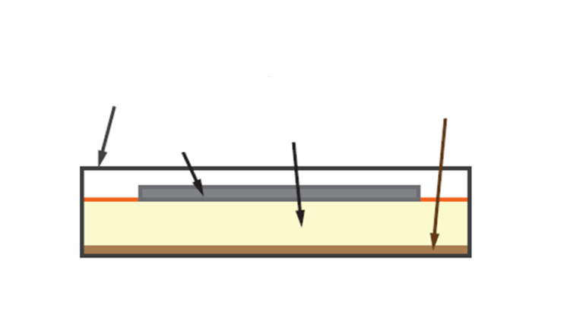
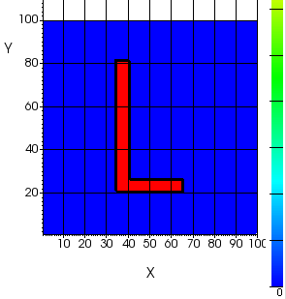
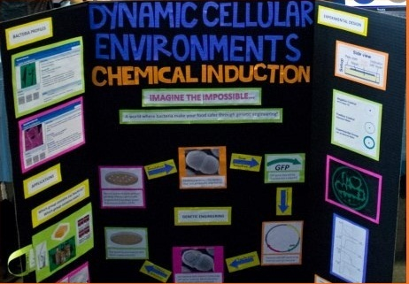

Nisin experimental design
Nisin diffusion tool
Engineering Open House
student outreach
Notes:
Outline of talk

Slide 3
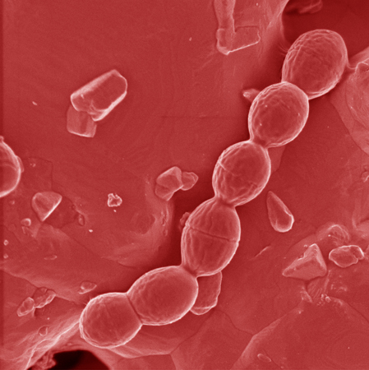
Genetically engineered lac bacteria produce nisin in a positive feedback loop
1 µm, 18000X
Notes:
Outline of talk

Slide 4
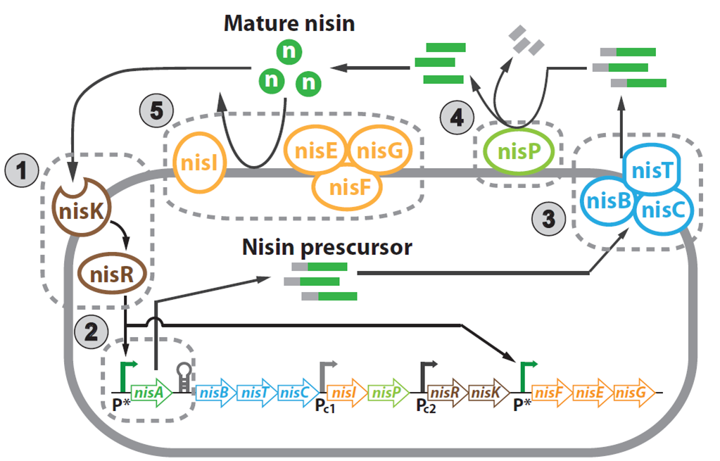
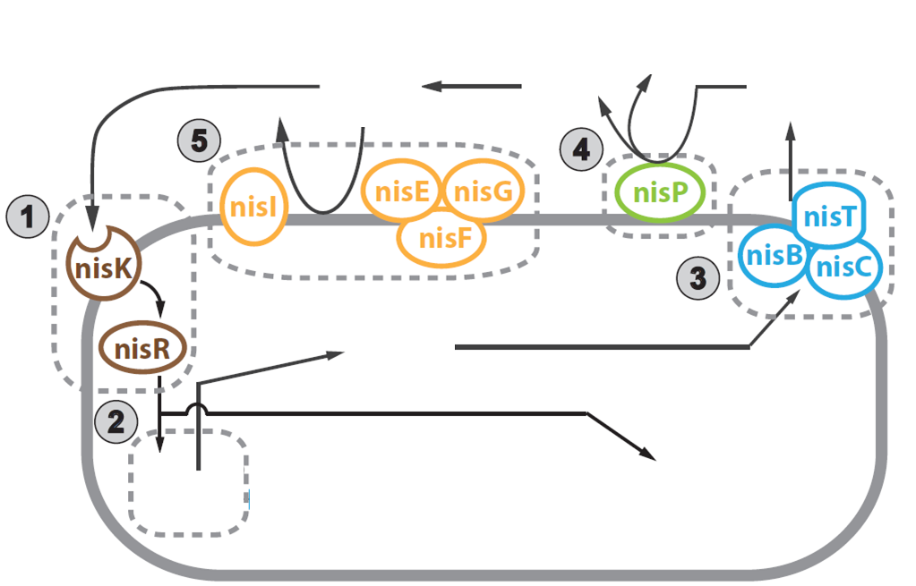
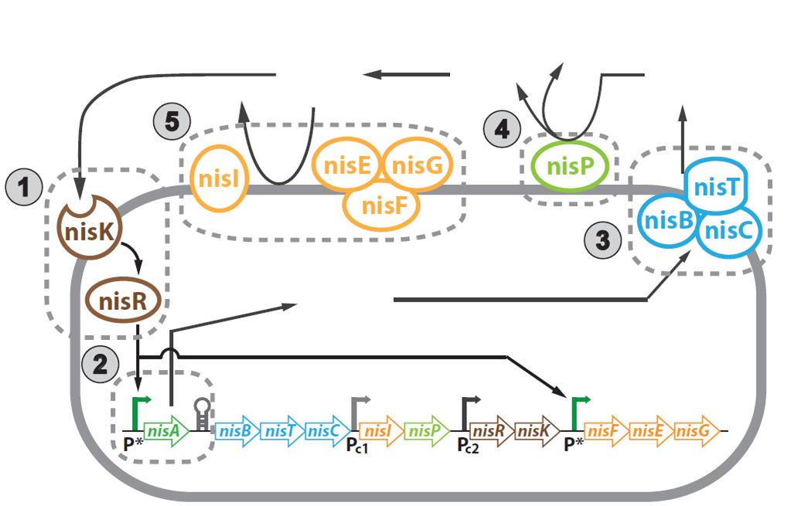
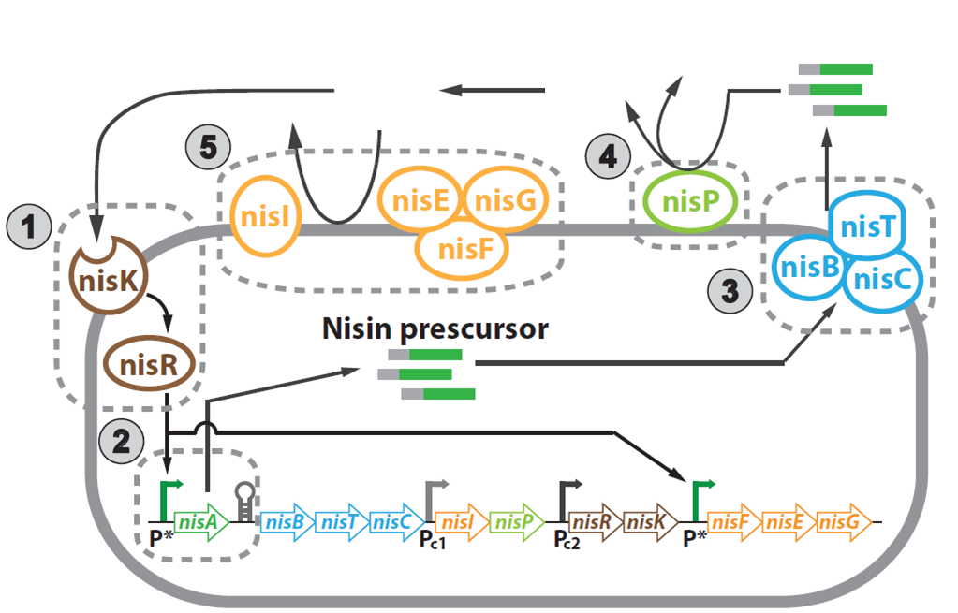
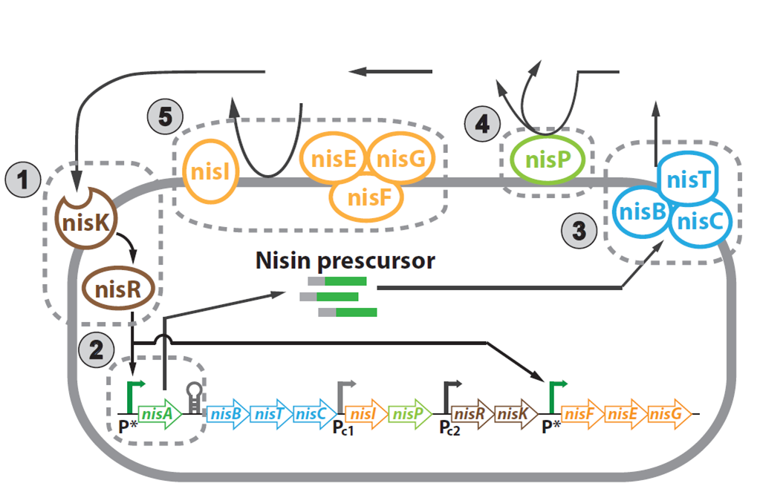
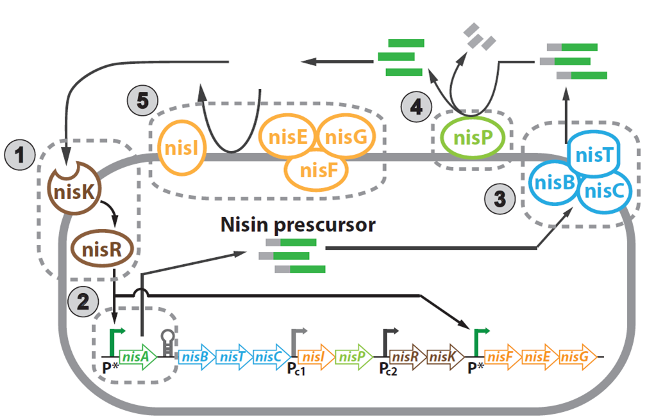
Genetically engineered lac bacteria produce nisin in a positive feedback loop
Notes:
Outline of talk

Slide 5
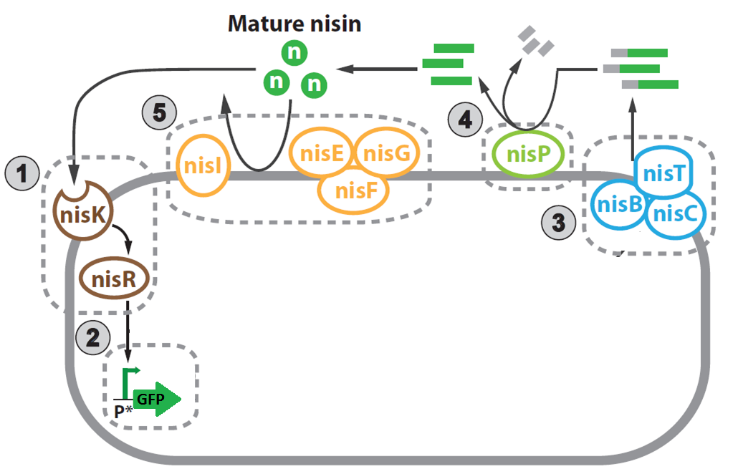
Nisin feedback induces GFP expression in the lac bacteria
~ 1 µm
~10 nm
Notes:
Outline of talk

Slide 6

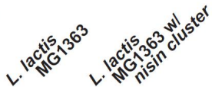
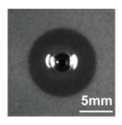
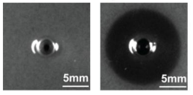
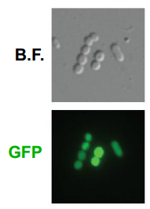
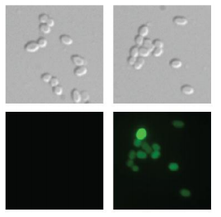
The nisin and GFP pathways result in 2 different functional properties
Antibacterial
Signaling
Notes:
Outline of talk

Slide 7
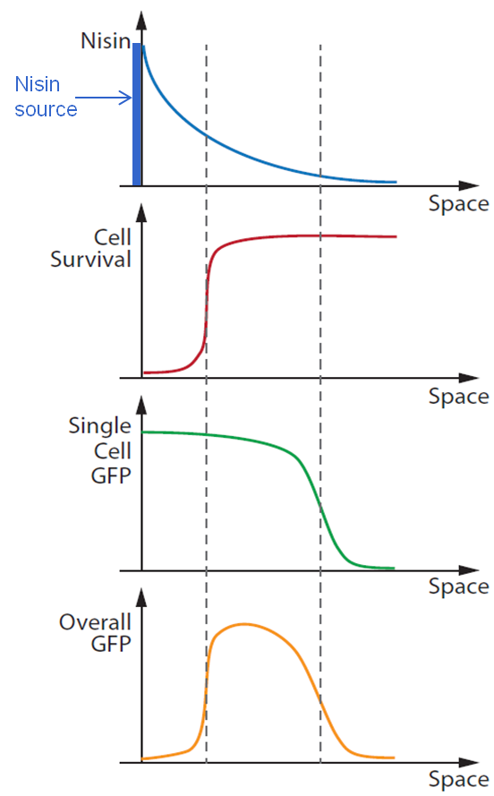
The antibacterial
and signaling properties
combine to create a natural bandpass filter for GFP expression
Notes:
Outline of talk

Slide 8
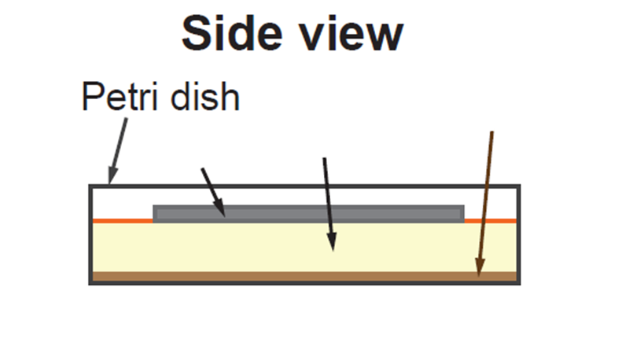
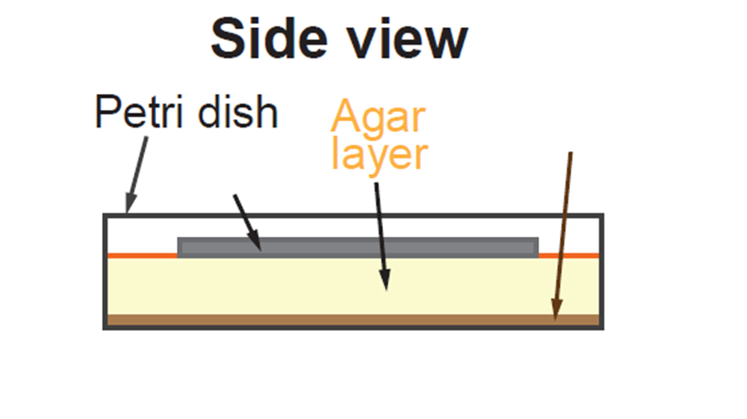
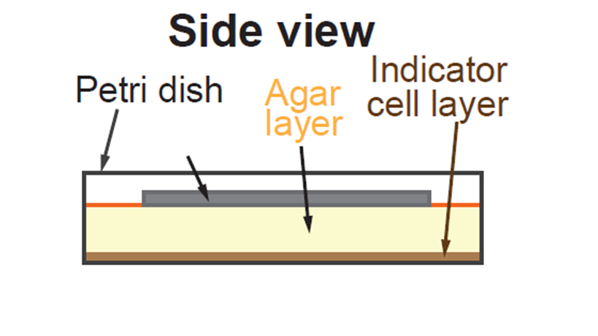
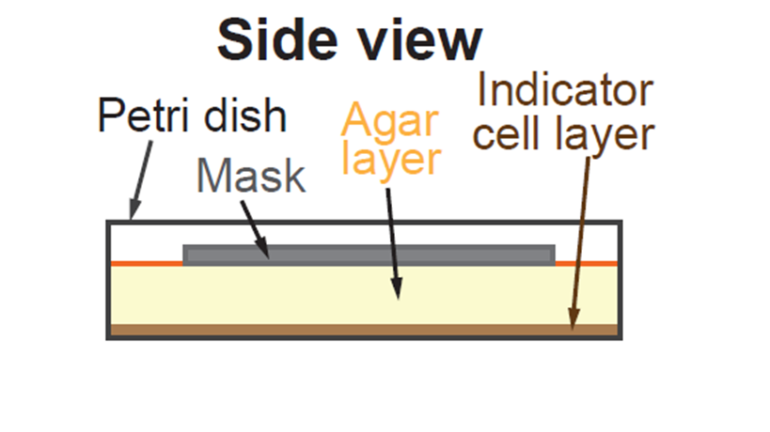
The bandpass behavior is utilized in spatial patterning with the bacteria
Notes:
The Nisin experiment is a simple set-up. Nisin is a toxin that kills bacteria. However, there is a genetically engineering lac bacteria that is nisin-sensitive. High levels of nisin will still kill the bacteria, but moderate to low levels of nisin induce fluorescence in the bacteria. Here you see 2 examples of the experimental set-up. The shapes are made by pieces of filter paper soaked in a nisin solution, serving as a chemical mask. From this mask the nisin will diffuse into the agar, eventually coming into contact with the nisin-sensitive cells to induce GFP production. ADD DETAILS ON WHY THE CELLS WOULD PRODUCE GFP ONLY IN A MODERATE CONCENTRATION OF NISIN, REVIEWERS ARE LOOKING FOR MULTISCALE SO INCLUDE CELL SIZE AND SCALE. DIFFERENTIAL EQUATIONS FOR MODEL ARE VERY GOOD.

Slide 9

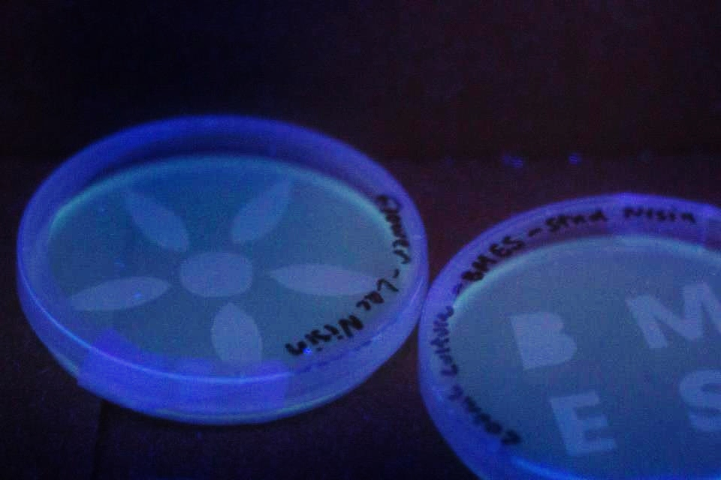
Diffusion of nisin through agar leads to expression of GFP by nisin-sensitive cells
Notes:
Outline of talk

Slide 10
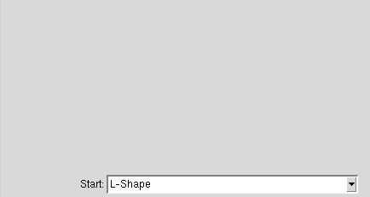
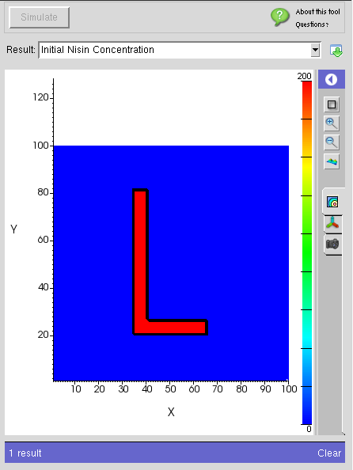
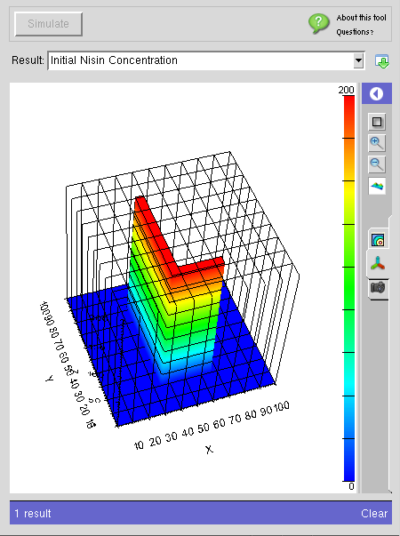
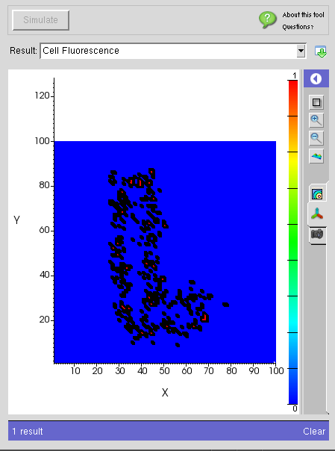
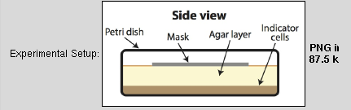
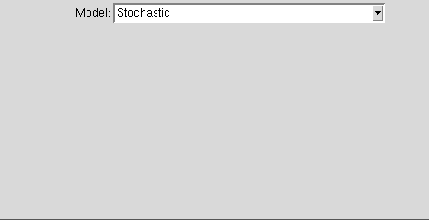
Notes:
This is the nisin-diffusion tool available on Nanohub.org. The visual output of the model is very clear and informative, making it an ideal tool for engineering education and outreach. ADD MATHEMATICAL DETAILS ABOUT NISIN MODEL.

Slide 11

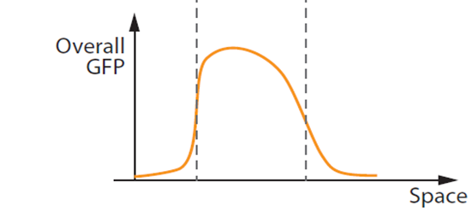
The model of nisin diffusion is governed by a 3 dimensional diffusion equation
N = nisin concentration
D = diffusion constant
ɣ = rate of nisin degradation
Deterministic
Stochastic
Cell Response
Notes:
Outline of talk

Slide 12


The model of bacteria fluorescence illuminates
the multi-scale nature of this experiment
~ 3 mm
~ 1 µm
Notes:
Outline of talk

Slide 13
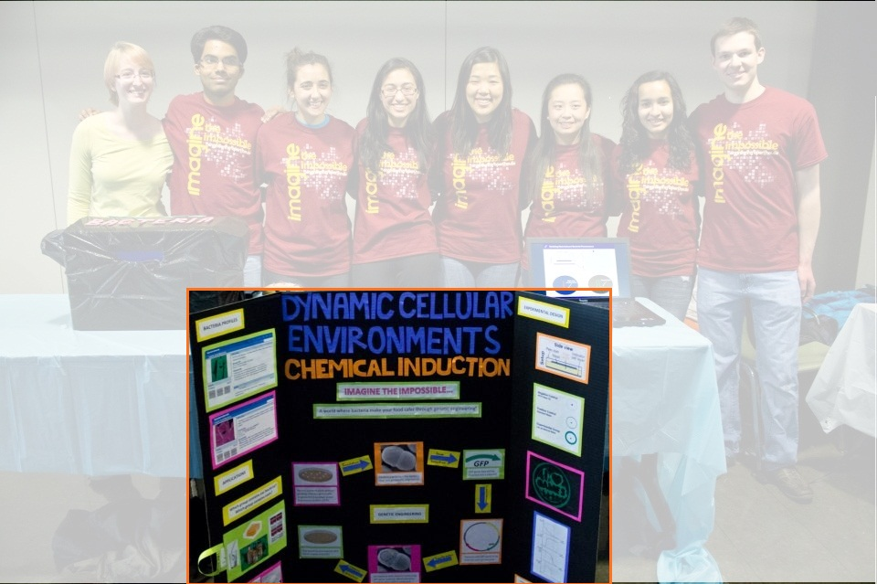
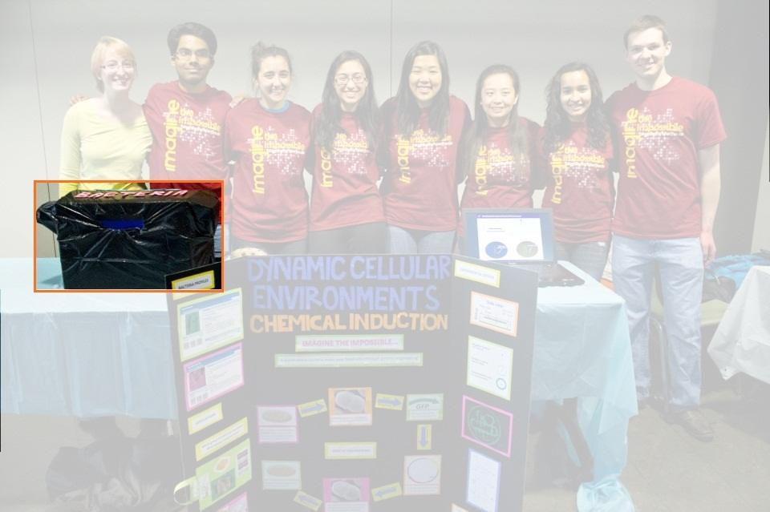
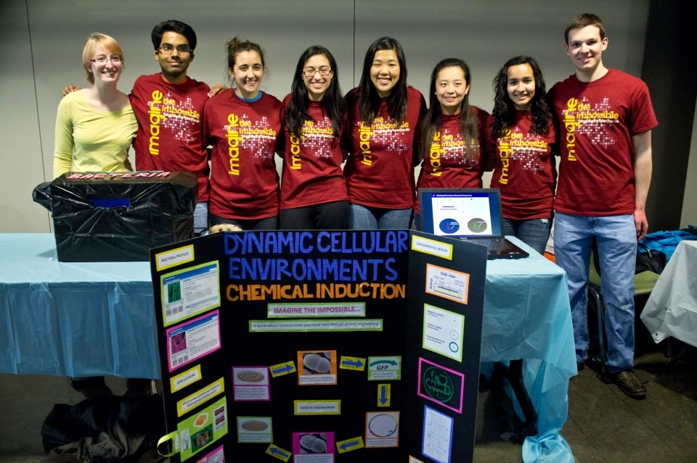
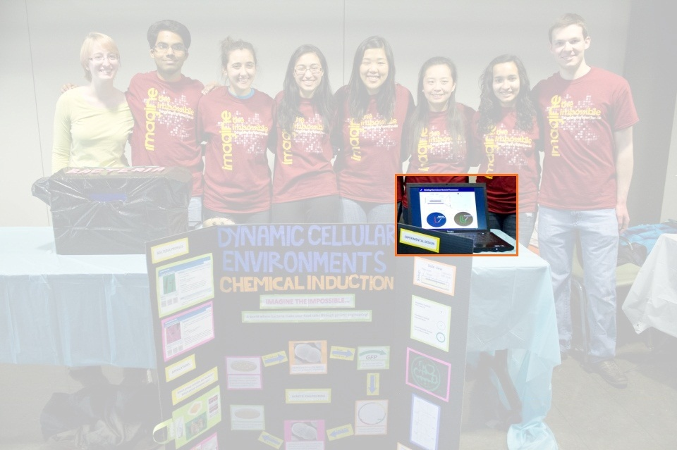

The Nisin diffusion tool and experiment were used as an engineering outreach exhibit by UIUC BMES
Notes:
The Nisin diffusion tool was used in an engineering outreach exhibit by the biomedical engineering society here at the U of I. The exhibit was part of the Engineering Open House event – a 2 day event held in March during which thousands of science lovers converge on the engineering campus. This is a picture of the exhibit, and by our unofficial count at least 300 people visited our station. They saw an explanation of the biology behind genetic engineering and nisin-sensitivity, viewed the GFP expressing lac-bacteria, and finally viewed the nisin diffusion model.

Slide 14
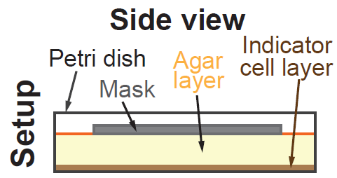

Modeling Nisin-Induced Bacterial Fluorescence
Diffusion
Top View – Initial Setup
Indicator Layer
Notes:
This slide is exactly what visitors to the EOH nisin exhibit saw. All ages found the video easy to understand, and for many it clarified the experimental set-up. It also exposed many students and adults to the interdisciplinary nature of bioengineering – combining cell culture and programming into a cohesive and impactful project.

Slide 15
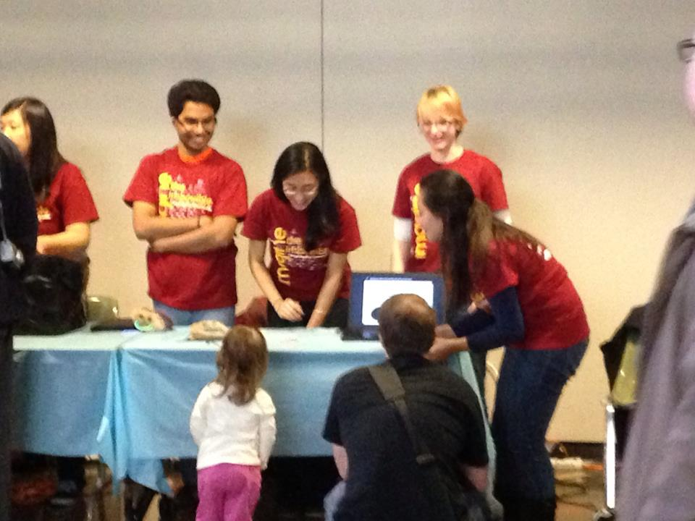
The Nisin diffusion tool was effective in engaging audience interest and demonstrating active diffusion

Slide 16


Acknowledgements
Dr. Ting Lu
Bioengineering
Andrew Blanchard
Graduate Student
Lu Lab

