Slide 1
Online simulations via nanoHUB: Binding curves for H₂ molecule
In this tutorial:
Density functional theory of atomic bonding
Characterize binding energy and bond distance
Discuss results in terms of electronic structure
Nicolas Onofrio and Ale Strachan
strachan@purdue.edu
School of Materials Engineering & Birck Nanotechnology Center
Purdue University
West Lafayette, Indiana USA

Slide 2
STEP 1: launch the ORCAtool
From your My dashboard page launch ORCAtool
From All Tools find:
orca
Launch tool by clicking on:
OR open the tool’s main page and launch the tool by clicking on:

Slide 3
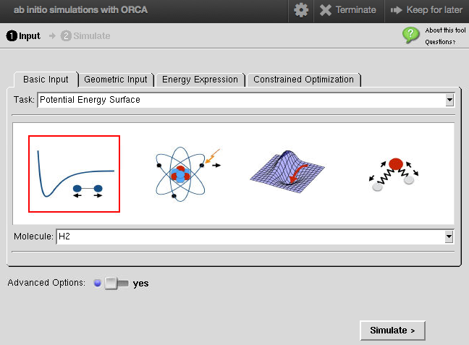
STEP 2: setup the basic input
Start from the pre-built H2 molecule
We will select a potential energy surface with the H2 molecule pre-build case and modify it
Turn ON the advanced Options in order to have access to the simulation details

Slide 4
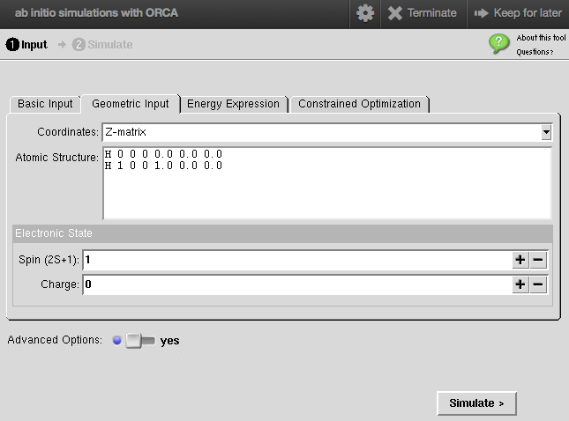
STEP 3: setup the geometry and spin state
From the Geometric Input tab
We keep the default Z-matrix coordinates
with H2 spin 0 (singlet)
Total spin S = 0, 2*S+1=1
For details about Z-matrix,
see appendix A of ORCAtool-LearningModule

Slide 5
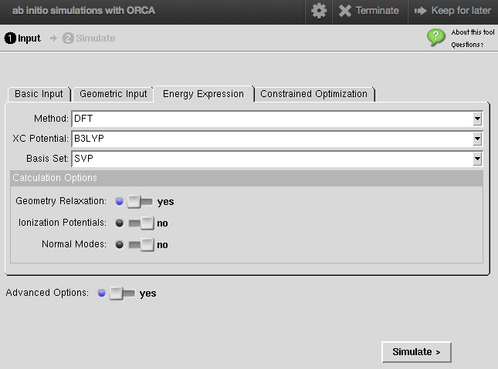
STEP 4: setup the simulation details and run!
From the Energy Expression tab
Select density functional theory method (DFT) with the exchange correlation potential B3LYP and the basis set SVP

Slide 6
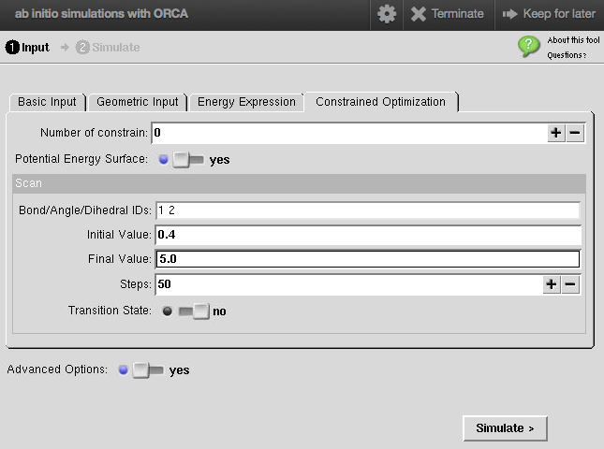
STEP 5: potential energy surface and run!
From the Constrained Optimization tab
We will perform a potential energy surface for the dissociation of H2 starting at 0.4 A to 5.0 A in 50 steps
Click simulate
And wait for the results (few minutes)

Slide 7
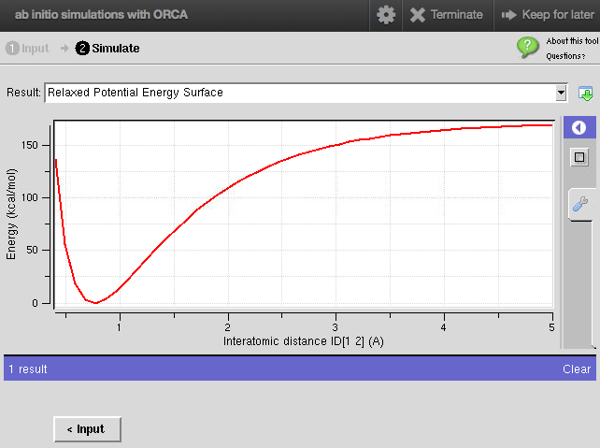
STEP 6: Simulation result
The Relaxed Potential Energy Surface shows the Energy as a function of the bond distance
The equilibrium distance for H2
The bond energy of H2

Slide 8
STEP 7: Assignments
i) Compare the bond energy you found with the experimental value for H2
ii) Reproduce the previous steps with different energy expressions: HF, MP2 and CASSCF (keeping additional parameters as default) and compare all the bonding curves
iii) Which method gives the most accurate bond energy? How about the equilibrium distance?
iv) Besides bond energy and length, what else could you extract from the calculations? Think about the curvature of the binding curve around the minimum energy.
v) The bonding curves are asymmetric around equilibrium, stiffer in compression and softer in tension. What well-known, macroscopic, phenomenon originates from this asymmetry?

Slide 9
Disclaimer
While very powerful, DFT makes well known approximations and the results in this tutorial highlight the limitations
You can easily obtain the energy of the H2 molecule when the bond distance is very large (two isolated hydrogen atoms) and verify that the DFT prediction is not accurate. The energy when the bond is formed is more accurately described
You can learn more about electronic correlation in Section 7 of ORCAtool-LearningModule

