Slide 1
acetamenophen

Slide 2
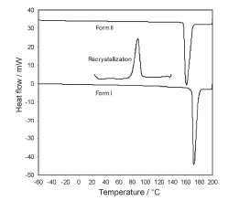
Polymorph--DSC

Slide 3
Preparation of Form II

Slide 4
DSC calibration curve

Slide 5
method
100, 80, 60, 40, 20,

Slide 7
Quenched amorphous

Slide 8
Melt and cooled down to room temperature in DSC---Form II

Slide 9
Cryomilled 30 min

Slide 10
enlarged

