Slide 1
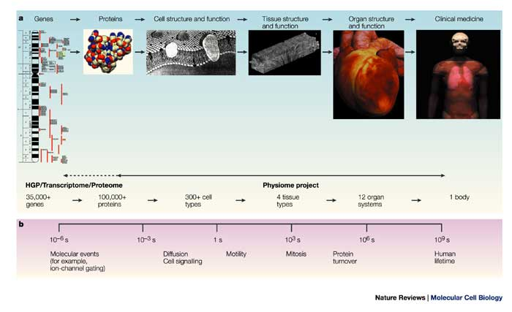
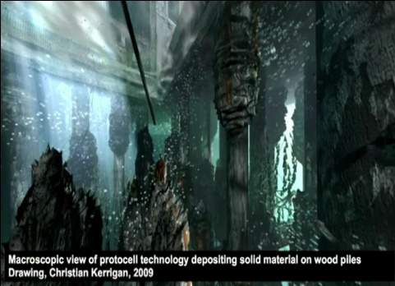
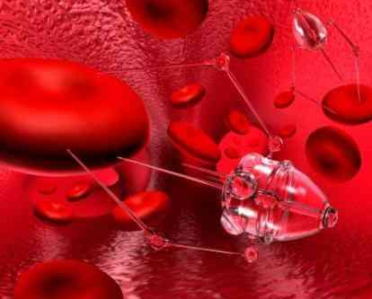
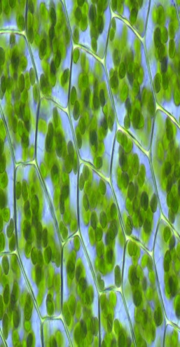
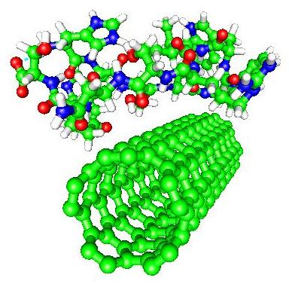
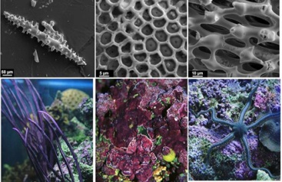
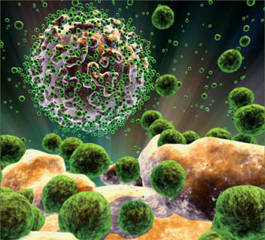
Nano-enabled Biological Tissues
http://www.afs.enea.it/
project/cmast/group3.
php
http://laegroup.ccmr.cornell.edu/
COURTESY: Nature Reviews Molecular
Cell Biology, 4, 237-243 (2003).
COURTESY: http://library.thinkquest.org/
05aug/00736/nanomedicine.htm
Your funding
agency logo
here
Your funding
agency logo
here
By Bradly Alicea
http://www.msu.edu/~aliceabr/
Presented to PHY 913 (Nanotechnology and Nanosystems, Michigan State University). October, 2010.

Slide 2
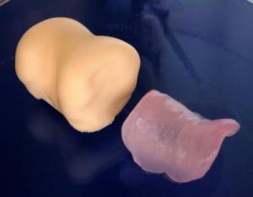
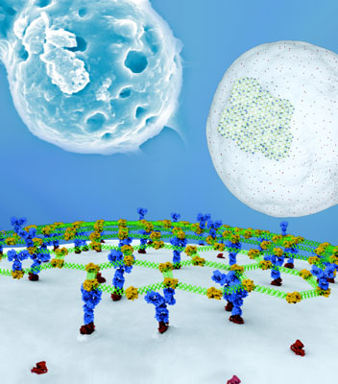
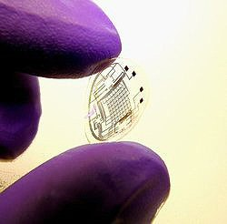
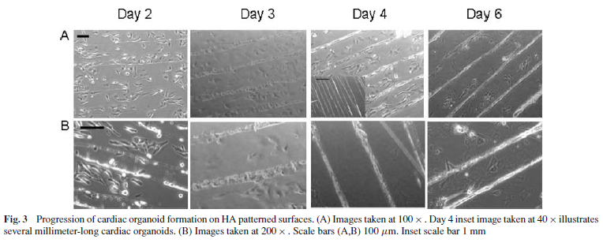
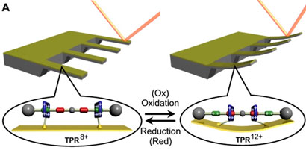
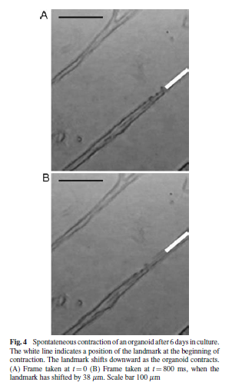
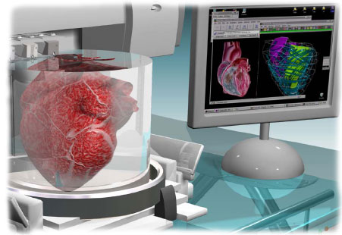
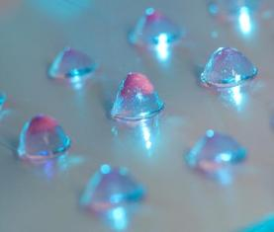
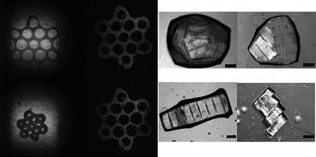
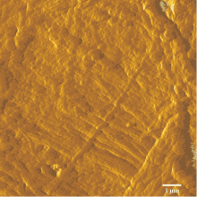
Nanoscale Technology Enables Complexity at Larger Scales…….
Formation (above) and function
(below) of contractile organoids.
Biomedical Microdevices, 9, 149–
157 (2007).
Self-assembled
cartilage
Nano-scale biofunctional surfaces
(cell membrane) http://www.nanowerk.
com/spotlight/spotid=12717.php
Flexible electronics
embedded in contact lens
DNA/protein sensor, example
of BioNEMS device (left).
“Bioprinting” to
construct a heart
(left).
Cells cultured in matrigel clusters
Guided cell aggregation. COURTESY: “Modular tissue engineering: engineering biological tissues from the
bottom up”. Soft Matter, 5, 1312 (2009).
Self-organized
collagen fibrils

Slide 3
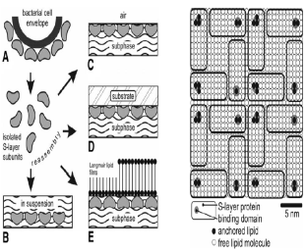
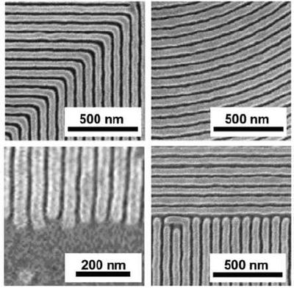
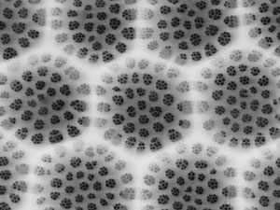
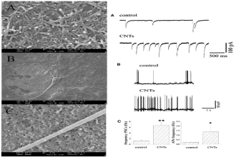
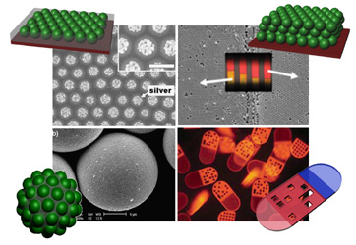
Role of Scale (Size AND Organization)
Single molecule monitoring
and bio-functionalization
Cell colonies and
biomaterial clusters
Self-assembled and
bioprinted organs
NanoBiotechnology, DOI: 10.1385/Nano:1:
2:153 (2005).
~ 1 nm
10-100 nm
1-100 μm
1-100 mm
1-100 cm
+ 1m
Nanopatterning and biofunctionalized surfaces
Embedded and hybrid bionic devices
NanoLetters, 5(6),
1107-1110 (2005)
Soft Matter, 6,
1092-1110 (2010)

Slide 4
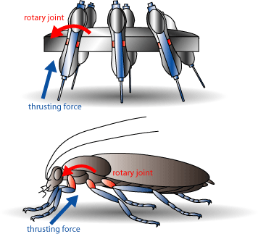
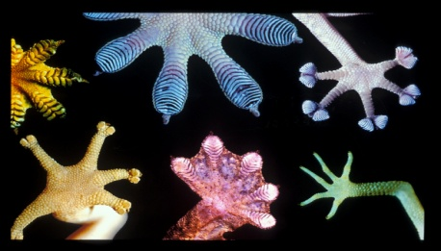
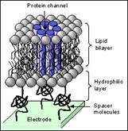
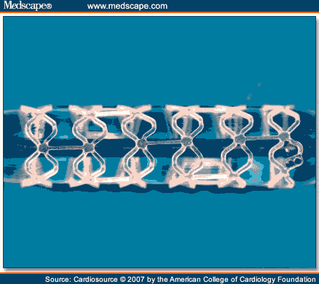
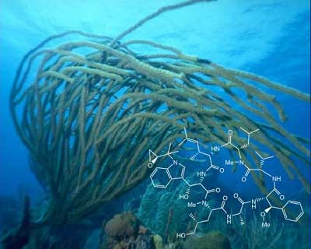
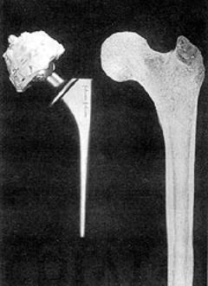
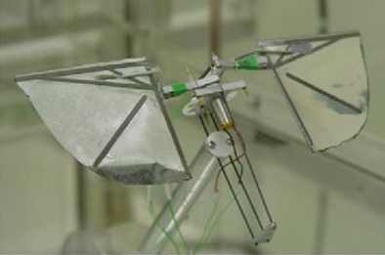
Ingredient I, Biomimetics/ Biocompatibility
Biomimetics: engineering design that mimics natural systems.
Nature has evolved things better
than humans can design them.
* can use biological materials (silks)
or structures (synapses).
Biocompatibility: materials that do not interfere with biological function.
* compliant materials used to
replace skin, connective tissues.
* non-toxic polymers used to
prevent inflammatory response
in implants.
Polylactic Acid
Coating
Cyclomarin
Source
Hydroxyapatite
(Collagen)
Parylene
(Smart Skin)

Slide 5
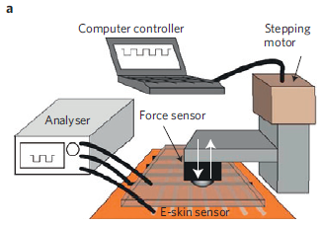
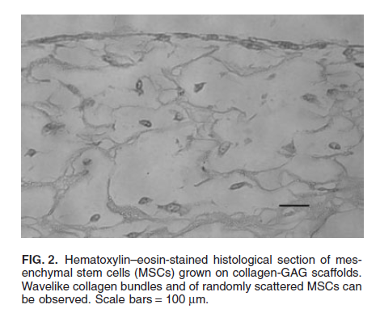
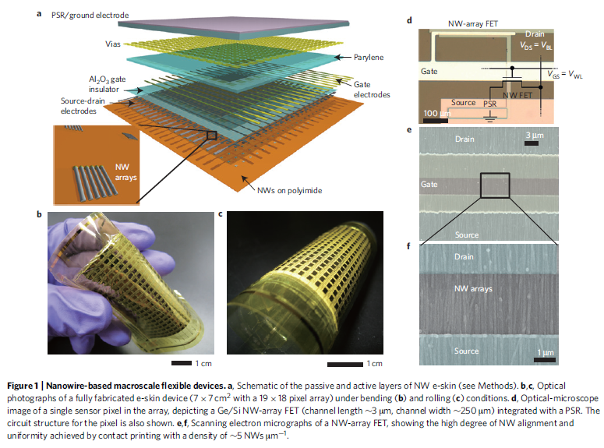
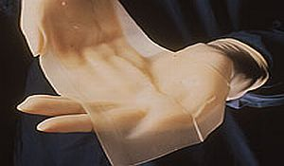
Artificial Skin, Two Approaches
Approximating cellular function:
Approximating electrophysiology:
“Tissue-Engineered Skin Containing Mesenchymal Stem Cells Improves Burn Wounds”. Artificial Organs, 2008.
“Nanowire active-matrix circuitry for low- voltage macroscale artificial skin”. Nature Materials, 2010.
Stem cells better than synthetic polymers (latter does not allow for vascularization).
* stem cells need cues to differentiate.
* ECM matrix, “niche” important.
* biomechanical structure hard to approximate.
Skin has important biomechanical, sensory functions (pain, touch, etc).
* approximated using electronics (nanoscale sensors embedded in a complex geometry).
* applied force, should generate electrophysiological-like signal.

Slide 6
Artificial Skin – Response Characteristics
Results for stimulation of electronic skin:
Output signal from electronic skin, representation is close to pressure stimulus.
* only produces one class of sensory information (pressure, mechanical).
Q: does artificial skin replicate neural coding?
* patterned responses over time (rate-coding) may be possible.
* need local spatial information (specific to an area a few sensors wide).
* need for intelligent systems control theory at micro-, nano-scale.

Slide 7
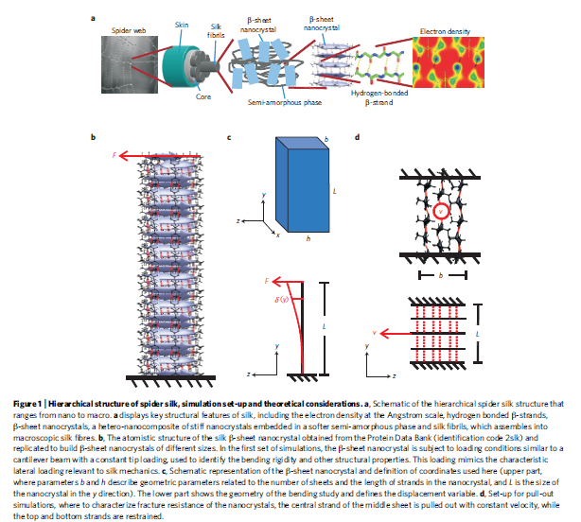
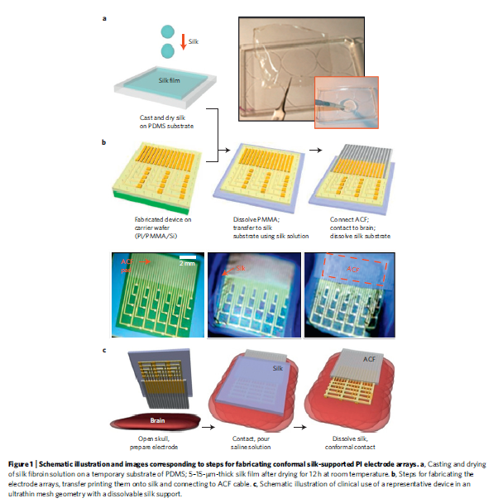
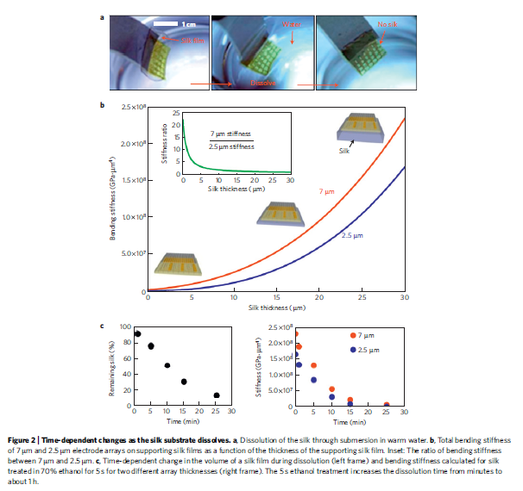
Silk as Substrate, Two Approaches
Nanoconfinement (Buehler group, MIT):
* confine material to a layer ~ 1nm thick (e.g. silk, water).
* confinement can change material, electromechanical properties.
Nanoconfinement
M. Buehler, Nature Materials, 9, 359 (2010)
Bio-integrated electronics (Rogers group, UIUC):
Silk used as durable, biocompatible substrate for implants, decays in vivo:
* spider web ~ steel (Young’s modulus).
* in neural implants, bare Si on tissue causes inflammation, tissue damage, electrical interference.
* a silk outer layer can act as an insulator (electrical and biological).
Bio-integrated Electronics. J. Rogers,
Nature Materials, 9, 511 (2010)

Slide 8
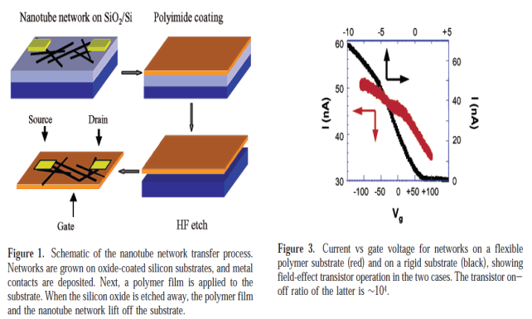
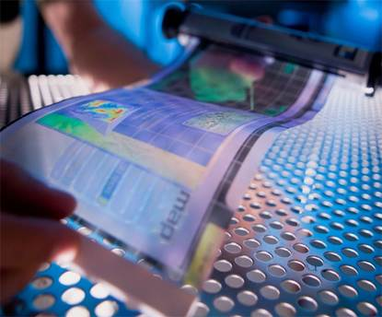
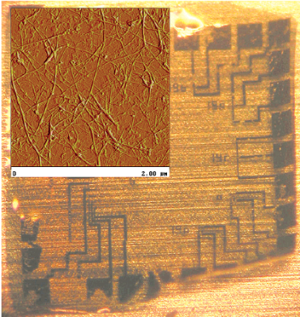
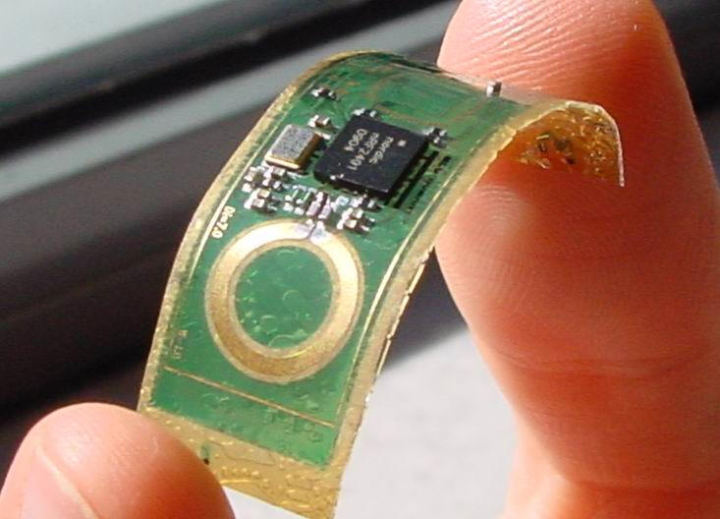
Ingredient II, Flexible Electronics
Q: how do we incorporate the need for compliance in a device that requires electrical functionality?
* tissues need to bend, absorb externally-applied loads, conform to complex geometries, dissipate energy.
A: Flexible electronics (flexible polymer as a substrate).
Flexible e-reader
Nano version (Nano Letters, 3(10), 1353-1355 - 2003):
* transistors fabricated from sparse networks of nanotubes, randomly oriented.
* transfer from Si substrate to flexible polymeric substrate.
Nano Letters, 3(10), 1353-1355 (2003)
Flexible circuit board
Sparse network
of NTs.

Slide 9
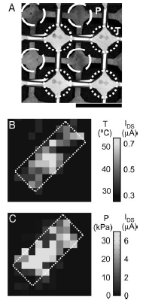
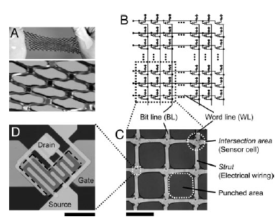
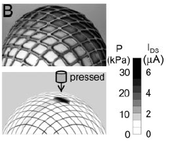
E-skin for Applications
Organic field effect transistors (OFETs):
* use polymers with semiconducting properties.
Thin-film Transistors (TFTs):
* semiconducting, dielectric layers and contacts on non-Si substrate
(e.g. LCD technology).
* in flexible electronics, substrate is a compliant material (skeleton for electronic array).
Embedded array
of pressure and
thermal sensors
PNAS, 102(35), 12321–
12325 (2005).
Conformal network of pressure sensors
Create a bendable array of pressure, thermal sensors.
Integrate them into a single device (B, C – on right).
PNAS, 102(35), 12321–
12325 (2005).

Slide 10
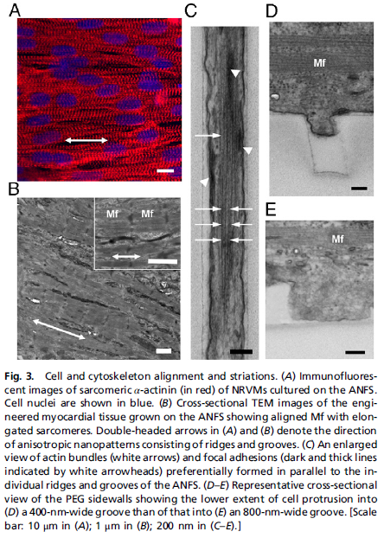
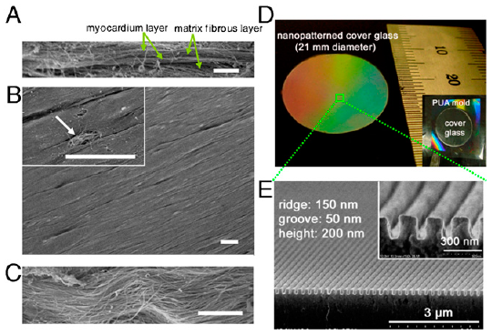
Ingredient III, Nanopatterning
Q: how do we get cells in culture to form complex geometries?
Alignment and protrusions w.r.t
nanoscale substrate
We can use nanopatterning as a substrate for cell monolayer formation.
* cells use focal adhesions, lamellapodia to move across surfaces.
* migration, mechanical forces an important factor in self-
organization, self-maintenance.
Gratings at
nanoscale dimensions
PNAS 107(2),
565 (2010)

Slide 11
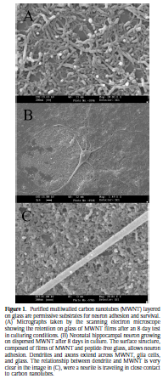
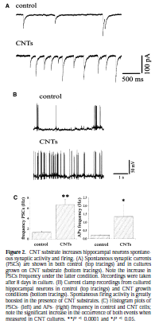
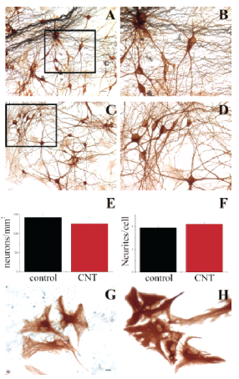
MWCNTs as Substrate for Neurons
Multi-Wall CNT substrate for HC neurons: Nano Letters, 5(6), 1107-1110 (2005).
CNTs functionalized, purified, deposited on
glass (pure carbon network desired).
Improvement in electrophysiology:
IPSCs (A) and patch clamp (B).
Neuronal density similar between CNTs and control.
* increase in electrical
activity due to gene expression, ion channel changes in neuron.

Slide 12
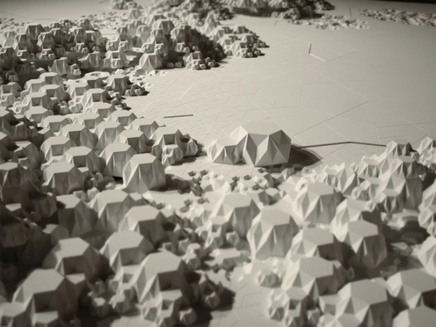
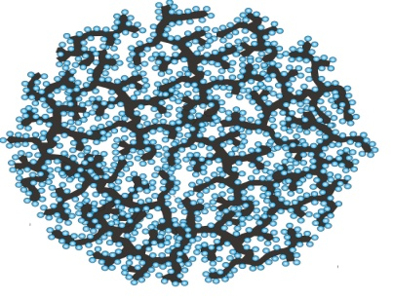
Bottom-up vs. Top-down Approaches
Theoretically, there are two basic approaches to building tissues:
bottom-up: molecular self-assembly (lipids, proteins), from individual components into structures (networks, micelles).
2) top-down: allow cells to aggregate upon a patterned substrate (CNTs, oriented ridges, microfabricated scaffolds).
Nature Reviews Microbiology 5,
209-218 (2007).
Soft Matter, 5, 1312–1319 (2009).

Slide 13
Top-down approach: Electrospinning
Align nanofibers using electrostatic repulsion forces
(review, see Biomedical Materials, 3, 034002 - 2008).
Contact guidance theory:
Cells tend to migrate along orientations associated with chemical, structural, mechanical properties of substrate.
Left: “Nanotechnology and Tissue Engineering: the scaffold”. Chapter 9.
Right: Applied Physics Letters, 82, 973 (2003).
Electrospinning procedure:
* fiber deposited on floatable table, remains charged.
* new fiber deposited nearby, repelled by still-charged, previously deposited fibers.
* wheel stretches/aligns fibers along deposition surface.
* alignment of fibers ~ guidance, orientation of cells in tissue scaffold.

Slide 14
Bottom-up approach: Molecular Self-assembly
Protein and peptide approaches commonly
used.
Protein approach – see review, Progress in
Materials Science, 53, 1101–1241 (2008).
Hierarchical Network Topology, MD simulations. PLoS ONE, 4(6), e6015 (2009).
α-helix protein networks in cytoskeleton withstand strains of 100-1000%.
* synthetic materials catastrophically fail at much lower values.
* due to nanomechanical properties, large dissipative yield regions in proteins.
Nature Nanotechnology,
3, 8 (2008).
Filament network, in vivo. PLoS ONE,
4(6), e6015 (2009).

Slide 15
Additional Tools: Memristor
Memristor: information-processing device (memory + resistor, Si-based) at nanoscale.
* conductance incrementally modified by controlling change, demonstrates short-term potentiation (biological synapse-like).
Learning = patterned
(time domain) analog modifications at synapse (pre-post junction).
Memristor response
Array of pre-neurons (rows), connect with post-neurons (columns) at junctions.
* theory matches experiment!
Biological Neuronal
response
Nano Letters, 10, 1297–1301 (2010).
Nano Letters, 10, 1297–1301 (2010).

Slide 16
Additional Tools: Bioprinting
Bioprinting: inkjet printers can deposit layers on a substrate in patterned fashion.
* 3D printers (rapid prototypers) can produce a complex geometry (see Ferrari,
M., “BioMEMS and Biomedical Nanotechnology”, 2006).
Optical
Microscopy
Atomic
Microscopy
Sub-femtoliter (nano) inkjet printing:
* microfabrication without a mask.
* amorphous Si thin-film transistors (TFTs), conventionally hard to control features smaller than 100nm.
* p- and n-channel TFTs with contacts (Ag nanoparticles) printed on a substrate.
PNAS, 105(13), 4976 (2008).

Slide 17
Conclusions
Nano can play a fundamental role in the formation of artificial tissues, especially when considering:
* emergent processes: in development, all tissues and organs emerge from a globe of stem cells.
* merging the sensory (electrical) and biomechanical (material properties) aspects of a tissue.
Advances in nanotechnology might also made within this problem domain.
* scaffold design requires detailed, small-scale substrates (for mechanical support, nutrient delivery).
* hybrid protein-carbon structures, or more exotic “biological” solutions (reaction-diffusion models, natural computing, Artificial Life)?

