Slide 1
Benchmark

Slide 2
Symbol of CNT interconnect
The symbol includes three nodes, including in, out and ref.
They are the input, output and ground nodes respectively.

Slide 3
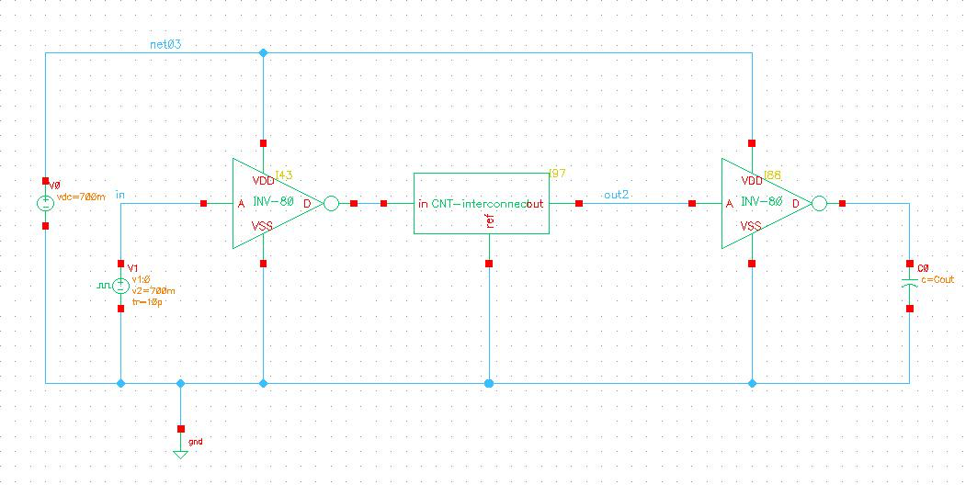
One case of application
Schematic of a CNT-interconnect connected between two inverters

