Slide 1
Tutorial5: (real) Device Simulations – Quantum Dots
Jean Michel D. Sellier
Yuling Hsueh, Hesameddin Ilatikhameneh,
Tillmann Kubis, Michael Povolotskyi, Jim Fonseca, Gerhard Klimeck
Network for Computational Nanotechnology (NCN)
Electrical and Computer Engineering

Slide 2
…in this tutorial
In this tutorial

Slide 3
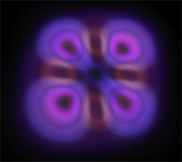
…in this tutorial
What is a Quantum Dot?
What are QDs applications?
Fabrication of Quantum Dots
Strain
Wavefunctions on a subdomain
Tutorials
What is a Quantum Dot?

Slide 4
…in this tutorial
What is a Quantum Dot?
What are QDs applications?
Fabrication of Quantum Dots
Strain
Wavefunctions on a subdomain
Tutorials
What is a Quantum Dot?
What are QDs applications?

Slide 5
…in this tutorial
What is a Quantum Dot?
What are QDs applications?
Fabrication of Quantum Dots
Strain
Wavefunctions on a subdomain
Tutorials
What is a Quantum Dot?
What are QDs applications?
Fabrication of Quantum Dots

Slide 6
…in this tutorial
What is a Quantum Dot?
What are QDs applications?
Fabrication of Quantum Dots
Strain
Wavefunctions on a subdomain
Tutorials
What is a Quantum Dot?
What are QDs applications?
Fabrication of Quantum Dots
Strain

Slide 7
…in this tutorial
What is a Quantum Dot?
What are QDs applications?
Fabrication of Quantum Dots
Strain
Wavefunctions on a subdomain
Tutorials
What is a Quantum Dot?
What are QDs applications?
Fabrication of Quantum Dots
Strain
Wavefunctions on a subdomain

Slide 8
…in this tutorial
What is a Quantum Dot?
What are QDs applications?
Fabrication of Quantum Dots
Strain
Wavefunctions on a subdomain
Tutorials
What is a Quantum Dot?
What are QDs applications?
Fabrication of Quantum Dots
Strain
Wavefunctions on a subdomain
Tutorials

Slide 9
What is a Quantum Dot?
What is a Quantum Dot?

Slide 10
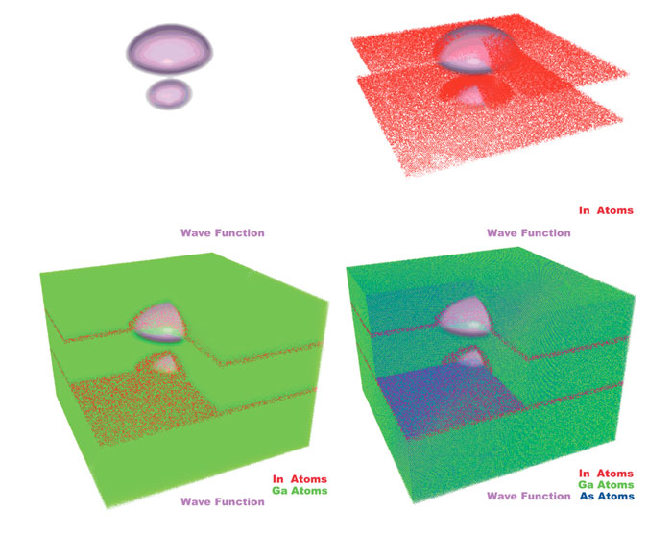
What is a Quantum Dot?
A quantum dot is a very small portion of matter where carriers are confined.
Their electric properties are somehow between a bulk semiconductor and a discrete set of molecules.
They have been discovered for the first time by Alexei Ekimov and Louis E. Brus, independently, in 1980.
A quantum dot is a very small portion of matter where carriers are confined.
[8] http://nanotechweb.org/cws/article/lab/46835

Slide 11
What is a Quantum Dot?
A quantum dot is a very small portion of matter where carriers are confined.
Their electric properties are somehow between a bulk semiconductor and a discrete set of molecules.
They have been discovered for the first time by Alexei Ekimov and Louis E. Brus, independently, in 1980.
A quantum dot is a very small portion of matter where carriers are confined.
Their electric properties are somehow between a bulk semiconductor and a discrete set of molecules.
[8] http://nanotechweb.org/cws/article/lab/46835

Slide 12
What is a Quantum Dot?
A quantum dot is a very small portion of matter where carriers are confined.
Their electric properties are somehow between a bulk semiconductor and a discrete set of molecules.
They have been discovered for the first time by Alexei Ekimov and Louis E. Brus, independently, in 1980.
A quantum dot is a very small portion of matter where carriers are confined.
Their electric properties are somehow between a bulk semiconductor and a discrete set of molecules.
They have been discovered for the first time by Alexei Ekimov and Louis E. Brus, independently, in 1980.
[8] http://nanotechweb.org/cws/article/lab/46835

Slide 13
What is a Quantum Dot?
A quantum dot is a very small portion of matter where carriers are confined.
Their electric properties are somehow between a bulk semiconductor and a discrete set of molecules.
They have been discovered for the first time by Alexei Ekimov and Louis E. Brus, independently, in 1980.
A quantum dot is a very small portion of matter where carriers are confined.
Their electric properties are somehow between a bulk semiconductor and a discrete set of molecules.
They have been discovered for the first time by Alexei Ekimov and Louis E. Brus, independently, in 1980.
[8] http://nanotechweb.org/cws/article/lab/46835

Slide 14
What is a Quantum Dot?
Quantum Dots (QDs) are (real) tiny object where : characteristic becomes comparable to Bohr radius
atoms are countable energy spectrum becomes discrete density of states becomes sharp
Quantum Dots (QDs) are (real) tiny object where : characteristic becomes comparable to Bohr radius

Slide 15
What is a Quantum Dot?
Quantum Dots (QDs) are (real) tiny object where : characteristic becomes comparable to Bohr radius
atoms are countable energy spectrum becomes discrete density of states becomes sharp
Quantum Dots (QDs) are (real) tiny object where : characteristic becomes comparable to Bohr radius
atoms are countable

Slide 16
What is a Quantum Dot?
Quantum Dots (QDs) are (real) tiny object where : characteristic becomes comparable to Bohr radius
atoms are countable energy spectrum becomes discrete density of states becomes sharp
Quantum Dots (QDs) are (real) tiny object where : characteristic becomes comparable to Bohr radius
atoms are countable energy spectrum becomes discrete

Slide 17
What is a Quantum Dot?
Quantum Dots (QDs) are (real) tiny object where : characteristic becomes comparable to Bohr radius
atoms are countable energy spectrum becomes discrete density of states becomes sharp
Quantum Dots (QDs) are (real) tiny object where : characteristic becomes comparable to Bohr radius
atoms are countable energy spectrum becomes discrete density of states becomes sharp

Slide 18
What is a Quantum Dot?
Quantum Dots (QDs) are (real) tiny object where : characteristic becomes comparable to Bohr radius
atoms are countable energy spectrum becomes discrete density of states becomes sharp quantum effects are VERY pronounced!
Quantum Dots (QDs) are (real) tiny object where : characteristic becomes comparable to Bohr radius
atoms are countable energy spectrum becomes discrete density of states becomes sharp quantum effects are VERY pronounced!

Slide 19
Applications
Applications

Slide 20
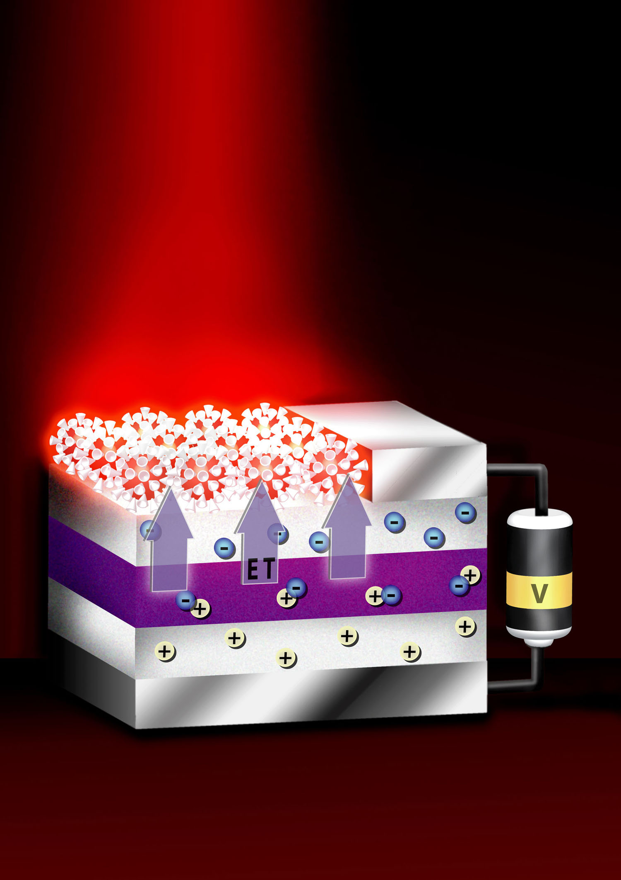
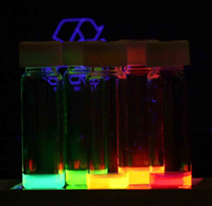
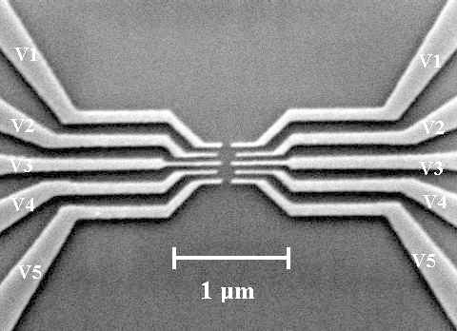
What are QDs applications?
QDs are considered to be revolutionary nanoelectronics devices next-generation lighting, lasers, quantum computing, information storage, quantum cryptography, biological labels, sensors, etc..
QDs are considered to be revolutionary nanoelectronics devices next-generation lighting, lasers, quantum computing, information storage, quantum cryptography, biological labels, sensors, etc..
[1] R. Maranganti, P. Sharma, “Handbook of Theoretical and Computational Nanotechnology”, American Scientific Publishers.
[3] http://en.wikipedia.org/wiki/Quantum_dot

Slide 21
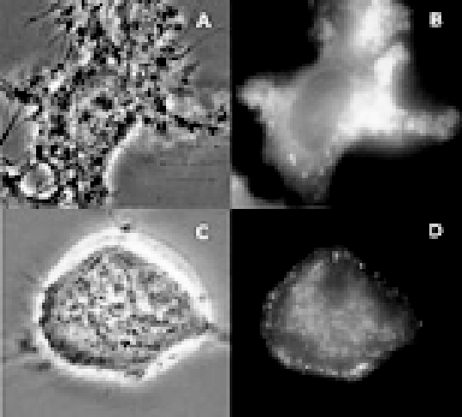
Applications
Magnified view of QD attachment to neurons. [1] R. Maranganti, P. Sharma, “Handbook of Theoretical and Computational Nanotechnology”, American Scientific Publishers.
Tracking of living cells
[4] X. Michalet, et al., “Quantum Dots for Live Cells, in Vivo imaging, and Diagnostics”, NIH Public Press.

Slide 22
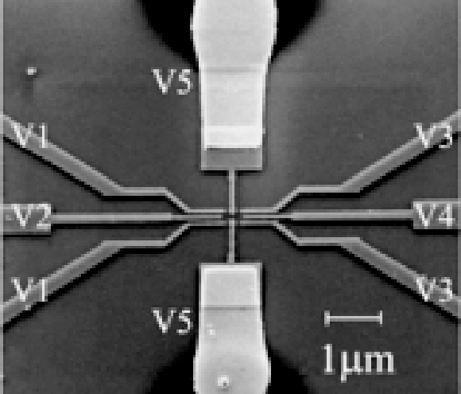
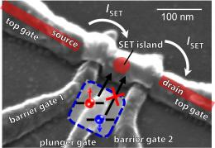
Applications
QD based transistor
[2] Martin Fuechsle, S. Mahapatra, F.A. Zwanenburg, Mark Friesen, M.A. Eriksson, Michelle Y. Simmons, “Spectroscopy of few-electron single-crystal silicon quantum dots”, NATURE NANOTECHNOLOGY LETTER.

Slide 23
Fabrication
Fabrication

Slide 24
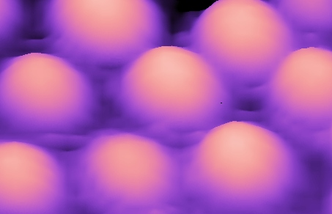
Fabrication of QDs
Strained QDs are: small regions of materials buried in a larger band gap material Stranski-Krastanov growth technique
[9] http://www.kprc.se/Framed/mainWindow.php?id=Doc/QDots.html

Slide 25
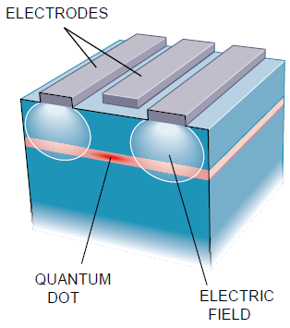
Fabrication of QDs
Electrostatically confined QDs are: small regions of materials buried in a larger band gap material built by etching technique
[10] M. Reed, “Quantum Dots”, Scientific American, January 1993.

Slide 26
QDs simulations
Simulation of Quantum Dots

Slide 27
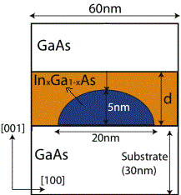
The structure
Simplified
[5] M. Usman et al., “Moving Toward Nano-TCAD Through Multimillion-Atom Quantum-Dot Simulations Matching Experimental Data”, IEEE Transactions on Nanotechnology, Vol. 8, No. 3, May 2009.

Slide 28
Models
What are the models needed to simulate such structures? Importance of long range strain effects Schroedinger equation in tight-binding formalism

Slide 29
Models
What are the models needed to simulate such structures? Importance of long range strain effects Schroedinger equation in tight-binding formalism

Slide 30
Shapes simulated
/
GaAs
/
GaAs
/
GaAs
InAs

Slide 31
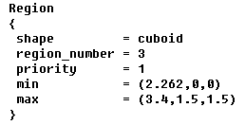
Shapes available
shape

Slide 32
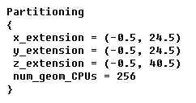
Spatial Parallelization
Spatial Parallelization (method 1)

Slide 33
Spatial Parallelization
Spatial Parallelization (method 2)

Slide 34
Tutorials
Exercises

Slide 35
References
[1] R. Maranganti, P. Sharma, “Handbook of Theoretical and Computational Nanotechnology”, American Scientific Publishers.
[2] Martin Fuechsle, S. Mahapatra, F.A. Zwanenburg, Mark Friesen, M.A. Eriksson, Michelle Y. Simmons, “Spectroscopy of few-electron single-crystal silicon quantum dots”, NATURE NANOTECHNOLOGY LETTER.
[3] http://en.wikipedia.org/wiki/Quantum_dot
[4] X. Michalet, et al., “Quantum Dots for Live Cells, in Vivo imaging, and Diagnostics”, NIH Public Press.
[5] M. Usman et al., “Moving Toward Nano-TCAD Through Multimillion-Atom Quantum-Dot Simulations Matching Experimental Data”, IEEE Transactions on Nanotechnology, Vol. 8, No. 3, May 2009.
[6] www.decodedscience.com
[7] S. Steiger, et al. “NEMO5: A parallel multiscale nanoelectronics modeling tool”, IEEE Transactions on Nanotechnology, Vol. 10, No. 6, November 2011.
[8] http://nanotechweb.org/cws/article/lab/46835
[9] http://www.kprc.se/Framed/mainWindow.php?id=Doc/QDots.html
[10] M. Reed, “Quantum Dots”, Scientific American, January 1993.

