Slide 1
Tutorial 6 – Device Simulation: Metals
Ganesh Hegde*, Michael Povolotskyi, Tillmann Kubis, Gerhard Klimeck
Network for Computational Nanotechnology (NCN) Electrical and Computer Engineering Purdue University, West Lafayette IN, USA
ghegde@purdue.edu
Summer School 2012

Slide 2
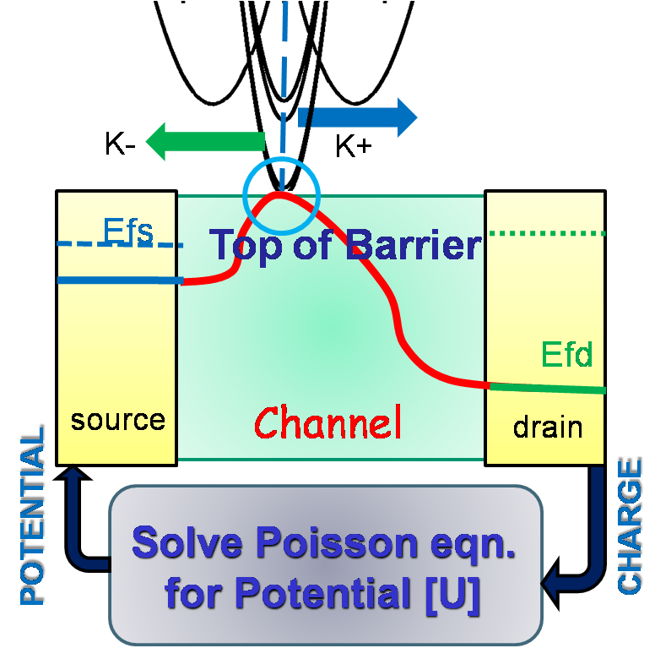
Metals in device modeling – existing paradigm
Metal – used to set Fermi Level in device
Either abstracted out or treated using effective mass approximation
As devices continue to scale, the metal needs to be treated atomistically
We are trying to bring metals into the device modeling paradigm using NEMO5
Image from https://engineering.purdue.edu/gekcogrp/research-group/AbhijeetPaul/project3.php with kind permission of Abhijeet Paul

Slide 3
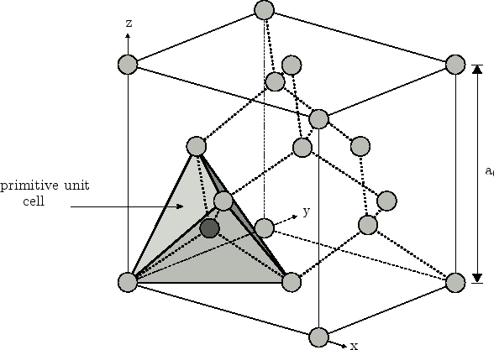
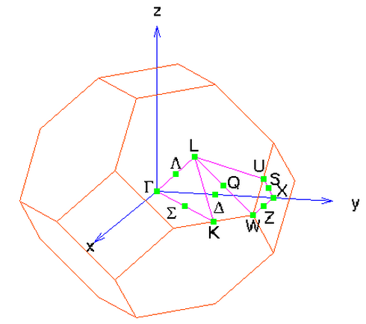
FCC Metal Unit Cell and Brillouin Zone
z
Single atom in Primitive Unit Cell at origin - say (0,0,0)
Primitive Lattice Vectors –
(0.5 0.5 0)*a/2
(0.5 0 0.5)*a/2
(0 0.5 0.5)*a/2
Primitive unit cell
a
x
Reciprocal Lattice is BCC
We would like to plot band structure along following directions in the 1st Brillouin Zone (Gamma -> X -> W -> L -> Gamma -> K)
Images from http://www.iue.tuwien.ac.at/phd/ungersboeck/img682.png and http://cst-www.nrl.navy.mil/bind/kpts/fcc/index.html

Slide 4
Setting up input deck for bulk Cu – structure options
Materials Section
Material
{
name = Cu
tag = substrate
crystal_structure = fcc
regions = (1)
neighbor_coupling = 2NN
bond_radius = 0.37
distance_1NN = 0.26
distance_2NN = 0.37
//which TB parameter set?
Bands:TB:sp3d5sstar:param_set = NRL_2NN_Orthogonal
}
distance_2NN
Distance_1NN
bond_radius

Slide 5
Domain options
Domain
{
name = structure1
type = pseudomorphic
base_material = substrate
dimension = (1,1,1)
periodic = (true, true, true)
crystal_direction1 = (1,1,0)
crystal_direction2 = (0,1,1)
crystal_direction3 = (1,0,1)
space_orientation_dir1 = (1,1,0)
space_orientation_dir2 = (0,1,1)
passivate=false
regions = (1)
geometry_description = simple_shapes
}

Slide 6
Geometry
Geometry
{
Region
{
shape = cuboid
region_number = 1
priority = 1
min = (-5,-5,-5) // in nm
max = ( 5, 5, 5)
tag = substrate
}
}

Slide 7
Solvers
solver
{
name = Cu
type = Schroedinger
domain = structure1
active_regions = (1)
job_list = (calculate_band_structure)
output = (energies, k-points)
tb_basis = sp3d5sstar
use_monomials = false
Matlaboutput = false
chem_pot = 0.0
shift = 0.0
// full band structure Gamma-X-W-L-Gamma-K
k_space_basis = reciprocal
k_points = [(0,0,0),(0.5,0,0.5),(0.5,0.25,0.75),(0.5,0.5,0.5),(0,0,0),(0.375,0.375,0.75)]
number_of_nodes = (100,100,100,100,100)
}

Slide 8
Global section
Global
{
solve = (Cu)
database = ../../../../materials/all.mat
}

Slide 9
Exercise 3 – metal bulk band structure
Log in to your workspace account
Retrieve the file Cu_bulk.in from folder /apps/share64/nemo/examples/current/public_examples/bulk_Cu :
Cu_bulk.in will execute a NEMO5 job to calculate the dispersion relationship for the bulk Cu unit cell that you just set up
Create a symbolic link to the database file using the following command:
ln -s /apps/share64/nemo/examples/current/materials/all.mat
Execute it on nanoHUB using the submit command
submit -v coates -i ./all.mat nemo-r7962 Cu_bulk.in
Retrieve the matlab file plot_bands.m from folder /apps/share64/nemo/examples/current/public_examples/bulk_Cu and copy into the directory you just executed in.
You should see files of the type Cu_*.dat. Make sure the file ‘Cu_energies.dat’ exists.
Load matlab in your workspace account using ‘use matlab-7.12’ followed by ‘matlab’. cd into the local directory where you executed nemo.
Execute plot_bands.m with the following arguments passed to it –
plot_bands(‘Cu’,-5,15,8.0223);

Slide 10
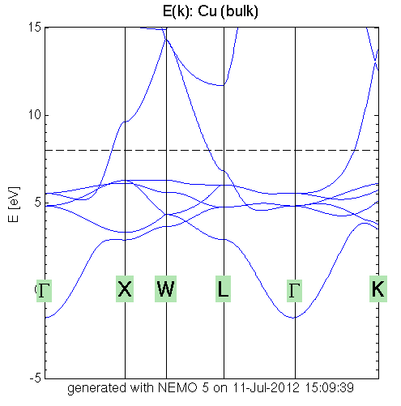
You should get the following result

Slide 11
Try this example with other metals too
name = ‘Ag’ / ‘Au’ / ‘Al’ – in the materials section.
The lattice parameters are 0.409/ 0.408/ 0.405 nanometers respectively.
The distance_1NN are <lattice_parameter>/sqrt(2).
distance_2NN = lattice_parameter.
Everything else remains the same.
Try it out!
You can modify this input deck to plot bulk band structure for other semiconductors having FCC unit cells too.
Remove the neighbor_coupling, bond_radius, distance_1NN, distance_2NN options, change the material name and the Bands:TB:sp3d5sstar:param_set options. The rest remains the same.

Slide 12
Metal-Semiconductor TB parameters
Transport through M-S junctions.
Metal alloy TB parameters
And lots more…!!

