Slide 1
Tutorial 2. Input & output in NEMO5
Michael Povolotskyi, Tillmann Kubis, James Fonseca,
Jean Michel Sellier, Daniel Mejia
Network for Computational Nanotechnology (NCN)
Purdue University, West Lafayette IN

Slide 2
Synopsis
How to control the simulator?
The NEMO5 input deck.
Creation of atomic structures.
Visualization of the atomistic output (structure).
Creation of Finite element mesh.
Visualization of finite element data (electric potential).

Slide 3
How to control the simulator? (I)
If you have NEMO5 installed in your system:
MPI execution command
NEMO5
executable
mpiexec -n N nemo transistor.in
material parameter database
Input deck
Two ASCII files that control NEMO5

Slide 4
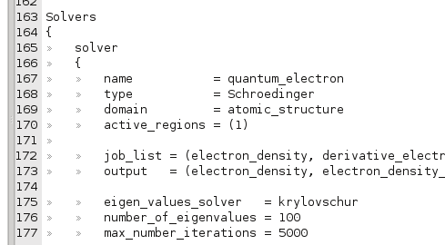
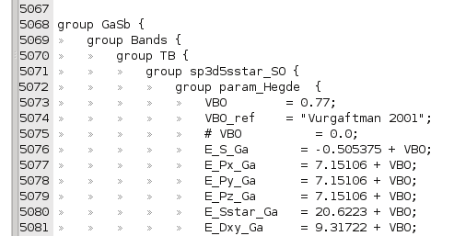
How to run the code? (III)
User editable files
Simulations are controlled by input deck
Material parameters are stored in a database file
The input deck files are created by a user.
The input deck files are written in “NEMO5 input language” or in Python.
Now we learn the “NEMO5 input language” which is sufficient for any simulation.
The database file is provided, but can be changed by an experienced user.

Slide 5
Synopsis
How to control the simulator? Done
The NEMO5 input deck.
Creation of atomic structures.
Visualization of the atomistic output (structure).
Creation of Finite element mesh.
Visualization of finite element data (electric potential).

Slide 6
The NEMO5 input deck (I)
block name
Input deck is an ASCII file –
can be opened by any text editor…
Solvers
{
solver
{//solver for the electron density
name = quantum_electron
type = Schroedinger
domain = atomic_structure
active_regions = (1,2,3)
job_list = (electron_density)
eigen_values_solver = krylovschur
number_of_eigenvalues = 10
max_number_iterations = 3000
convergence_limit = 1e-12
}
}
Input deck consists of blocks
surrounded by “{“ and “}”
a block contains other blocks
and/or options
options are assignments like:
voltage = 1.0
k_vector = (0.0, 0.5, 0.5)
C++ style comments are supported
Input deck fragment

Slide 7
The NEMO5 input deck. (II)
There are 3 blocks in the input deck:
Structure
{
}
defines material and simulation domains
Solvers
{
}
defines simulations that has to be solved, e.g. equations,
boundary conditions,iteration processes, output,
numerical options, etc
Global
{
}
defines global variables such as temperature, which database file to use, diagnostic output, etc.

Slide 8
The NEMO5 input deck – the first block “Structure”
Structure
{
}
Material
{
name = Si
…
}
Material
{
name = SiGe
…
}
Domain
{
name = device
…
}
Domain
{
name = contact1
…
}
Geometry
{
}
materials
Domains for simulations
Description of the geometry

Slide 9
Synopsis
How to control the simulator? Done
The NEMO5 input deck. Done
Creation of atomic structures.
Visualization of the atomistic output (structure).
Creation of Finite element mesh.
Visualization of finite element data (electric potential).

Slide 10
Creation of atomic structures (I)
Structure
{
}
Material
{
name = Si
…
}
Material
{
name = SiGe
…
}
Domain
{
name = device
…
}
Domain
{
name = contact1
…
}
Geometry
{
}
User’s steps
Input deck sections
Design the device
Chose material and crystal structures
Define where each equation is solved
Geometry block
Material and domain blocks
Solver and domain blocks

Slide 11
Example1: Si/SiGe quantum wire
Goal: create Si wire surrounded by a Si_{0.4}Ge_{0.6} layer
Si_{0.4}Ge_{0.6}
Si
Additional requirements:
[100] transport direction
SiGe alloy is represented as a disordered system

Slide 12
Example1. Si/SiGe wire: definition of materials.
Material
{
name = Si
tag = core
crystal_structure = diamond
regions = (1)
}
Material
{
name = SiGe
tag = substrate
crystal_structure = diamond
regions = (2)
mole_fraction = 0.4
disorder_type = totally_random_alloy
}
Si_{0.4}Ge_{0.6}
reg.1
reg.2
Si
Each material occupies a region (or regions)
Material definition requires:
name
tag
crystal_structure
special parameters for an alloy

Slide 13
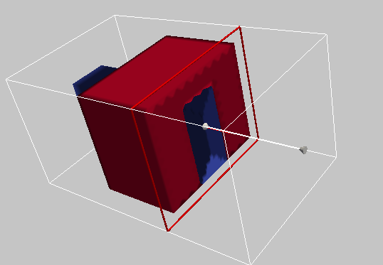
Example1. Si/SiGe wire: definition of geometry shapes.
reg.2
reg.2
reg.1
Si_{0.4}Ge_{0.6}
reg.1
reg.1
reg.2
Si
Full view
Cross-section view
If two regions overlap, then the biggest priority value wins!
Region
{
shape = cuboid
region_number = 1
priority = 2
min = ( 0,2,0)
max = ( 10,4,4)
}
Region
{
shape = cuboid
region_number = 2
priority = 1
min = (3,0,0)
max = (7,6,5)
}
*coordinates are defined in nanometers

Slide 14
Example1. Si/SiGe QWR. Atomistic domain.
Two ways to create an atomistic domain:
Read-in atomic structure
(see discussion forum for details )
Generate atomic structure.
(this tutorial)
Any structures (crystals, amorphous, bio molecules, etc…) are possible;
Chemical bonding has to be provided;
Only pseudomorphic lattice is supported;
Chemical bonds are calculated by NEMO5;
Strain relaxation is required for lattice mismatched systems (see tutorial 5)

Slide 15
Example1. Si/SiGe wire: Pseudomorphic domain (I)
Pseudomorphic domain is an ideal lattice that consists of materials with the same crystallographic structure.
No defects.
No different lattices in one domain such as GaN and Si together.
but…
Different lattice constants are possible.
Some defects in the lattice may be created by NEMO5 (e.g. single impurities,
Lecture 7 ).

Slide 16
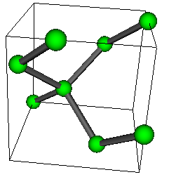
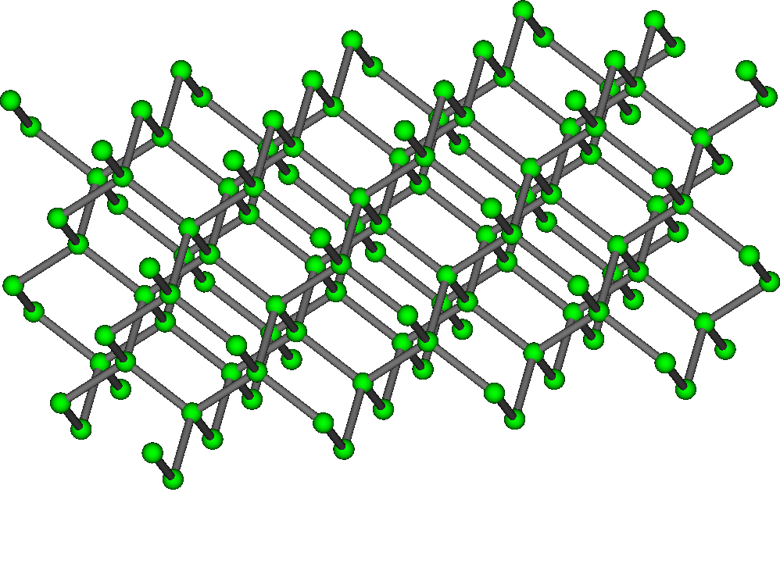
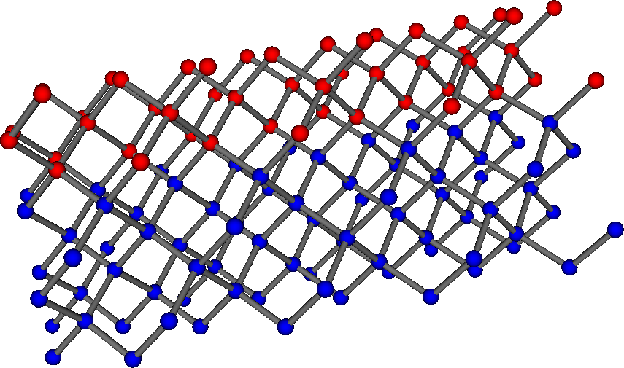
Steps to create a pseudomorphic domain.
Select the base material.
Domain block
Create a big lattice by repeating the base material unit cells.
Domain block
Substitute the base material atoms by the actual material atoms.
Remove unnecessary atoms if needed.
Geometry block
Relax the structure (will be shown in tutorial 5)

Slide 17
Example1. Si/SiGe wire: Pseudomorphic domain (II)
Domain{
name = wire_atomistic
type = pseudomorphic
base_material = core
crystal_direction1 = (1,0,0)
crystal_direction2 = (0,1,0)
crystal_direction3 = (0,0,1)
space_orientation_dir1 =(1.0,0.0,0.0)
space_orientation_dir2 =(0.0,1.0,0.0)
dimension = (30,20,20)
periodic = (false, false, false)
regions = (1,2)
geometry_description = simple_shapes
passivate = true
random_alloy = true
}
Base material cell definition
Bravais vectors of the cell (miller indexes)
Orientation of the crystal directions in the laboratory Cartesian system
Repetition of the unit cell.
Shaping of the domain
Post-processing of the domain

Slide 18
Synopsis
How to control the simulator? Done
The NEMO5 input deck. Done
Creation of atomic structures. Done
Visualization of the atomistic output (structure solver).
Creation of Finite element mesh.
Visualization of finite element data (electric potential of the Poisson solver).

Slide 19
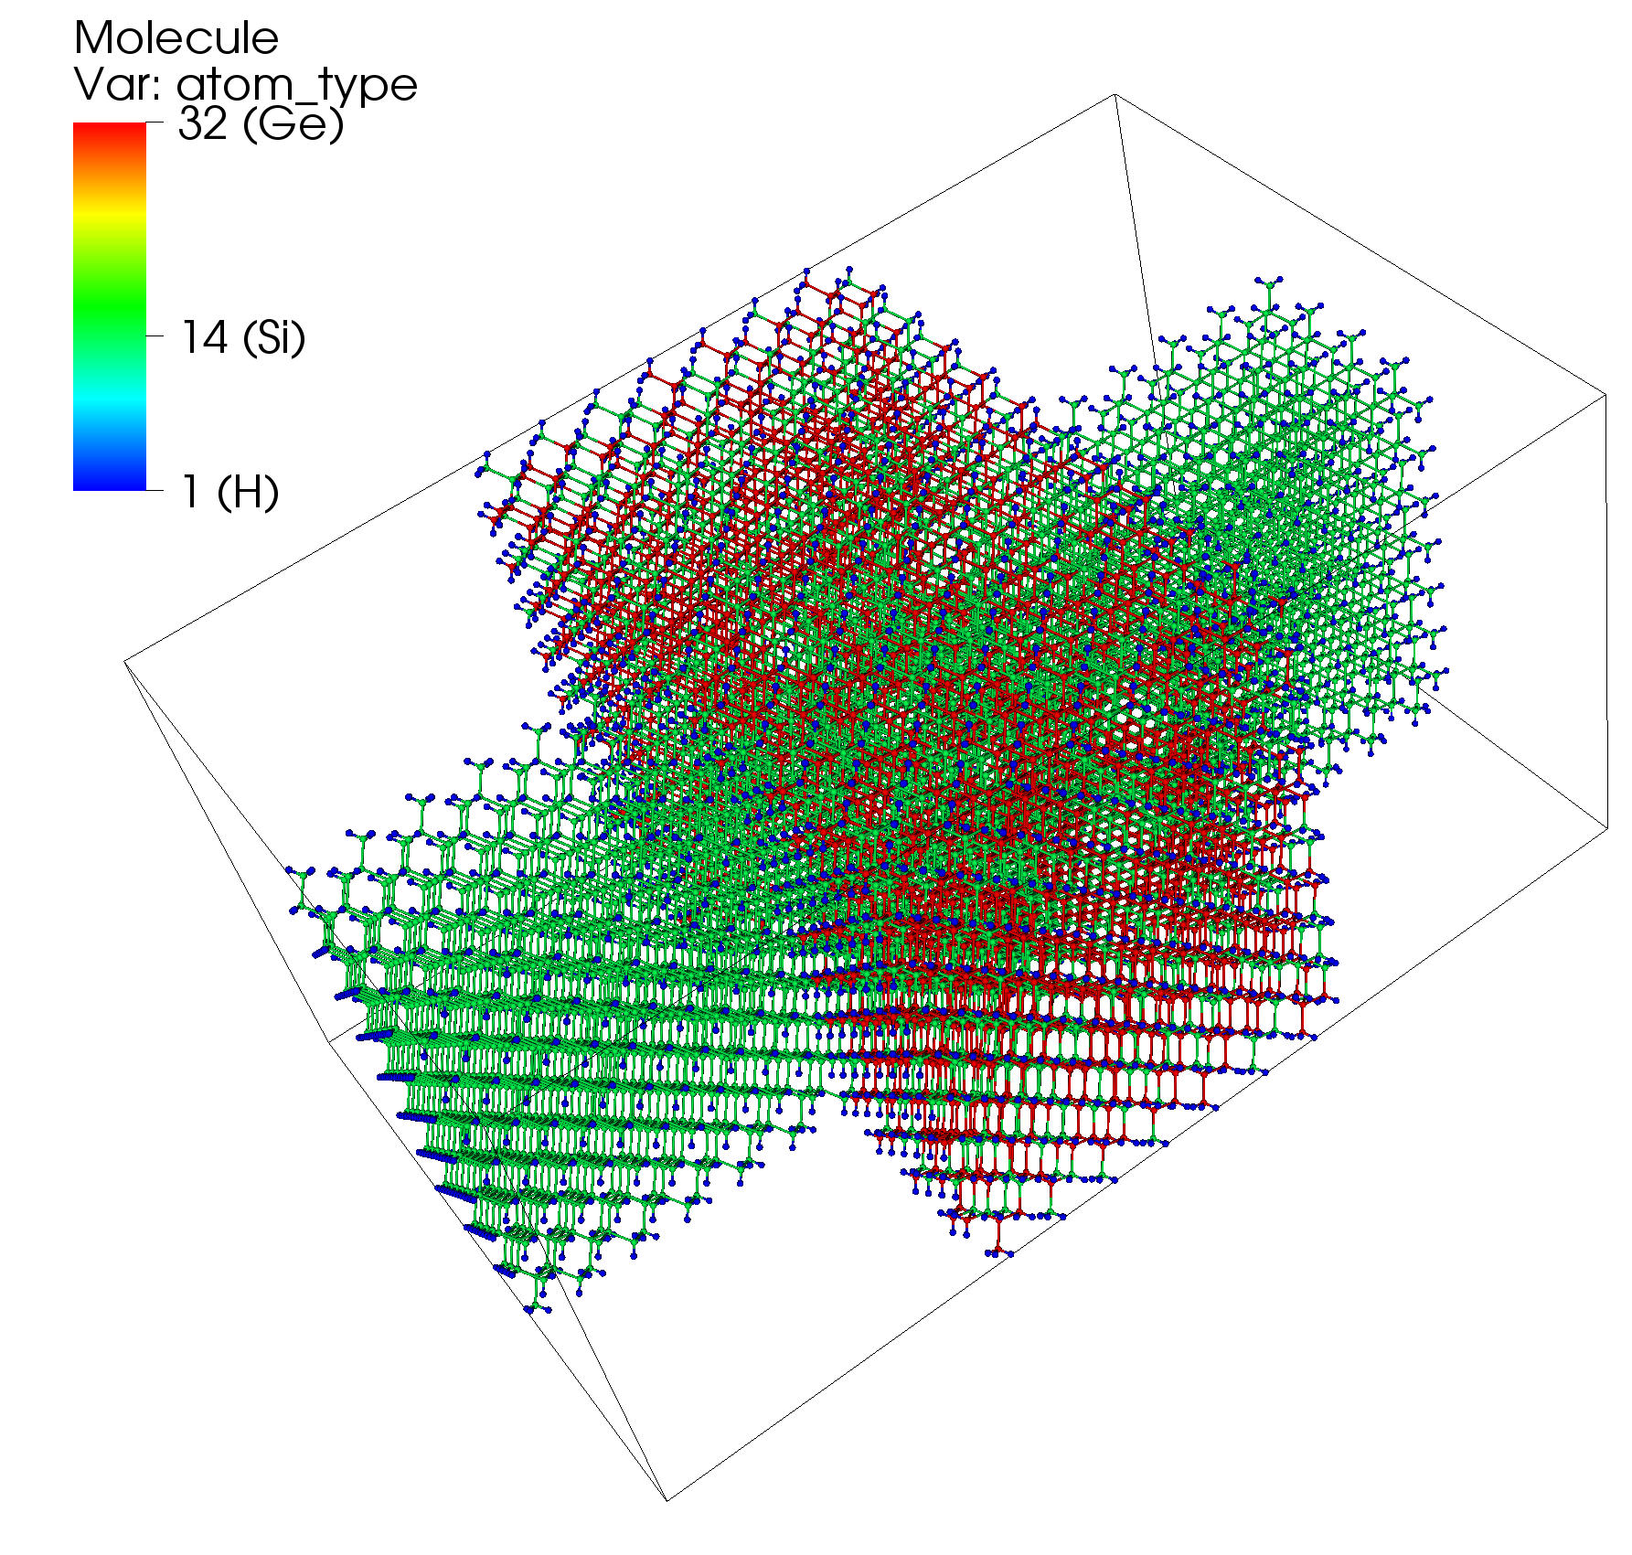
Visualization of atomic structures in NEMO5
Task: visualize atomic structure of our Si/SiGe wire.
Solution:
Define a solver that outputs the structure in the input deck.
Run NEMO5.
Use available visualization software.
visulaized by Visit

Slide 20
Solver that dumps out structures
solver
{
name = view_shapes
type = GeometryVIS
geometry_volumes_output = true
geometry_volumes_resolution = 20
geometry_volumes_filename = regions.vtk
}
solver
{
name = view_atoms
type = Structure
domain = wire_atomistic
output_format = vtk
structure_file = Si_SiGe_wire.vtk
}
Outputs user-defined
geometry
Outputs an atomistic
domain

Slide 21
Let’s see example1…
Execute tutorial2_1.in input deck
Visualize the output using Paraview
Modify the input deck: change crystallographic grows directions
crystal_direction1 = (1,0,0)
crystal_direction2 = (0,1,0)
crystal_direction3 = (0,0,1)
crystal_direction1 = (1,1,0)
crystal_direction2 = (-1,1,0)
crystal_direction3 = (0,0,1)

Slide 22
Synopsis
How to control the simulator? Done
The NEMO5 input deck. Done
Creation of atomic structures. Done
Visualization of the atomistic output (structure). Done
Creation of Finite element mesh.
Visualization of finite element data (electric potential).

Slide 23
Finite element (FE) domains.
$$∇\left(κ∇φ\right)=−ρ$$
Device simulation requires solution of the Poisson equation:
NEMO5 solves the Poisson equation using the FE method.
NEMO5 can create the FE mesh automatically:
atoms
atoms and mesh

Slide 24
Example 2. Si/SiGe wire: creation of a FE mesh domain
Atomistic domain “wire_atomistic”
FE domain “wire_fem”
Domain
{
name = wire_fem
type = finite_elements
mesh_from_domain = wire_atomistic
output = mesh
}

Slide 25
Example 2. Si/SiGe wire: electrostatic boundary conditions (I)
$$∇\left(κ∇φ\right)=−ρ$$
Device simulation requires solution of the Poisson equation:
The Poisson equation requires boundary conditions:
1. If no boundary conditions are specified, the Neumann boundary condition is applied :
$$∇φ=0$$
2. In the input deck one can define boundary regions and apply
boundary conditions there, e.g. impose a fixed potential value.

Slide 26
Example 2. Si/SiGe wire: electrostatic boundary conditions (II)
Device simulation requires solution of the Poisson equation:
$$∇\left(κ∇φ\right)=−ρ$$
The Poisson equation solution depends on boundary condition:
1. If no boundary conditions are specified, the Neumann boundary condition is applied.
2. In the input deck one can define boundary regions and apply
boundary conditions there.

Slide 27
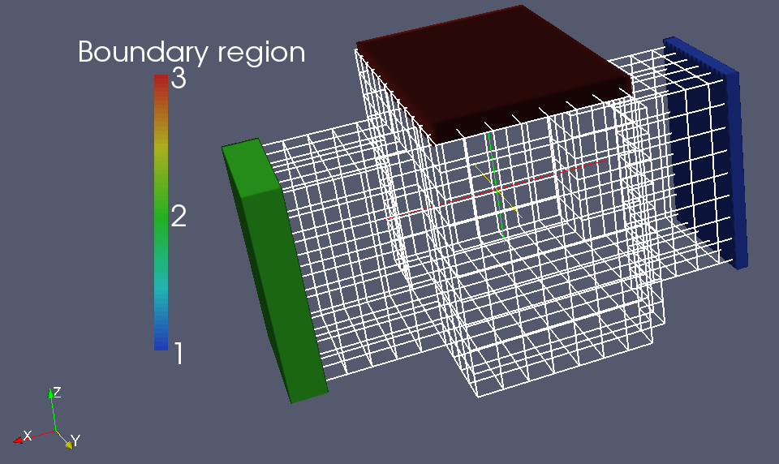
Example 2. Si/SiGe wire: electrostatic boundary conditions (III)
3
Let’s apply 3 boundary conditions.
Boundary_region {
shape = cuboid
region_number = 1
priority = 1
min = ( -0.1,1.5,-0.2)
max = ( 0.2,4.5, 4.5)
}
Boundary_region {
shape = cuboid
region_number = 2
priority = 1
min = ( 9.7, 1.5,-0.2)
max = ( 10.5,4.5, 4.5)
}
Boundary_regionn {
shape = cuboid
region_number = 3
priority = 1
min = ( 3, 0, 5.2)
max = ( 7, 6, 5.6)
}
2
1
Output of the boundary regions and FE mesh
Boundary conditions are applied to the mesh points that are inside the boundary regions.

Slide 28
Example 2. Si/SiGe wire: solving the Poisson equation.
solver{
name = my_poisson
type = Poisson
domain = wire_fem
fem_output = (potential)
boundary_condition{
type = ElectrostaticContact
boundary_regions = (1)
voltage = 0.0
}
boundary_condition{
type = ElectrostaticContact
boundary_regions = (2)
voltage = 1.0
}
boundary_condition{
type = ElectrostaticContact
boundary_regions = (3)
voltage = 2.0
} }

Slide 29
Synopsis
How to control the simulator? Done
The NEMO5 input deck. Done
Creation of atomic structures. Done
Visualization of the atomistic output (structure). Done
Creation of Finite element mesh. Done
Visualization of finite element data (electric potential).

Slide 30
Let’s run example 2…
Execute tutorial2_2.in input deck
Visualize the output using Paraview
Modify the input deck: change applied voltage.
voltage = 1.0
voltage = 2.0

Slide 31
Synopsis
How to control the simulator? Done
The NEMO5 input deck. Done
Creation of atomic structures. Done
Visualization of the atomistic output (structure). Done
Creation of Finite element mesh. Done
Visualization of finite element data (electric potential). Done

Slide 32
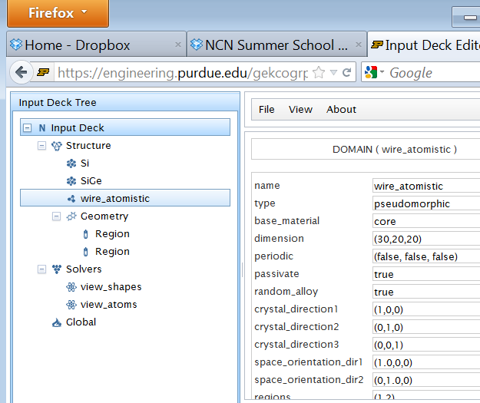
Appendix. Input deck editor and database browser.
https://engineering.purdue.edu/gekcogrp/software-projects/nemo5/InputDeckEditor/
PHP based input deck editor:
can show input deck/database in a structured form;
can facilitate input deck edition;
can automatically translate input deck into Python;

