Slide 1
Tutorial1: NEMO5 Technical Overview
Jim Fonseca, Tillmann Kubis, Michael Povolotskyi, Jean Michel Sellier, Gerhard Klimeck
Network for Computational Nanotechnology (NCN)
Electrical and Computer Engineering

Slide 2
Overview
Licensing
Getting NEMO5
Getting Help
Documentation
Compiling
Workspace
Parallel Computing
Run a job on workspace

Slide 3
NEMO5 Licensing
License Provides access to NEMO5 source code and ability execute NEMO5
License Types
Commercial/Academic/Governmental
Non-commercial (Academic)
Free, with restrictions
Cannot redistribute
Must cite specific NEMO5 paper
Must give us back a copy of your changes
Commercial
License for the Summer School week

Slide 4
Getting NEMO5
How to run NEMO5
1. Download source code and compile
Configuration file for Ubuntu
2. Download static binary
Runs on x86 64-bit version of Linux
3. Execute through nanoHUB workspace
4. Future – nanoHUB app with GUI
NEMO5 powers some nanoHUB tools already, but they are for specific uses

Slide 5
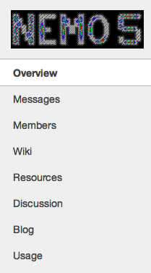
Getting Help
https://nanohub.org/groups/nemo5distribution/

Slide 6
For Developers
Can download source from NEMO Distribution and Support group
NEMO5 source code resource (for developers) Configure, build libraries, compile NEMO5, link
NEMO5 designed to rely on several libraries
Need good knowledge of Makefiles, building software

Slide 7
Libraries
PETSc for the solution of linear and nonlinear equation systems
Both real and complex versions employed simultaneously
SLEPc for eigenvalue problems
MUMPS
Parallel LU-factorization
Interfaces with PETSc/SLEPc
PARPACK for sparse eigenvalue solver
Libmesh for finite element solution of Poisson equation
Qhull for computation of Brillouin zones
Tensor3D for small matrix-vector manipulations
Boost::spirit for input/output (will be covered later)
Output in Silo(for spatial parallelization) or VTK format
Others will be discussed in input/output tutorial

Slide 8
For Developers
NEMO5/configure.sh configuration_script
NEMO5/mkfiles contains configuration scripts
NEMO5/prototype/libs/make
Builds packages like petsc, slepc, ARPACK, libmesh, silo
NEMO5/prototype/make
Binary: NEMO5/prototype/nemo
Examples: NEMO5/prototype/public_examples
Materials database: NEMO5/prototype/materials/all.mat
Doxygen documentation: NEMO5/prototype/doc
make

Slide 9
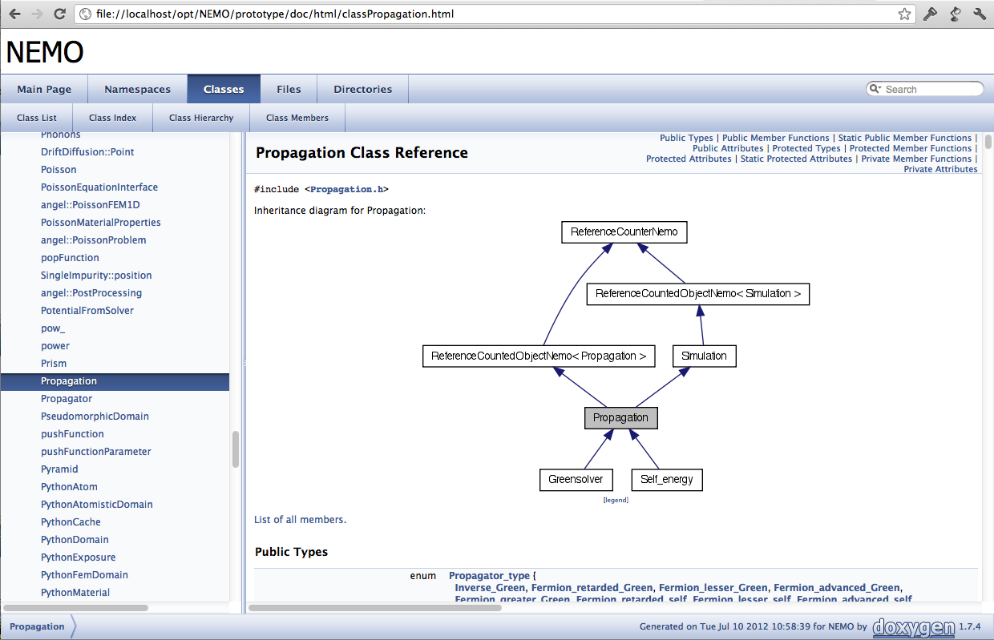
Doxygen
Generates online documentation browser (also PDF, etc.)
Extracts information directly from source code
doxygen.org

Slide 10
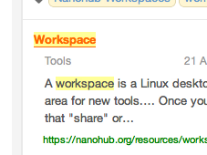
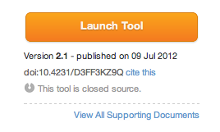
Workspace

Slide 11
Workspace

Slide 12
Interacting with Workspace
nanoHUBMenu
Multiple Desktops
Pop Out Window

Slide 13
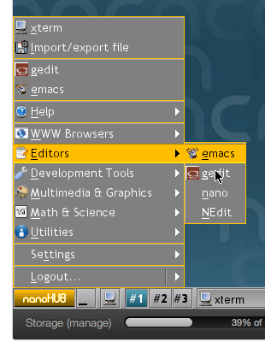
nanoHUB Menu and Editors

Slide 14
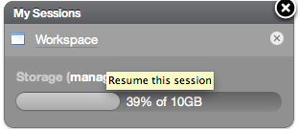
File Transfer to/from Workspace
Can use file transfer capability in workspace ‘start’ menu
How to copy files to/from workspace
In workspace; nanoHUB menu->import/export file
Can ssh/sftp/scp to nanohub.org
sftp username@nanohub.org
ssh -Y -l username nanohub.org
https://nanohub.org/tools/storage

Slide 15
Parallel Computing
NEMO5 scales to 100,000 cores
In the past, processors had only one “central processing unit”
Now a processor, has multiple “central processing units” aka “cores”
“processor” is outdated – use “cores”
All memory on a node is shared
NEMO5 uses MPI (message passing interface)
standardized and portable message-passing system
Cores
C1
C2
C3
C4
C5
C6
C7
C8
Processors
P1
P2
P3
P4
Nodes
N1

Slide 16
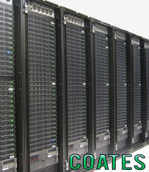
Rosen Center for Advanced Computing (RCAC) Infrastructure
Two main cluster computer systems we will use
http://www.rcac.purdue.edu/
Rossmann (#345)
~400 nodes
Each node has:
Dual 12 core AMD Opteron 6172
24 cores/nodes
48 GB RAM
Coates
~1,000 nodes
Each node has:
Two 2.5 Ghz quad-core AMD 2380
8 cores/nodes
32 GB RAM
Newer systems available soon
Carter #88
Intel Xeon-E5
NVIDIA GPUs

Slide 17
nanoHUB/RCAC interaction via ‘submit’
A workspace is a Linux desktop in your browser
Virtual machine
NEMO5 is installed on clusters on RCAC machines
Rosen Center for Advanced Computing
‘submit’ command
nanoHUB workspace
RCAC
PBS Queuing System
Output

Slide 18
bulkGaAs_parallel.in
Small cuboid of GaAs before and after Keating strain model applied
Before: qd_structure_test.silo
After: GaAs_20nm.silo
You can set these in the input file & will be covered later
qd.log

Slide 19
Parallel run (1 Node, 8 cores)
NEMO5 revision(XXXX = 8028)
mkdir test (make directory)
cd test (change directory)
ln -s /apps/share64/nemo/examples/current/materials/all.mat (make a link to materials database)
submit -v [venue] -i ./all.mat -n 8 -w 0:05:00 nemo-rXXXX /apps/share64/nemo/examples/current/public_examples/NCN_summer_school_2012/Technical_Overview/bulkGaAs_parallel.in
Submit command
-v venue where the job will run
Venue be ncn-hub@coates OR ncn-hub@rossmann
ncn-hub is a queue
For Summer School only! (after summer school use coates or rossmann)
Will go to ‘standby’ queue
-i filename to pass to the venue (materials database: all.mat)
-n number of cores (must be correct for machine)
-w walltime (5 minutes)
submit --help

Slide 20
MPI Parallelization
Real space partitioning
Determined in advance by user
Two different methods (bulkGaAs_parallel.in example uses method #2)
Try changing num_geom_CPUs
Partitioning
{
x_partition_nodes = (-0.1, 3.0, 6.1) y_partition_nodes = (-0.1, 3.0, 6.1) z_partition_nodes = (-0.1, 3.0, 6.1)
}
CPU 7
CPU 8
1
CPU 3
CPU 4
6
CPU 1
CPU 2
Partitioning
{
x_extension = (-0.1,6.1)
y_extension = (-0.1,6.1)
z_extension = (-0.1,6.1)
num_geom_CPUs = 8
}
2
Notes:
Currently, 1-D and 3-D
regular grid partitioning is supported. A user may 1) choose the
exact positions of the partition boundaries or 2) just specify the
total extension of the device and a desired total number of processes
for the partitioning, leaving the partitioning to NEMO5.
In this case, the partition boundaries are determined from a
minimization of the interfaces between partitions.

Slide 21
Multi-Node Run
(copy example to your present working directory)
cp /apps/share64/nemo/examples/current/public_examples/NCN_summer_school_2012/Technical_Overview/bulkGaAs_parallel.in .
submit -v [venue] -i ./all.mat –n X -N Y -w 0:05:00 nemo-rXXXX bulkGaAs_parallel.in
argument | meaning | Rossmann | Coates
X | -n (cores) | 48 | 16
Y | -N (cores/node) | 24 | 8
submit –v ncn-hub@rossmann -i ./all.mat –n 48 –N 24 -w 0:05:00 nemo-rXXXX bulkGaAs_parallel.in
submit -v ncn-hub@coates -i ./all.mat –n 16 –N 8 -w 0:05:00 nemo-rXXXX bulkGaAs_parallel.in

Slide 22
Walltime
1 hour default
4 hour maximum
Cores
Default is 1 core
cd ~
cp -r /apps/share64/nemo/examples/current/public_examples/ .

Slide 23
Schedule for the NEMO5 tutorial
Device Modeling with NEMO5
10:00 Break
10:30 Lecture 14 (NEMO5 Team): “NEMO5 Introduction”
12:00 LUNCH
1:30 Tutorial 1 (NEMO5 Team): “NEMO5 Technical Overview”
3:00 Break
3:30 Tutorial 2 (NEMO5 Team): “NEMO5 Input and Visualization”
4:30 Tutorial 3 first part (NEMO5 Team): “Models”
5:00 Adjourn

Slide 24
Thanks!

