Slide 1
NEMO5 Tutorial:
Graphene Nanostructures
NCN Summer School 2012
Junzhe Geng, NEMO5 team

Slide 2
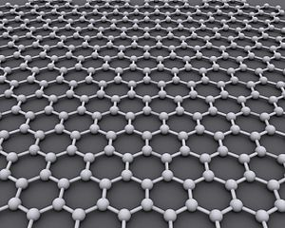
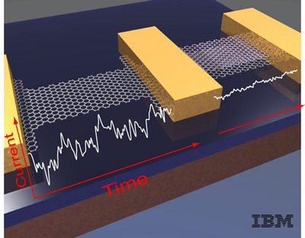
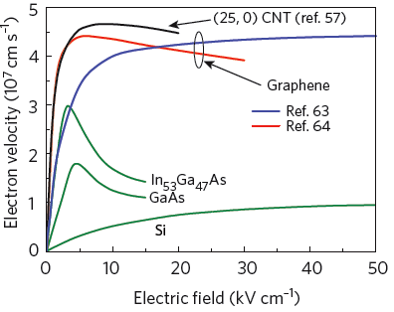
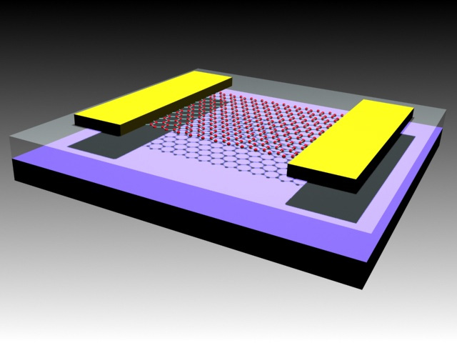
Graphene and transistor
100GHz Graphene FET
Image credit: IBM
Advantages:
High intrinsic mobility (Over 15,000 cm²/V-s)
High electron velocity ➔ Good transport
2D material → Good scalability
CNT (Perebeinos, PRL 2005)
Akturk, JAP 2008
Shishir, JPCM 2009
Frank Schwierz, Nature Nano. 5, 487 (2010)
Image from: University of Maryland

Slide 3
Outline
Tutorial Outline:
  Tight binding surface treatment in NEMO5
  Graphene models, lattice, setup in nemo5
  Example 1: Graphene bandstructure, band model comparison
  Example 2: Armchair graphene nanoribbon
  Exercise: Zig-zag graphene nanoribbon
  Example 3: Graphene nanomesh with a circular hole
  Exercise: Graphene nanomesh with a rectangular hole

Slide 4

Surface Treatment
In NEMO5

Slide 5
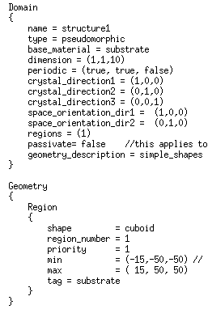
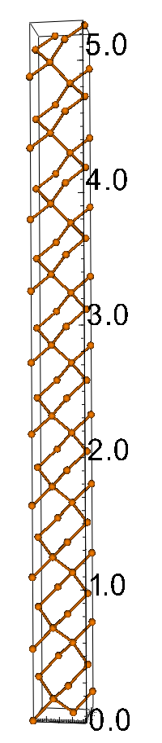
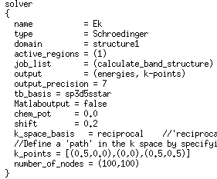
Surface Passivation in NEMO5: example Si UTB
Example: Si_UTB_10uc_no_pass.in
passivate = false
10 unit cell
Inputdeck: Bandstructure calculation of a Si UTB with default settings, no passivation used

Slide 6
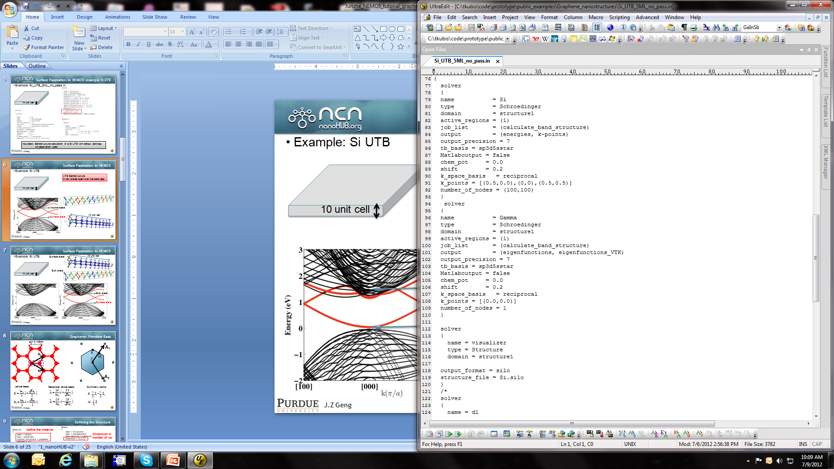
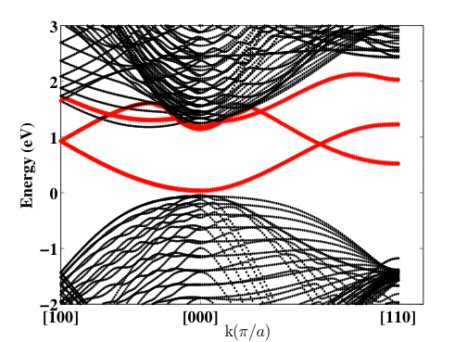
Surface Passivation in NEMO5
Example: Si_UTB_10uc_no_pass.in
UTB Bandstructure:
A few states span over the band gap
10 unit cell
Identify the nature of band gap states:
Get the wave functions
Calculate the wave functions at the Γ point

Slide 7
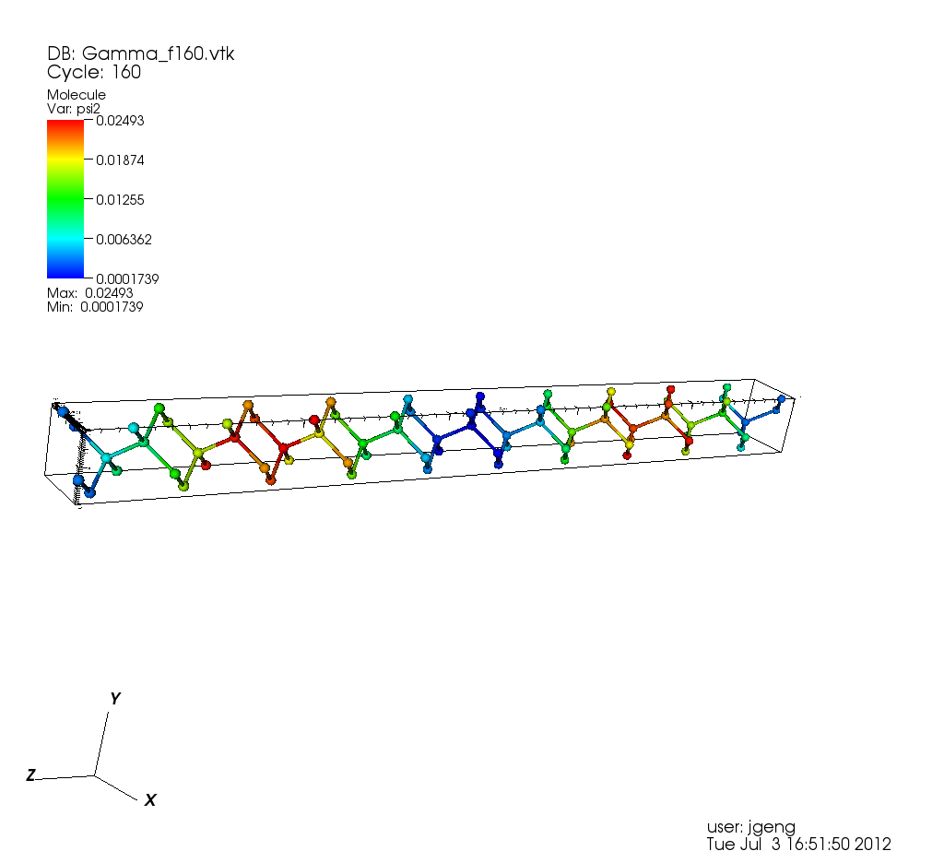
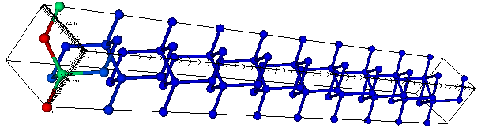
Surface Passivation in NEMO5
Example: Si_UTB_10uc_no_pass.in
States in the bandgap are surface states
They are produced by dangling bonds
10 unit cell
Volume state
Surface state
10 unit cell

Slide 8
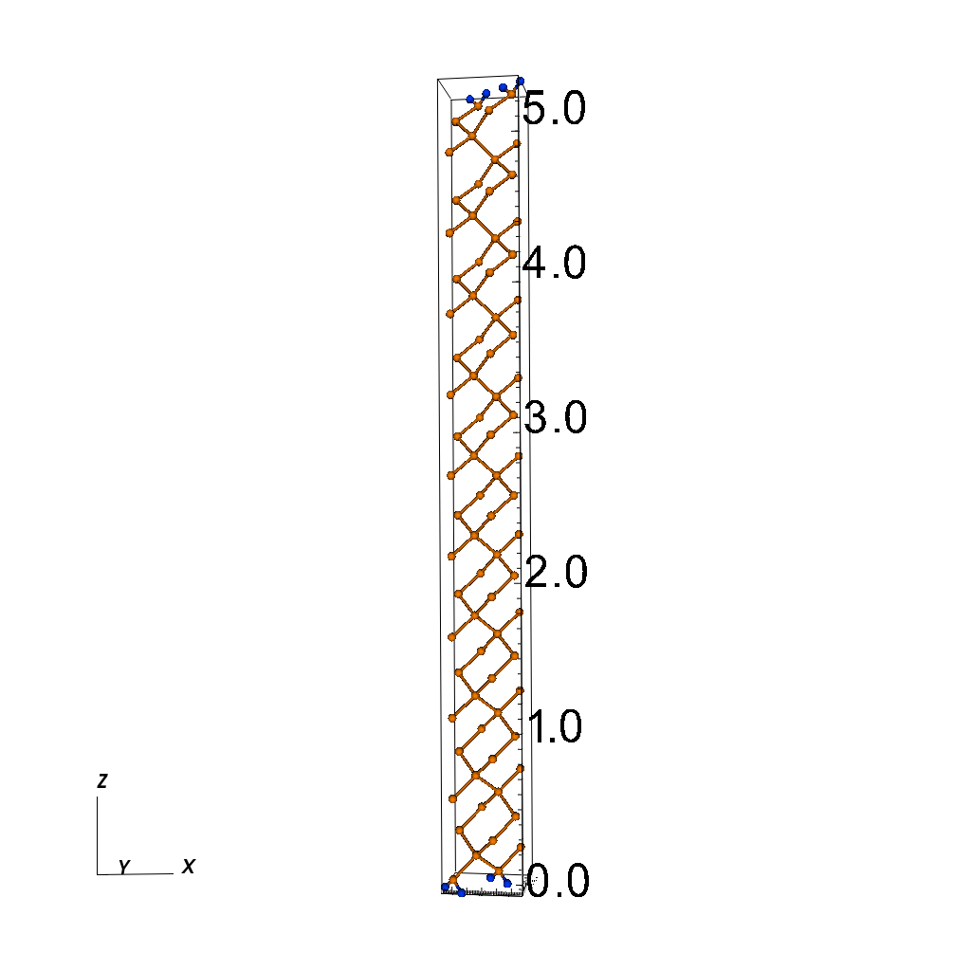
Surface Passivation in NEMO5
Example: Si_UTB_10uc_pass.in
10 unit cell
“passivate = true”
Adds H-atoms at the surface

Slide 9
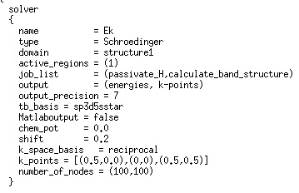
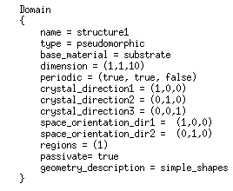
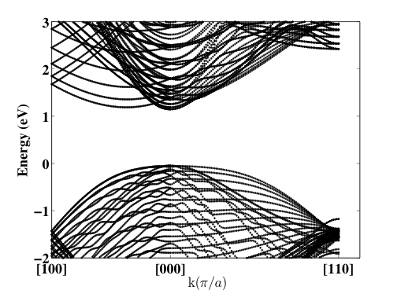
Surface Passivation in NEMO5
Example: Si_UTB_10uc_pass.in
10 unit cell
Surface states are shifted out of band gap region to very high energies (~1 keV)

Slide 10
Graphene
http://en.wikipedia.org/wiki/Graphene

Slide 11

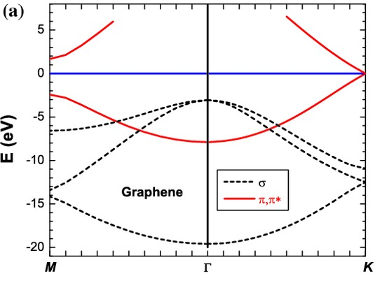
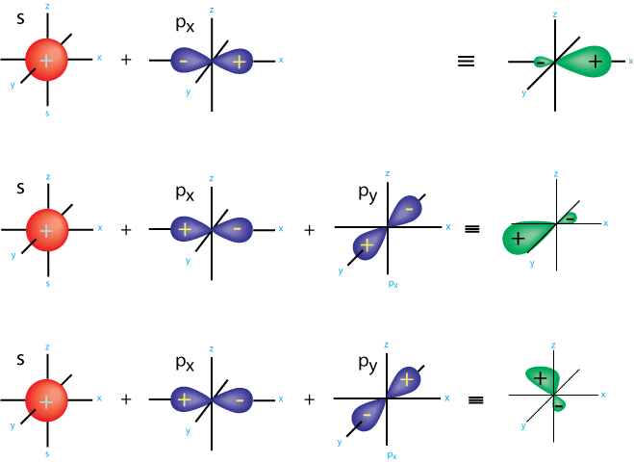
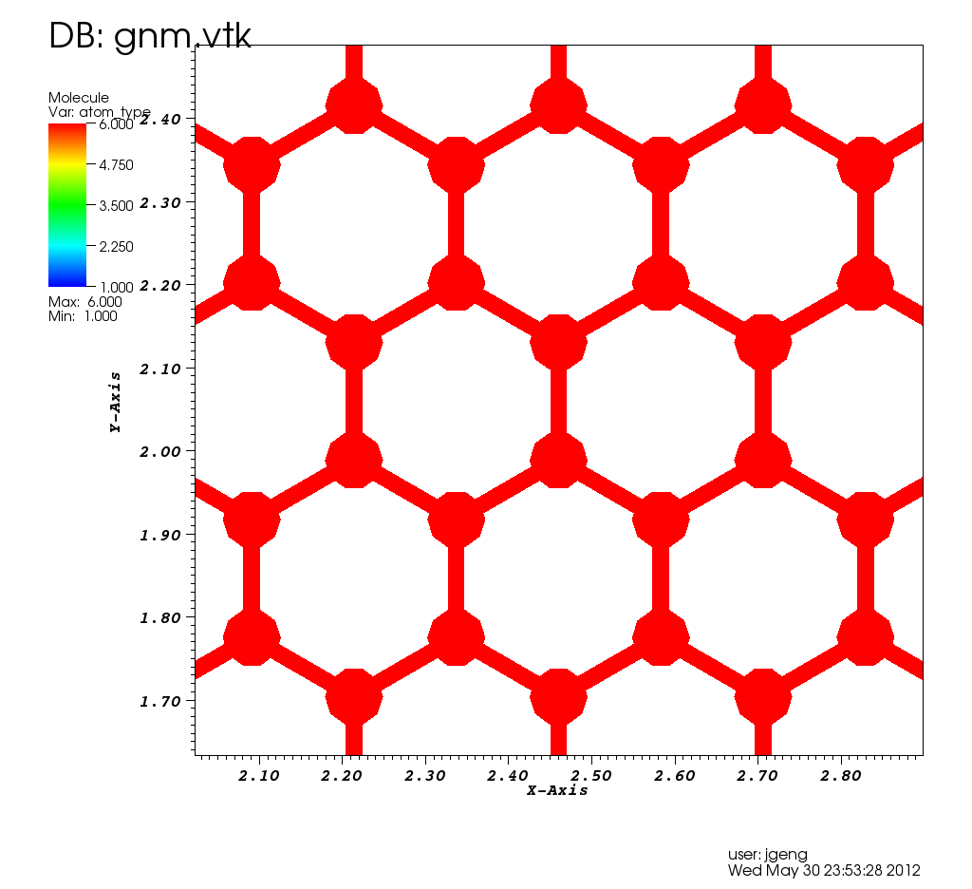
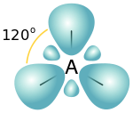
Tight-binding Model
Y. Zhang and R.Tsu, Nanoscale Research Letters Vol. 5 Issue 5
2p_{z}
2p_{y}
2p_{x}
2p_{z}
sp²
2s
p_{z} orbital is well separated in energy from the sp² orbitals
More importantly, only the p_{z} electron is close to the Fermi level
Therefore, the common tight-binding method for graphite/graphene considers only the p_{z} orbital (P.R. Wallace, PRB 1947)

Slide 12


Passivation in PD and Pz tight binding model
NEMO5: two models for Graphene bandstructure
Standard model of tight binding literature “Pz”
Includes just one p_{Z} orbital per atom
Does not allow for hydrogen passivation
Because p_{z} orbital of C has zero coupling to s orbital in H
p_{Z}
Recently developed model “PD” (J. Appl. Phys. 109, 104304 (2011)
Includes {p_{z} d_{yz} d_{zx}} orbital set on each C atom and H atom
Hydrogen atoms included explicitly (realistic treatment)
“passivate_H” not required in job_list
BUT
Make H atoms “active”, i.e. include them explicitly:
Domain
{
activate_hydrogen_atoms = true (default = false)
p_{Z}
d_{yz}
d_{zx}
Always have passivate = true in the domain section (default)

Slide 13
Graphene: Primitive Basis
a₀= 0.142nm
A₁
a₁
K
M
Γ
a₂
A₂
Lattice basis:
Reciprocal lattice basis:
Symmetry points:
Given in NEMO5
User defined points

Slide 14
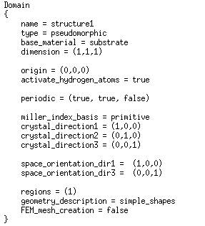
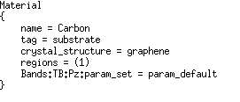
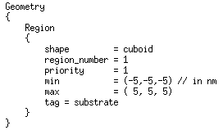
Defining the Structure
Define the material
Dimension in number of unit cells
Have “true” only for PD model
‘primitive’ or ‘Cartesian’
With a large enough region, device is limited by dimension only

Slide 15
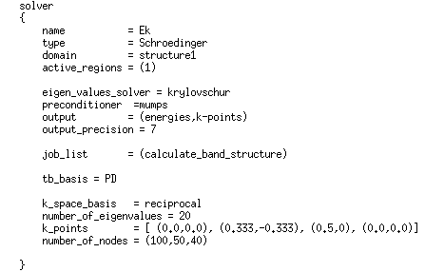
Defining Solver
A₁
K
M
Γ
A₂
Symmetry points:
‘Pz’ or ‘PD’
Γ → K → M → Γ
Expressed in units of A₁ and A₂

Slide 16
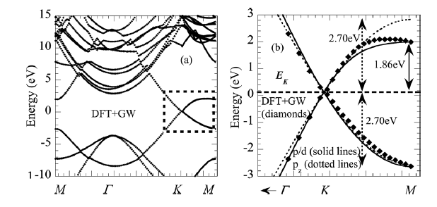
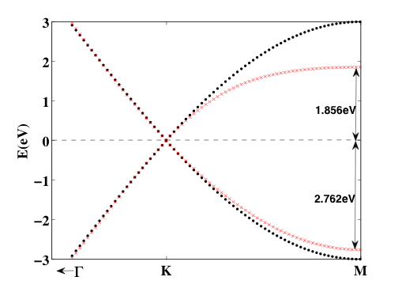
Graphene Bandstructure: P_{Z} vs. P/D
NEMO5
Boykin et al.
pz
p/d
DFT results are much better reproduced with the PD model
J. Appl. Phys. 109, 104304 (2011)

Slide 17
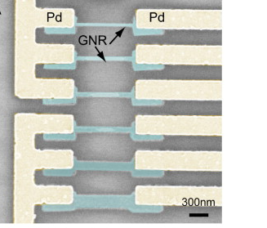
Graphene Nanoribbons
Z.Chen, et al. Physica 40, 228-232 (2007)

Slide 18
Graphene: Cartesian Basis
A₂
a₀= 0.142nm
a₁
A₁
a₂
Lattice basis:
Reciprocal lattice basis:
Γ

Slide 19
Structure
a₁
a₂
cartesian
A₂
A₁

Slide 20
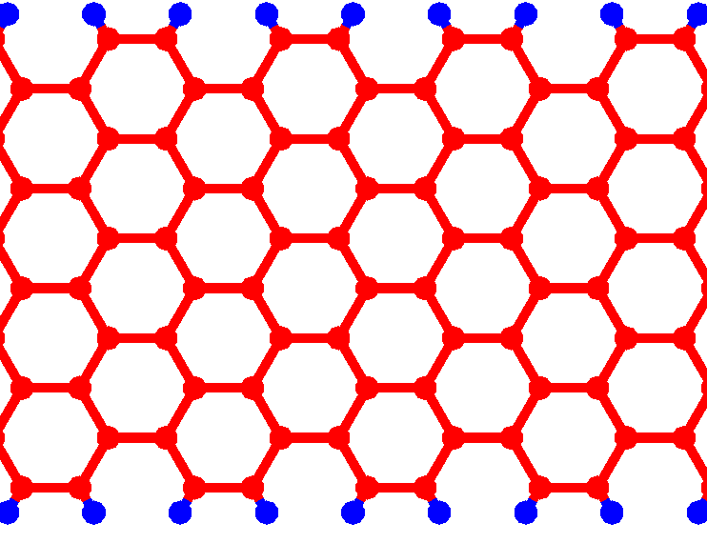
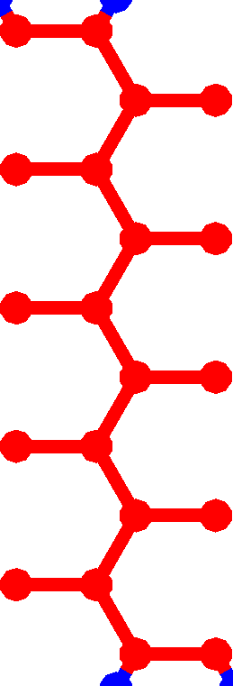
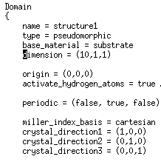
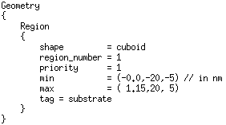
Example 1 : 10-AGNR
“Armchair”
10 atomic layers wide
Periodic
x
y
A big domain

Slide 21
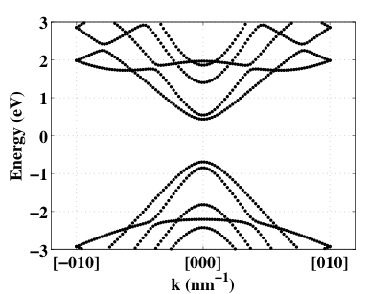
10-AGNR Bandstructure
bandgap
Armchair edges allow opening up a bandgap

Slide 22

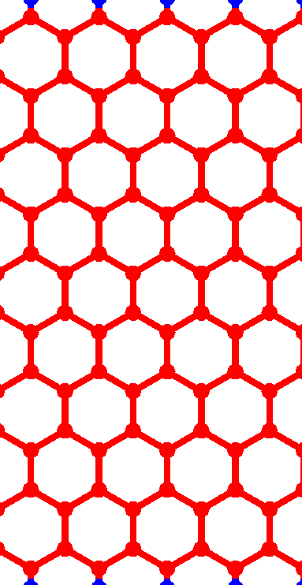
Exercise: Define a “10-ZGNR” in NEMO5 and calculate its bandstructure along x direction ([100])
“zigzag”
1
2
3
a₀= 0.142nm
4
a₁
y
x
a₂
9
10

Slide 23
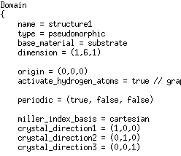
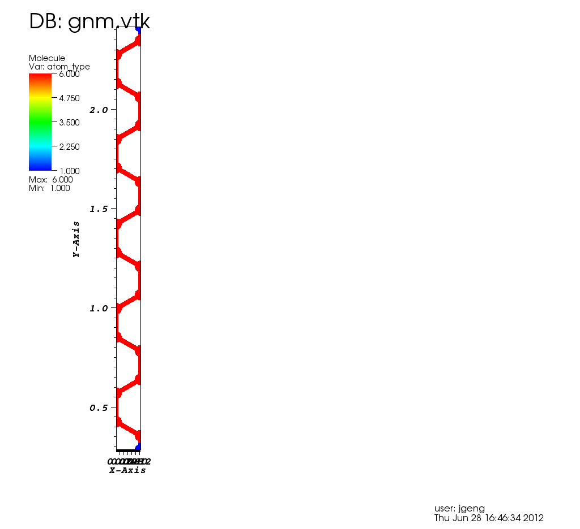
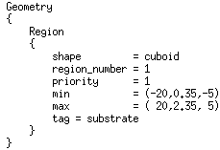
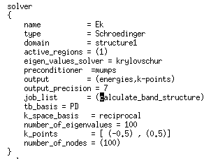
Exercise1 : 10-ZGNR
“zigzag”
1
2
3
4
y
x
9
10

Slide 24
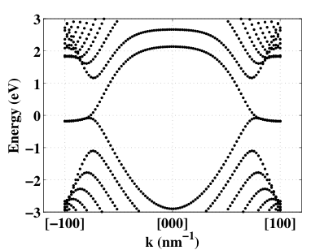
Bandstructure: 10-ZGNR
Zigzag edges give metallic behavior

Slide 25
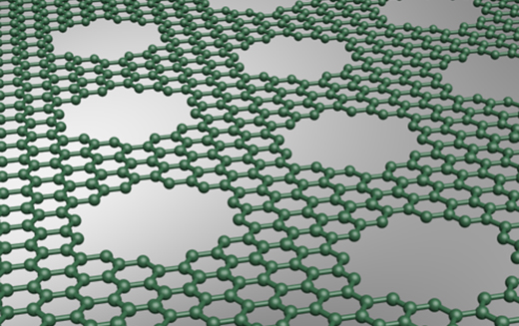
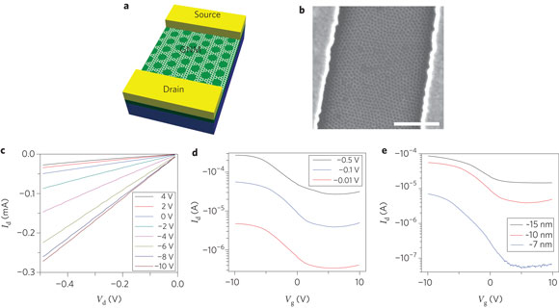
Graphene Nanomeshes
http://today.ucla.edu/
J. Bai et al. Nature Materials 5, 190-194 (2010)

Slide 26
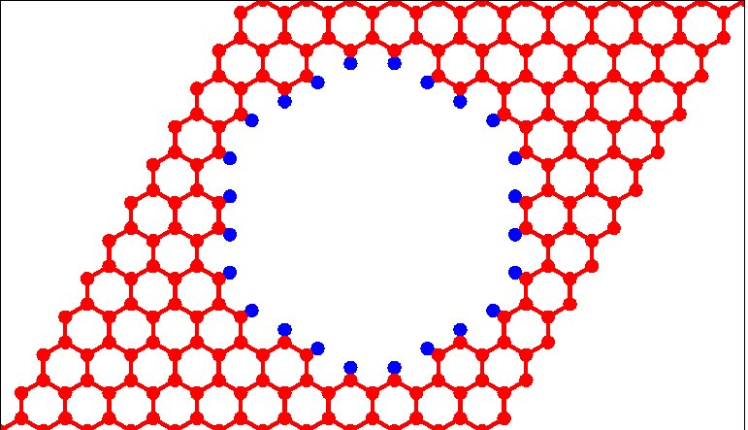
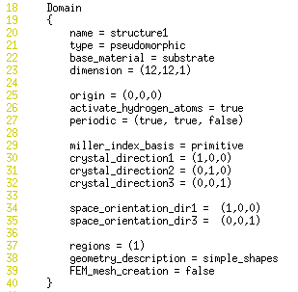
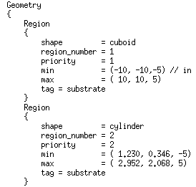
Example 2: Graphene Nanomesh
12 unit cell
7 unit cell
12 unit cell
Region 1 defines the graphene supercell
Region 2 defines a hole
Only include region 1 in the domain
Higher priority in the hole region

Slide 27
Bandstructure: GNM
12 unit cell
7 unit cell
E_{g} = 0.75 eV
12 unit cell
Flat bands in the middle of the bandgap
Need to visualize the wavefunction at the Γ point

Slide 28
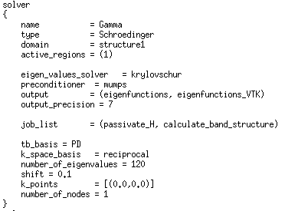

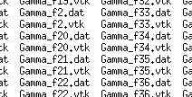

Wavefunction Visualization
A new directory
That stores all wavefunction files

Slide 29
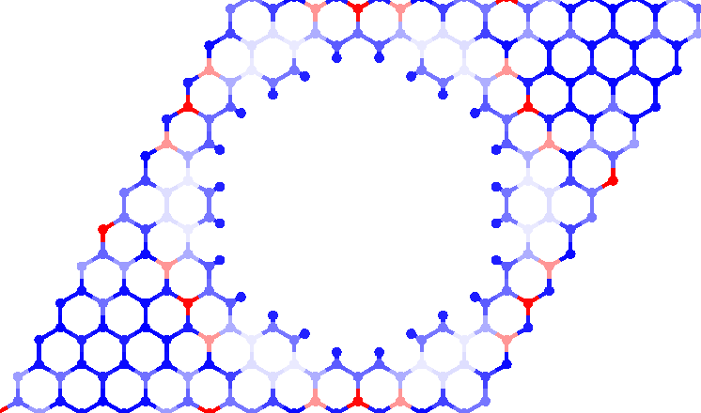
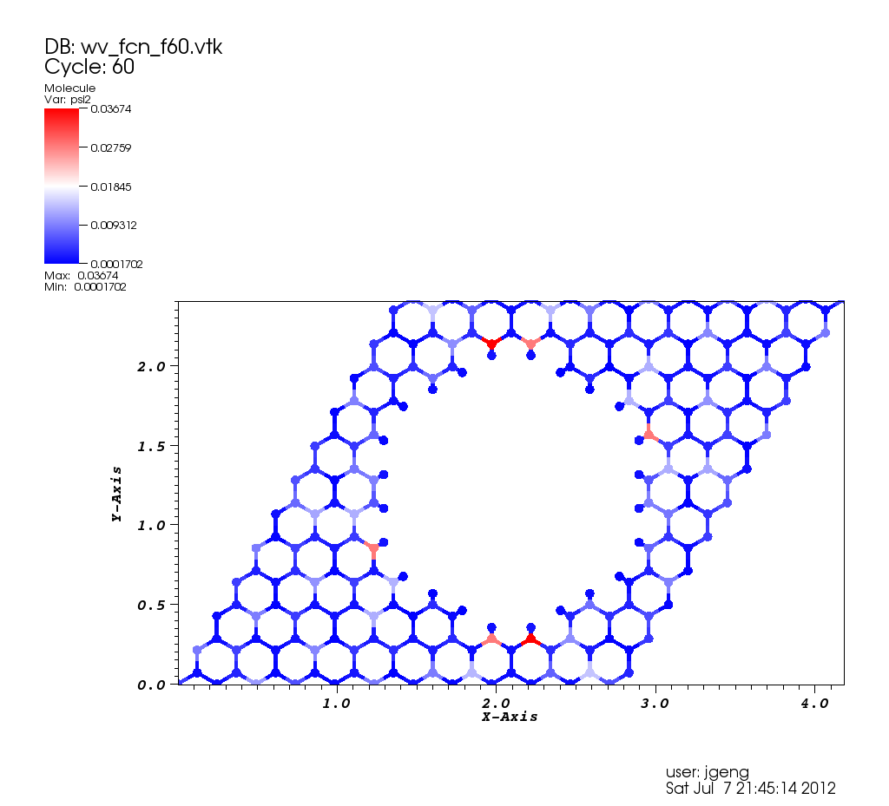
GNM: Edge state
d = 7 uc
High
Propagating state
Low
Localized state
zigzag
Wavefunctions on the flat band are localized at the zigzag edges

Slide 30

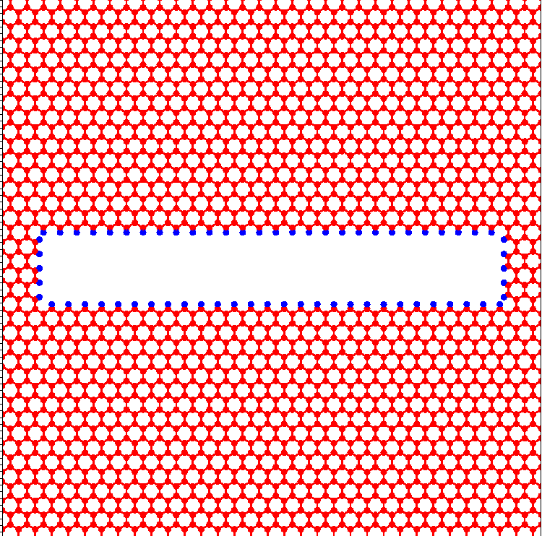
Exercise 2: Graphene Nanomesh
Exercise:
Define a graphene nanomesh of 8nm x 8nm with rectangular hole 7nm x 1nm.
Plot bandstructure along x and y.
Obtain and visulize wavefunctions at Γ point
8nm
a₀= 0.142nm
a₁
y
1nm
x
7nm
a₂
8nm

Slide 31
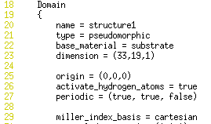
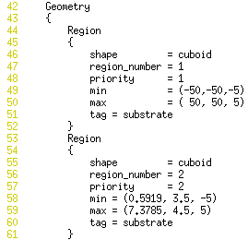
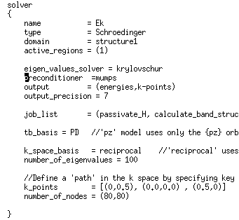
Exercise 2: Graphene Nanomesh
Structure:
8nm
1nm
7nm
8nm

Slide 32





Bandstructure and Wavefunctions
High
Low
Edge state at the zigzag edges
[010]
[100]

Slide 33
Thank you !

Slide 34



Example 2: Graphene Nanomesh
12 unit cell
5 unit cell
12 unit cell
Hole defined here:
Material is only defined for region 1

Slide 35

Bandstructure: GNM
How can we visualize electron wavefunctions at Gamma point?

Slide 36
Wavefunction Visualization
A new directory
That stores all wavefunction files

Slide 37


Wavefunction Visualization
Wave functions are
centered at edges (zigzag edges)
spread out over the total sheet

