Slide 1
Using NEMO5 to quantitatively predict topological insulator behaviour
Parijat Sengupta, Tillmann Kubis, Michael Povolotskyi, Jean Michel Sellier, Jim Fonseca,
Gerhard Klimeck
Network for Computational Nanotechnology (NCN) Electrical and Computer Engineering Purdue University, West Lafayette IN, USA
psengupta@purdue.edu
Summer School 2012

Slide 2
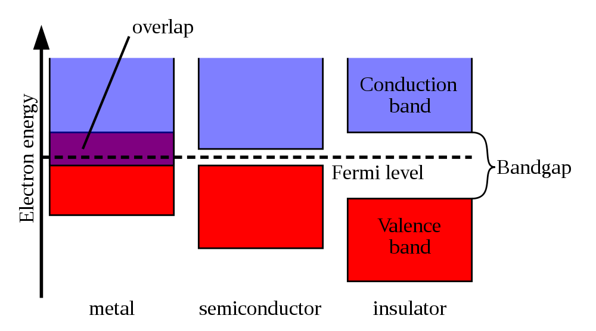
Some commonly known facts
*
*Wikipedia

Slide 3
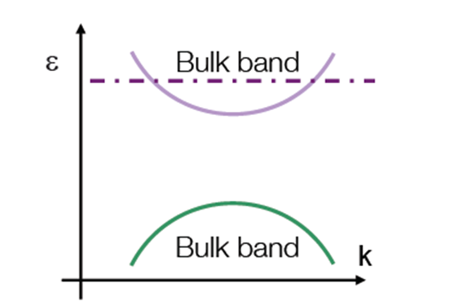
A dispersion cartoon
Conduction band
E_{g}
Valence band
An insulator such as SiO₂, Si₃ N₄ with
large band-gap
Conduction and Valence bands describe electrons and holes
The band gap is zero in a metal
Some materials possess the dual properties of metals and insulators
We will use NEMO5 to investigate some of these unique materials

Slide 4
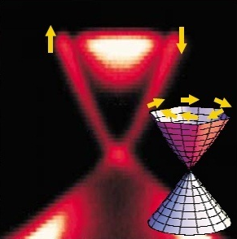
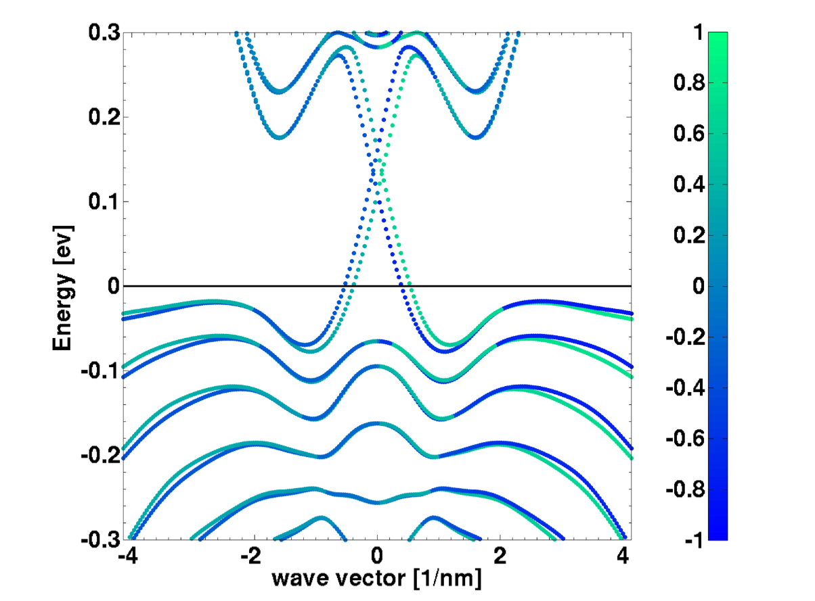
What are these materials?
Dispersion obtained through ARPES*
sp³d⁵s* tight binding calculation
Dirac Cone
*Rev of Mod. Phys, Vol 82, Oct-Dec 2010
ε
Primary examples are Bi₂Te₃ , Bi₂Se₃ , Bi_{x}Sb_{1-x} etc…
They are known as topological insulators
These materials contain bound surface states
κ

Slide 5
Setting up the simulation task
sp³d⁵s* tight binding calculation
We will use a sp³d⁵s* tight binding model
Bi₂Te₃ is our topological insulator material
A 9 nm (appx) long quantum well will be the target device
This will produce a band structure as shown on left
Dirac Cone
Key feature of this dispersion is a graphene-like linear character (Dirac cone)
Linearity is not due to same reason as in graphene!

Slide 6
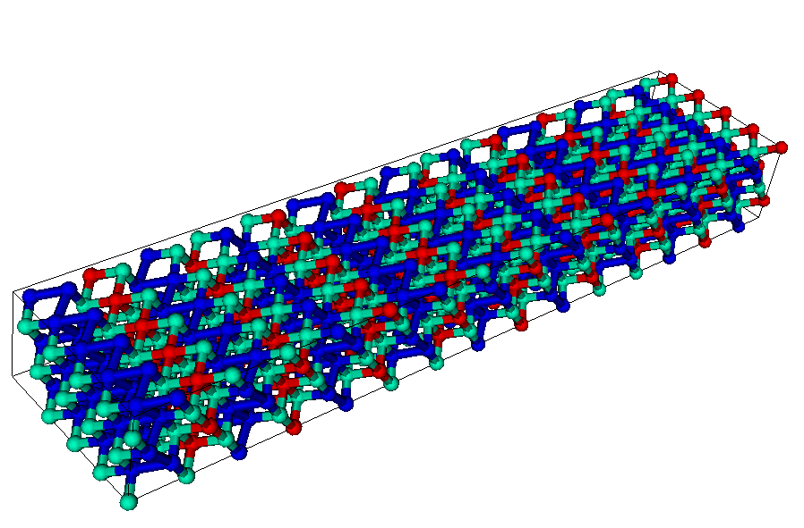
Details of the simulation structure
9 nm wide c-axis oriented Bi₂Te₃ thin film
Z-axis : Confined
X & Y axes : Periodic
Bi terminated surface
periodic
Bi
Te1
periodic
Te2
Te terminated surface
Different surface termination: Surface 1 (2) is Bi (Te2) terminated

Slide 7
The NEMO5 input deck skeleton
There are 3 blocks in the input deck:
Structure
{
}
Defines material and simulation domains
Solvers
{
}
Sets up simulations that has to be solved, e.g. equations,
boundary conditions, iterative processes, output,
numerical options, etc.
Global
{
}
Defines global variables such as temperature, which database file to use, diagnostic output, etc.

Slide 8
The NEMO5 input deck: The first block “Structure”
Structure
{
}
Material
{
name = XYZ
…
}
Material
{
name = ABC
…
}
Domain
{
name = device
…
}
Domain
{
name = contact1
…
}
Geometry
{
}
Materials
Domains for simulations
Description of the geometry

Slide 9
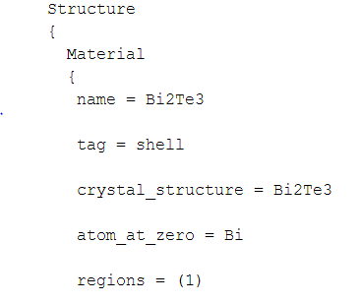
Setting the input deck…
Every input deck begins with the Structure group
Each region is identified by a name known as the tag
The underlying crystal structure of the material needs to be provided
Each simulation can have multiple regions, NEMO5 needs the exact number of those for correct execution
The surface atoms can be controlled by asking NEMO5 to place a specific atom when constructing the first unit cell

Slide 10
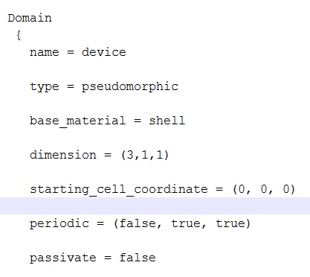
Defining parameters and the domain
Any parameter defined in the input deck takes precedence over the corresponding database entry
Dimension creates a canvas of unit cells
Periodicity set as false refers to a confined axis → k is not a good quantum number
Passivate options allows inclusion of Hydrogen atoms

Slide 11
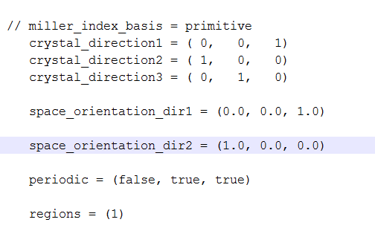
Crystal orientation in NEMO5
Crystal directions set up the coordinate system within the crystal using the basis vectors
The basis vectors are aligned to the Cartesian axes through the space orientation option
In this example: crystal_direction1 = (0,0,1) is aligned along space_orientation_dir1 = (0,0,1) or the z-axis.
You need to specify only 2 directions. N5 computes the third using the crystal structure info.
space_orientation_dir1 is the z-axis and is confined: the first entry of periodic option

Slide 12
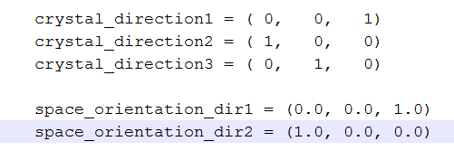
“crystal_direction” & “space_orientation”: A closer look
What NEMO5 internally produces ?
It produces three basis vectors
These basis vectors can be obtained by examining the first three lines of the device_coupling.dat file
To obtain this file, include output = (xyz, coupling) in the Domain section. You will see an example of it in your first exercise
Three vectors in the device_coupling.dat file
a = [0 0 3.0487]
b = [0.4383 0 0]
c = [-0.2191 0.3796 0]
How do you check that these vectors make sense?
All length units are in nm

Slide 13
Reconciling results to known crystal geometry
Our test case here is Bi₂Te₃ which has a hexagonal base
Each edge of hexagon is 0.4383 nm
Two hexagons are displaced along z-axis by 3.0487 nm
c
Three vectors in the device_coupling.dat file
a = [0 0 3.0487]
b = [0.4383 0 0]
c = [-0.2191 0.3796 0]
b
Check:
Hexagonal base of Bi₂Te₃ quintuple layer
The vectors b and c have an 120 degree angle between them
Norm of vectors b and c is equal to 0.4383 nm
Norm of vector a is equal to 3.0487 nm
Angle between b and c is 120⁰ as expected

Slide 14
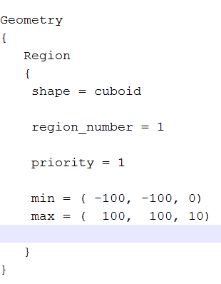
The actual geometry in numbers
Shape options allows you to input a geometric shape for your device
Setting the priority gives you control over structure creation when dealing with composite geometric shapes.
Higher priority gets constructed first
Actual device size is specified through min & max

Slide 15
The NEMO5 input deck skeleton
There are 3 blocks in the input deck:
Structure
{
}
$$☑$$
Defines material and simulation domains
Solvers
{
}
Sets up simulations that has to be solved, e.g. equations,
boundary conditions, iterative processes, output,
numerical options, etc.
Global
{
}
Defines global variables such as temperature, which database file to use, diagnostic output, etc.

Slide 16
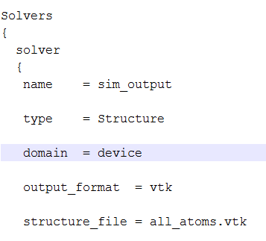
Executing the input deck: The solvers!
Each solver has a name
The first solver (usually) is the geometry constructor
The atomic coordinate positions are dumped out in a structure file
The structure file can have several formats such as vtk, silo, xyz, pdb…

Slide 17
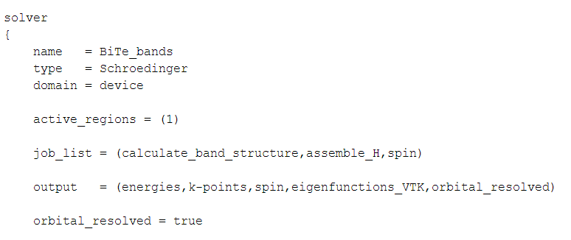
Electronic structure calculation options - I
Electronic structure calculation must set the type to Schroedinger
job_list shows what actions N5 must perform
Setting orbital_resolved to true shows the contribution of each orbital to overall band structure

Slide 18
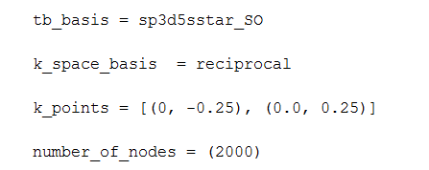
Electronic structure calculation options - II
tb_basis option lets you choose the band structure calculation model.
tb_basis can also be set to effective mass (em)
k_space_basis can also be set to Cartesian
Number of nodes → Number of k-points in the chosen k interval

Slide 19
The NEMO5 input deck skeleton
There are 3 blocks in the input deck:
Structure
{
}
$$☑$$
Defines material and simulation domains
Solvers
{
}
Sets up simulations that has to be solved, e.g. equations,
boundary conditions, iterative processes, output,
numerical options, etc.
$$☑$$
Global
{
}
Defines global variables such as temperature, which database file to use, diagnostic output, etc.

Slide 20
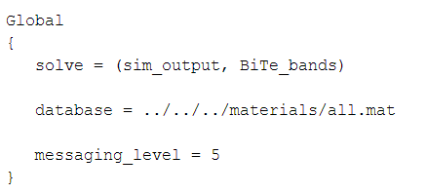
Putting it all together…
The global section has the command solve: All job names are included under solve
database is custom built for N5 and contains all material parameters
messaging level indicates code progress output on screen. Level 5 is verbose

Slide 21
Exercise -I
Log in to your workspace account and create a folder TI in your home directory. Navigate to the TI folder
mkdir TI
cd TI
Pull the necessary files in your TI folder by typing the following :
cp ../public_examples/NCN_summer_school_2012/
Topological_Insulators_psengupta/ex*.in .
cp ../public_examples/NCN_summer_school_2012/
Topological_Insulators_psengupta/spin_analysis_ex*.m .
ex1.in is the input file to calculate the dispersion relationship for a 9.0 (appx) long Bi₂Te₃ quantum well
Submit a job by typing the command :
submit -v ncn-hub@coates -i ../all.mat -n 16 -N 8 nemo-r8028 ./ex1.in

Slide 22
What do you expect to see as a solution?
NEMO5 will produce four files (SS12_TI_ex1_*.dat)
Start MATLAB on your workspace
Your folder has a MATLAB file called spin_analysis_ex1.m
Execute the MATLAB script by typing spin_analysis_ex1 at the command prompt
You will have the figure on your left!
Band structure for a 9.0 nm long Bi₂Te₃ quantum well
To run Matlab:
$ use matlab-7.12
$ matlab

Slide 23
Exercise –I contd…
Pre-computed results are stored in folder /public_examples/NCN_summer_school_2012/Topological_Insulators_psengupta
Supplementary exercise :
Change line 20 of the spin_analysis_ex1.m file from the preset
n = [1 0 0] to n = [0 0 1] and n = [0 1 0]
Run Matlab
The three different spin-polarized plots that you obtain highlight a fundamental theory of TIs

Slide 24
Inter-linking solvers in NEMO5
Several solvers defined in the Solver block can be inter-linked:
Solver1
{
}
Solver2
{
}
We will see a specific example of this coupling of solvers in the next part of the tutorial
Solver3
{
}

Slide 25
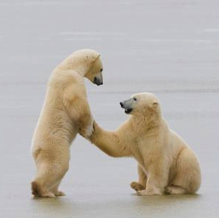
NEMO5 is a toolbox….
solve = (struct, schrödinger, poisson)
Start
Density solver (e.g. Schrödinger)
Update ɸ
Potential solver (e.g. Poisson (ɸ))
No
Yes
Conv ?
Solvers can also speak to one another
e.g. A self-consistent charge calculation
End

Slide 26
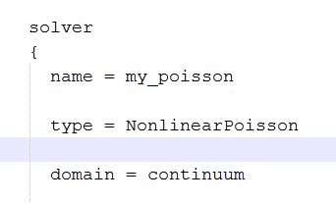
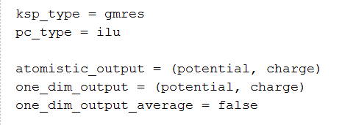
Setting up the Poisson…
A name is assigned to the Poisson solver (similar to previous slides)
A non-linear Poisson will be solved
A continuum domain is constructed
Linear solver settings
Electrostatic output option

Slide 27
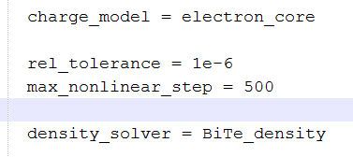
Linking Poisson to Schroedinger…
Specific model applicable to topological insulators
Convergence criterion
The simple linking step done through inserting name of desired solver
job_list tells NEMO5 to compute specific physical quantities
For a self-consistent calculation electron density is computed

Slide 28
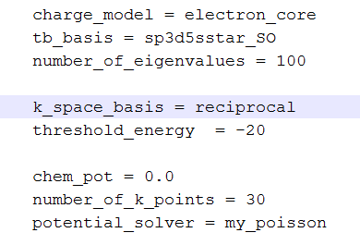
A few options in the density solver
First two blocks of input statements are identical to normal eigen value calculations done earlier
threshold_energy lets you choose eigen states beginning with energy as set in the option
chem_pot is the Fermi level to start calculations
Schrodinger receives the potential from the my_poisson potential solver
Inter-linking solvers : my_poisson and BiTe_density
More advanced calculations can use boundary condition options

Slide 29
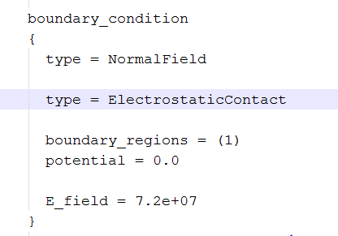
Implementing boundary conditions
Boundary conditions can be of two forms in NEMO5.
Dirchlet (potential (ɸ) = constant)
Neumann (∂ɸ = constant)
The input deck statements shown on left can be included multiple times at all possible external boundaries
The right boundary region number must be specified
E_field allows to apply an electric field of certain magnitude to device structure. It is in units of V/cm

Slide 30
Updating Schrödinger for eigen states calculation
Exactly same format as in Exercise 1
Potential solver is added which supplies potential to the tight - binding Hamiltonian

Slide 31
Exercise -II
ex2.in is the input file to calculate charge self-consistent dispersion relationship for a 9.0 (appx) long Bi₂Te₃ quantum well
This task will produce a dispersion relationship, potential landscape, and the charge profile in the device
Submit the job by typing the command :
submit -v ncn-hub@coates -i ../all.mat -n 16 -N 8 nemo-r8028 ./ex2.in

Slide 32
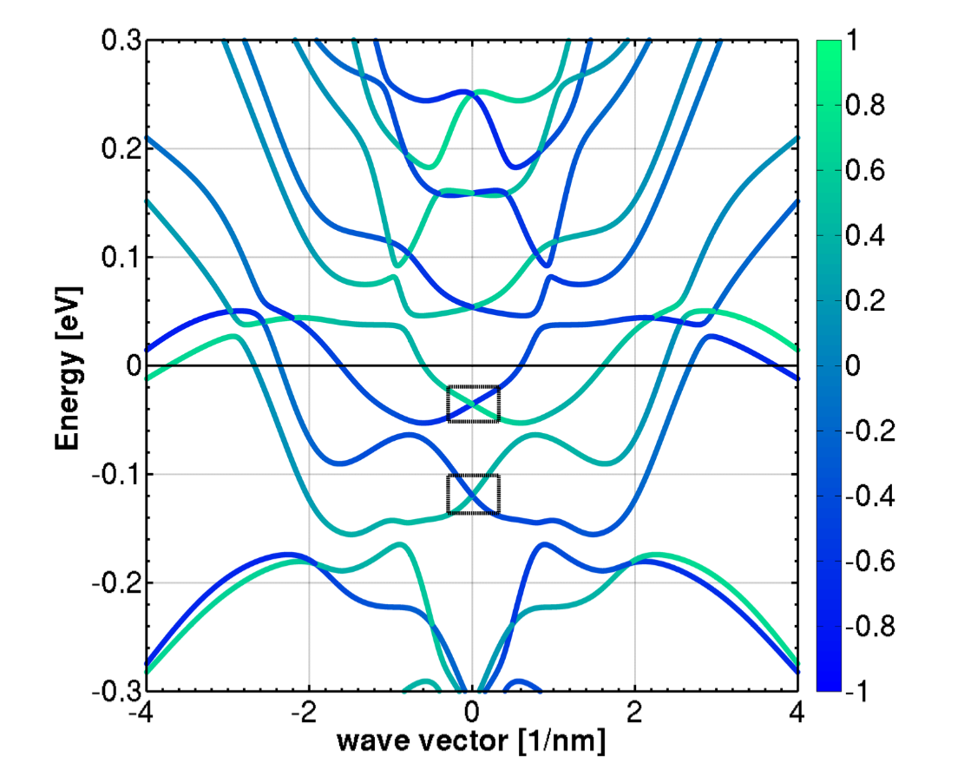
What do you expect to see as a solution?
NEMO5 will produce four .dat files (SS12_TI_ex2_*.dat) and a .xy file (poisson_ex2.xy)
Start MATLAB on your workspace
Your folder has a MATLAB file called spin_analysis_ex2.m
Execute the MATLAB script by typing spin_analysis_ex2 at the command prompt
You will have the figure on your left!
Self-consistent band structure for a 9.0 nm long Bi₂Te₃ quantum well

Slide 33
Electrostatic calculations
Use the poisson_ex2.xy file (three column file) in your folder to plot the charge and potential profile
Start MATLAB on your workspace
Type the following for the charge & potential plot :
cp = load(‘poisson_ex2.xy’);
% potential plot
figure(1)
plot(cp(:,1), cp(:,2))
% charge plot
figure(2)
plot(cp(:,1), cp(:,3))
You can also use any plotting software :
Please remember : Column 1 is device coordinate followed by potential and charge data on columns 2 and 3

Slide 34
How do the results from Exercise I and II look like?
Self-consistent electronic structure
Schrödinger 20 band tight binding
Poisson calculation has large impact:
Energy separation between Dirac cones gets enhanced
Fermi velocity of Dirac states changes (mobility)
Dirac points move below the Fermi level, into the bulk DOS

Slide 35
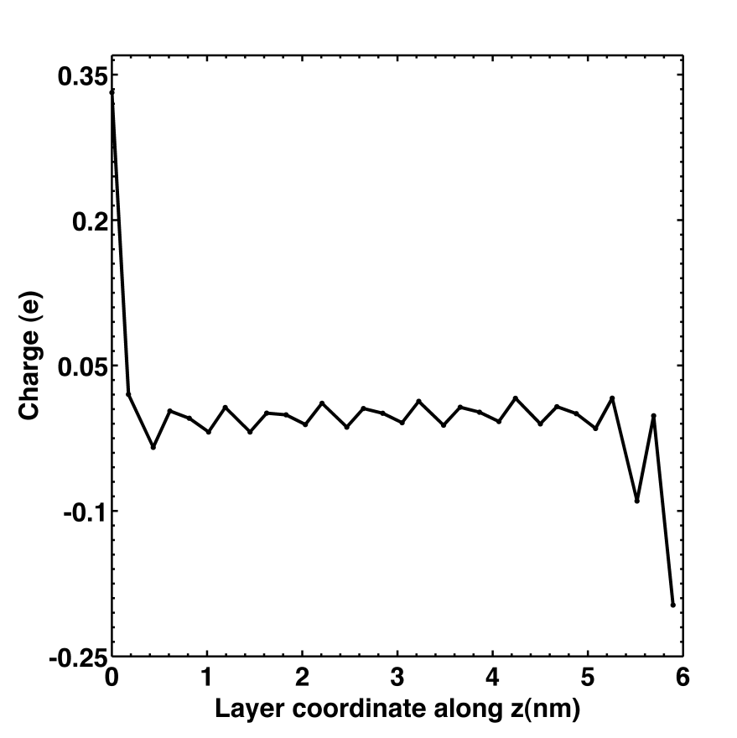
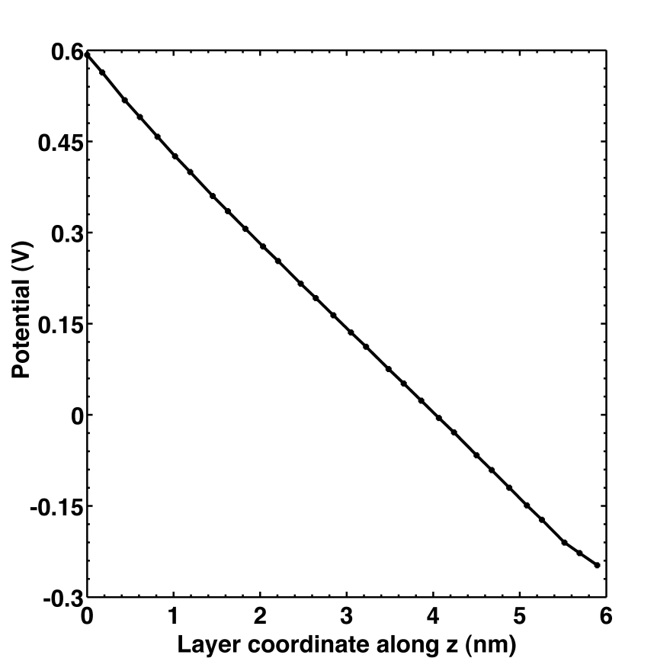
Self-consistent electrostatic calculations
Bi terminated surf.
Intrinsic dipole due to distinct surfaces
Common in TB:
Charge oscillations between atom types
Te terminated surf.
Smooth perturbative potential
Oscillations in the potential between anion/cation covered by bulk parameters
Change of charge polarity at two surfaces due to different atomic termination

Slide 36
Conclusion
Band structure calculations
Can handle the newest materials like topological insulators
Charge self-consistent band structure calculation
For accurate device prediction
Use of solvers to accomplish modular tasks
As many solvers as needed can be added
Solvers can be inter-linked
Simple process accomplished by inserting appropriate solver name
Thank you.

Slide 37
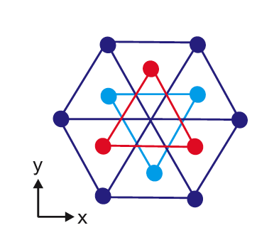
Crystal Structure of Bi₂Te₃ and tight-binding representation
Bi₂Te₃
Devices represented atomically in their native rhombohedral crystal structure
Electronic structure calculations with atomistic tight binding sp³d⁵s* 20 band model
Te
5 atom unit cell
Bi
quintuple layer
Te
Inequivalent Te atom
Bi
Te
Quintuple layer ordered as Te(1) - Bi(1) -Te(2) - Bi(1) - Te(1)
Inequivalent Te atom serves as centre of inversion

