Slide 1
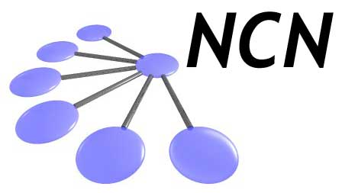
Device Simulation: Transport (Double Gate MOSFETs)
Network for Computational Nanotechnology (NCN)
Mehdi Salmani Jelodar, Seung Hyun Park,
Zhengping Jiang, Tillmann Kubis,
Michael Povolotsky, Jim Fonseca,
Jean Michel Sellier, Gerhard Klimeck
msalmani@purdue.edu
Network for Computational Nanotechnology (NCN)
Electrical and Computer Engineering
Purdue University
1

Slide 2
Outline
Device Modeling Approach
Device Simulation Test Samples
Device structure
Sample input decks: input parameters description
Output files and MATLAB scripts
*.VTK files: structures / charge distribution
MATLAB scripts: Extract ON-current, S.S, and DIBL from I-V characteristics
Band structure calculation and effective mass extraction

Slide 3
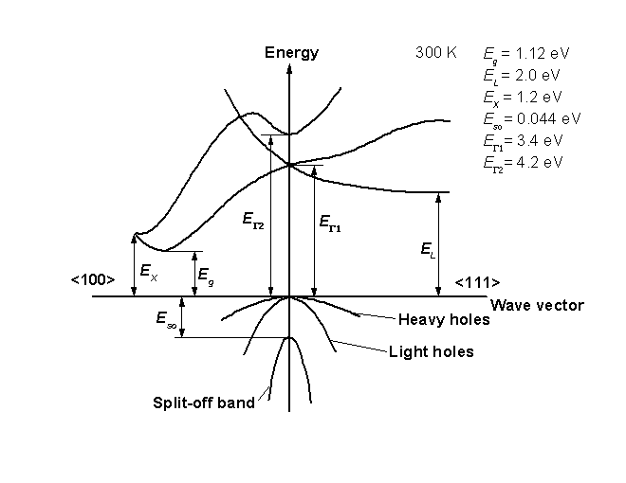
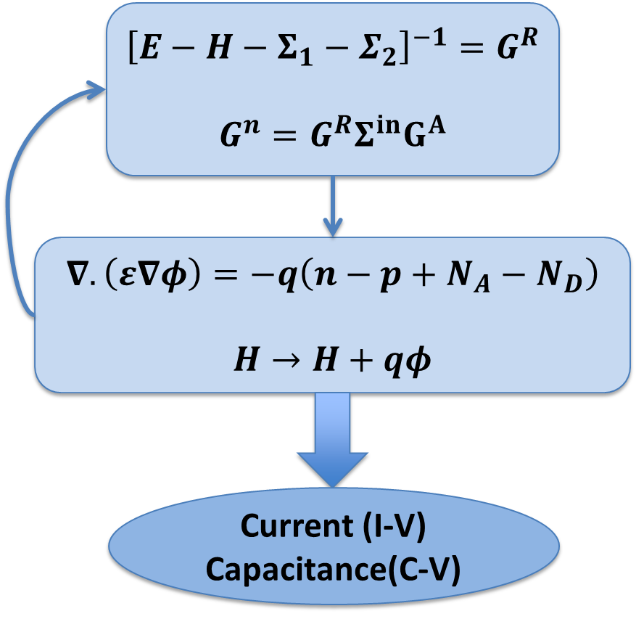
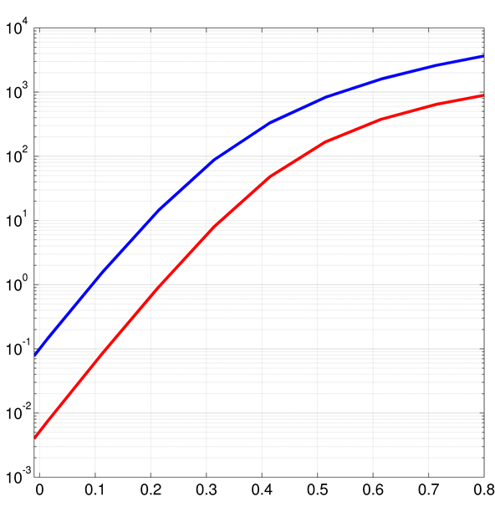
Device Modeling Approach
Input
NEMO5
Output
Post Processing
m* from Full Band / Literature,
Band offset, Electron affinity
2-D / 3-D NEGF (or transfer matrix) & Poisson Solver:
Effective Mass Approximation
Like: I_{D}-V_{G} characteristics,
Charge distributions
Extract Device Performance Parameters:
ON-current, S.S, and DIBL
I_{ON}
SS=60

Slide 4
Device Simulation Set-Up
L_{CH}
L_{CH}
L_{S}
Gate
L_{D}
L_{S}
Gate
L_{D}
SiO₂
T_{OX}
SiO₂
T_{OX}
Source
Si Channel
Drain
Source
Si Channel
Drain
T_{CH}
SiO₂
SiO₂
Gate
T_{CH}
L_{CH}
L_{S}
L_{D}
T_{ox} (EOT)
N_{S,D}
5nm
11nm
10nm
10nm
0.6nm
1e20 cm⁻³
Simulation Features (ITRS 2020):
Channel material: Si
SiO₂ as dielectric material
Channel length / thickness : 11 nm / 5nm
Doping concentration: 1e20 cm⁻³

Slide 5
Required Files on Workspace
1. Go to:
/apps/share64/nemo/examples/current/public_examples/TransportDG/
Subfolders:
MatlabFiles
TB2EMInputDecks
TransportInputDecks
outputs_VD005
outputs_VD068

Slide 6
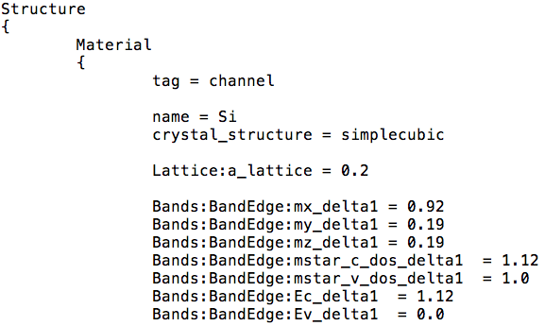
Device Simulation Test Samples
Read the sample input deck: ./TranportInputDecks/inputDeckMetaDG.in
Structure:
First block defines tag, material, crystal structure, and lattice size
Second block addresses effective masses (mx, my, mz), also multi-valley can be defined by using multiple delta
In third block, band gap can be modulated.
Fourth block defines doping type (N/P), and doping concentration.
Also, different region number must be assigned to each material.
3 effective masses (m*_delta1, m*_delta2 and m*_delta3) are for 6 degenerate valleys.

Slide 7
Device Domain
Device Domain:
In the first block, the domain name, type can be defined.
base_material is the channel material for the central of device.
passivation_regions is for the oxide areas in case of necessary (TB usage)
In second block, dimension creates a canvas of “unit cells”, representing total dimension.
periodic sets a “false” refers to a confined axis along k direction.

Slide 8
Device Domain (cont.)
Device Domain:
In the first block, the coordinate system within the crystal_direction can be set up.
In space orientations first one is the first entry of periodic option. Only 2 directions need to be specified. NEMO5 computes the third using the crystal structure info.
In the second block, the starting cell coordinate is determined.
The contact and geometry description are shown in the third block. (Some output can be generated by de-commenting the output line.)

Slide 9
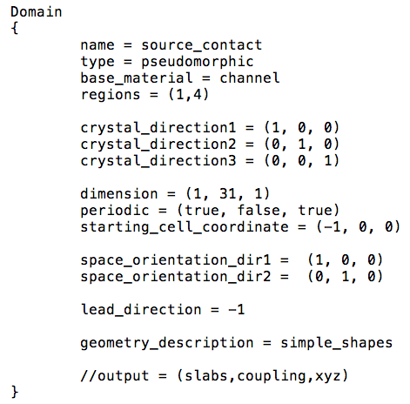
Device Domain (cont.)
Device Domain:
In the first block, the domain name, type can be defined.
Same material is used for contacts -> base_material = channel
In the second block, the contact direction (lead_direction) can be specified.
“-1” indicates the direction of the incoming electrons. This means that n=1 for +x, n=-1 for -x, n=2 for +y, and n=-2 for –y.

Slide 10
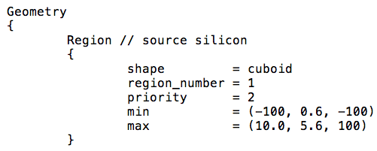
Device Geometry
Device Geometry:
Each component has an order of information as shown in the below.
Firstly, base shape of the region, and previously assigned region_number need to be addressed.
In min and max, the exact location and size can be adjusted. Unit is [nm]
Secondly, priority must be assigned for each component. This arranges the order of overlapping when the whole structure is built.
SiO₂
1
Si (source)
2
Si (channel)
2
Si (drain)
2

Slide 11
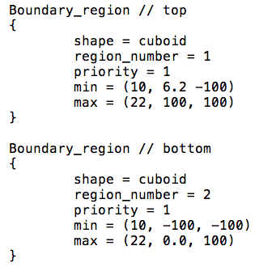
Device Geometry (cont.)
Device Geometry:
Top and bottom gates must be defined as same way as other components.
However, Boundary_region must be used as the tag for contacts instead of Region used in the other components.
The gates (min and max) are normally sandwiching the insulator (SiO₂) and channel regions.

Slide 12
NEMO5 Meta-Solver (1)
Meta-solver:
First it determines the solver’s name and type. By type NEMO5 will look for “MetaUTBTransport.py” in . / Meta
In transport_type it can be transfer_matrix or NEGF. For EM modeling usually transfer_matrix is faster.
We need to determine transport domain, active regions, prefix of of all output files names and as many contacts we have in the device.
In the second part, the applied voltages to source, drain and gate(s) are set up.

Slide 13
NEMO5 Meta-Solver (2)
In first unit:
Poisson will provide the potential otherwise it will be zero.
tb_basis will determine the type of tight-binding basis should be used
Charge_self_consistant make it self-consistent with the NEGF or semi-classical (by turning on use_semiclassical_potential)
In second unit:
Number_of_enegry_points and numbe_of_momentum_points determine the number of E and K.
Momentum_intervals determines the region of calculations in Brillouin Zone.
Momentum_space_degenracy determines the degeneracy factor (2 for degeneracy and 2 for making the k region just in positive space)

Slide 14
NEMO5 Meta-Solver (3)
output will provide the required output files during the simulation and some of these info will be stored in the VTK files
output_along_path and path_points and number_of_path_points tell the simulator to dump out only information along the path with the #points precision.
enable_structure makes the structure VTK file.

Slide 15
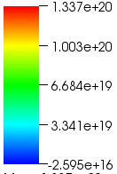
Outputs with VTK files
Device Schematic
Insulator
6.2nm
Y
Source
Channel
Drain
Y [nm]
X
0nm
0nm
X [nm]
31nm
Electron Density [/cm²]
VTK files:
*.VTK file is created in the beginning of the simulation.
The device structure can be checked by using the VTK file in Paraview / Visit.
Charge density profile for each bias points can be obtained and checked.
Off state
Y [nm]
On state
X [nm]
For regions load into visit/paraview DG2020_structure.vtk
For charge density ./outputs_VD068/DG_Ramper_X.vtk

Slide 16
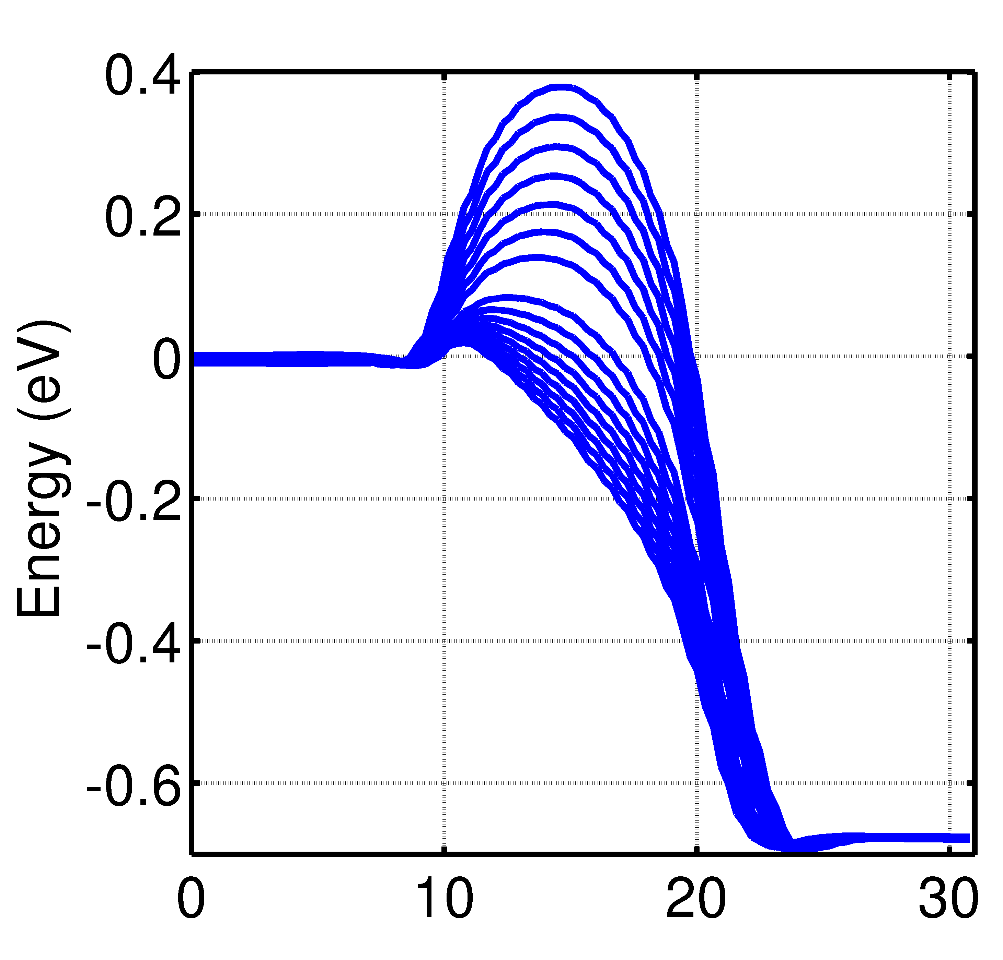
Output files and MATLAB scripts
Gate
I_{D}-V_{G} Characteristics
SiO₂
Y
Source
Si Channel
Drain
X
SiO₂
Gate
I_{D} [μA/μm]
Conduction Band edges
Si
DG UTB
S.S [mv/dec]
75
DIBL [mV/V]
78
I_{ON} [μA/μm]
5900
V_{GS} [V]
X[nm]

Slide 17
MATLAB scripts (1)
-- > Load required files and set the variables:
clear all;clc;close all;
DIR1 = ‘../outputs_VD068/'
DIR2 = ‘../outputs_VD005/'
IVVdd = load([DIR1 ‘DG_Ramper_current.dat']);
IVV05 = load([DIR2 ‘DG_Ramper_current.dat']);
Vdd = 0.68;
IdOff = 0.1; %Set the off current to 100nA/mum as ITRS
Vg = IVVdd(:,5);
Id = 1e6*IVVdd(:,4); %convert the current from Ampere to micro-Ampere
Id05 = 1e6*IVV05(:,4);
Id05 = Id05(1:length(Id));
%% Calculate Ion
VdOff = interp1(Id,Vg,IdOff,'cubic');
Ion = interp1(Vg,Id,VdOff+Vdd,'cubic')
I_{ON} = I_{D} (V_{GS} = V_{DS})

Slide 18
MATLAB scripts (2)
%% Calculate SS
[a b] = find(Id>=0.1);
SS = 1000*(Vg(a(2)) - Vg(a(1)))/log10(Id(a(2))/Id(a(1)))
SS = (V₂-V₁)/log(I₂/I₁) [mV/dec]
DIBL = (V2-V1)/(V_{DS2}-V_{DS1})
I_{D}-V_{G} Characteristics
%% Calculate DIBL
Idibl = 1; %Current is set to 1muA/mum
Va = interp1(Id,Vg,Idibl,'cubic');
Vb = interp1(Id05,Vg,Idibl,'cubic');
DIBL = 1000*(Vb-Va)/(Vdd-0.05)
I_{D} [μA/μm]
%% Plot IV
figure(1);hold on;box on;axis square;grid on;
plot(Vg,Id,'b','linewidth',3);
plot(Vg,Id05,'r','linewidth',3);
set(gca,'YScale','log'); hold off;
V_{GS} [V]

Slide 19
MATLAB scripts (3)
%% Plot conduction band
figure(4);hold on;box on;axis square;grid on;
for ii =1:N
XY = load ([DIR1 ‘DG_Ramper_' int2str(ii-1) '.xy']);
plot(XY(:,1), XY(:,3), '-b','LineWidth',2.5); %Conduction band
end
Conduction Band edges
X[nm]

Slide 20
Transport effective mass
What is effective mass (m*)?
It is determining how easily an electron moves in a material in specific condition (like direction, temperature and pressure)
$E\left(k_{x}\right)=\frac{ℏ^{2}k_{x}^{2}}{2m^{∗}}$ where $\frac{1}{m^{∗}}=\frac{1}{ℏ^{2}}\frac{d^{2}E\left(k_{x}\right)}{dk^{2}}$
$E\left(k_{x}\right)\left[1+αE(k_{x})\right]=\frac{ℏ^{2}k_{x}^{2}}{2m^{∗}}$
How to find m*?
Measure in a lab
DFT calculations (from band structure)
Tight binding approach (from band structure)

Slide 21
Band structure calculation with N5 (input deck)
→ Please look at ./TB2EMInputDecks/InAs_TB2EM.in
Determine the material (s)
Material (InAs)
Parameter set (param_Klimeck)
Domain
Periodicity (periodic = (true, true, true))
Solver
Type (Schroedinger)
Set the K space
k_space_basis = reciprocal
k_points = [(0.1,0.1,0.1),(0.0,0.0,0.0),(0.1,0.0,0.1)]
number_of_nodes = (21,21)
Calculate the effective mass (run the Matlab script TB2EM.m)

Slide 22
Extracting effective mass for InAs bulk
→ Please run the Matlab script ./MatlabFiles/TB2EM.m
Load InAs_k_distance;
load InAs_energies; plot(InAs_k_distance,InAs_energies);
box on; axis square;
Effective mass calculations:
a = 6.0583;%e-010; %[m]
hBar = 1.0546e-034;
q = 1.60217646e-19;
m0 = 9.10938188e-31;
EE = Energies(21:25,9);
dK = diff(K_distance(21:22));
EK = (EE(1)+EE(3)-2*EE(2))/((dK)^2);
mStar = (hBar^2)/EK/q/m0/1e-18;
L
$$Γ$$
X

Slide 23
Effective mass – non-parabolicity
figure(1); %Plot parabolic EK
plot(K_distance,Energies,'k','linewidth',2.5);
axis square; box on;ylim([-1 2]);
K_points = load([x '_k_points.dat']);
K = sum(K_points.^2,2);
E = (hBar^2/mStarGamma/2/q/m0/1e-18)*K;
hold on;
H3 = plot(K_distance,E+0.5942,'s-b');
ENP = (-1+sqrt(1+4*alpha*E))/(2*alpha);
H4 = plot(K_distance,ENP+0.5942,'o-r');
L
X

Slide 24
Extracting effective mass for InAs sheet
Domain
Periodicity (periodic = (true, true, false))
Solver
Set the K space
k_points = [(0.0,0.5),(0.0,0.0),(0.5,0.0)]
number_of_nodes = (21,21)
Calculate the effective mass
(run the Matlab script TB2EM.m)

Slide 25
Thank you!
Questions/feedback send me email to:
msalmani@purdue.edu

Slide 26
$${\left[E−H−Σ_{1}−Σ_{2}\right]}^{−1}=G^{R}$$
$$G^{n}=G^{R}Σ^{in}G^{A}$$
$$∇.\left(ε∇φ\right)=−q\left(n−p+N_{A}−N_{D}\right)$$
$$H→H+qφ$$
Current (I-V)
Capacitance(C-V)

