Slide 1
Advanced Portable Batch System (PBS)
Xufeng Wang, Kaspar Haume, Gerhard Klimeck
Network for Computational Nanotechnology (NCN)
Electrical and Computer Engineering
wang159@purdue.edu
khaume@gmail.com
Last reviewed May 2013

Slide 2
Overview of Education Materials
Introduction to computing clusters [Done. Summer, 2009]
Fundamentals of computers, clusters. Concept of massive computation via cluster resources.
Introduction to Subversion (originated from “Data preservation via SVN for NCN students) [Done. Fall, 2008]
Data preservation. Subversion. SVN clients on windows and mac. Data storage system. Project accesses.
Front-end machine access [by Ben Haley]
Basic Portable Batch System [Done. Summer, 2009, Review May 2013]
PBS queue system. Basic manipulations.
Advanced Portable Batch System [Done. Summer/Fall, 2009]
PBS queue system. Advanced manipulations.

Slide 3
From Basic Portable Batch System
Definition of Portable Batch System (PBS)
Composition of a PBS script
PBS job submission (qsub)
PBS queue related commands (qstat)
Simple PBS job manipulation (qdel, qselect, etc.)

Slide 4
Outline
Advanced manipulation of PBS jobs in queue
Batch jobs and job array
Job dependencies
Passing variables to jobs

Slide 5
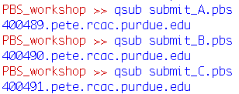
Right after the morning coffee…
Boss: “Deadline is today! Run program A, B, and C now!”

Slide 6
Hold a job
Boss: “Oh wait, hold program C! I need check first!”
How to pause a job in PBS?
qhold
The pause of a job in PBS is called “hold”.
The job can be running, or queuing.
A job being “held” basically means its execution stops. It will no longer utilize any CPU, and its state is preserved (which means it can resume at the same point later).

Slide 7
Release a job
Boss: “Nevermind. Go ahead with program C”
How to un-pause a job in PBS?
qrls
The un-pause of a job in PBS is called “release”.
If a previously queued job was held, and then released, it will be in “queued (Q)” state again; if it was running (R), it will be in “waiting (W)” state upon release.

Slide 8
Move and modify a job
Boss: “Hmm! Job A will take about 6 hours to run!”
How to move a job to new queue in PBS?
qmove
How to modify a queued job’s walltime?
qalter
The above two actions can only apply to “queued” or “held” jobs, not to others such as “running” jobs.

Slide 9
Reorder a job
Boss: “Sorry! I meant job B, not A.”
How to reorder jobs in PBS?
qorder
In PBS, you can only exchange the queue order between two jobs.
You cannot really “squeeze” a job into a certain position, but rather you have to “swap”.
You can only reorder jobs that are either “queued” or “held”.
Error

Slide 10
Reorder a job
How to reorder jobs in PBS?
qorder
PBS reorder will swap the jobs, not their queues! Queues are like seats; they do not move when two persons are switching seats.
The 10 hours walltime is not acceptable in standby. That’s what the error means.
In this case, we have to modify the walltime first, and then reorder.
Final

Slide 11
Summary
Advanced manipulation of PBS jobs in queue
Command | Usage | Q jobs? | R jobs? | H jobs?
qhold | Hold a queued/executing PBS job | Yes | Yes | No
qrls | Release a held PBS job | No | No | Yes
qmove | Move jobs between queues | Yes | No | Yes
qalter | Alternate the attributes of a PBS job | Yes | No | Yes
qorder | Reorder PBS job | Yes | No | Yes

Slide 12
Job array
Boss: “Good! Sweep program D. With inputs 1:1:100!”
How to sweep jobs in PBS?
#PBS -t
Often, we need to sweep a certain parameter of a program, thus creating an “array” of similar but “incoherent” jobs.
Such things can be archived by writing some shell script generating PBS scripts one by one, or some other “pre-processing” method.
PBS has inherent support for such batch of similar jobs. This concept is called a “job array” in PBS.

Slide 13
Job array
PBS job array
#PBS -t
……
…
Input=4
Job[4]
PBS script
Input=3
Job[3]
Input=2
Job[2]
Input=1
Job[1]
Key characteristics of job array is “different parameters, but same executable”.

Slide 14
Job array
How to form a job array
#PBS -t
#PBS –t 1-10 creates 10 instances the job, indexed 1 to 10.
Environmental variable PBS_ARRAYID corresponds to the index of each array element.
Each job runs with the commands specified in the script, meaning that if procs had been set to 10, then each job will run with 10 cores
In this case job[1] will run helloworld_1 and output to output_1.txt

Slide 15
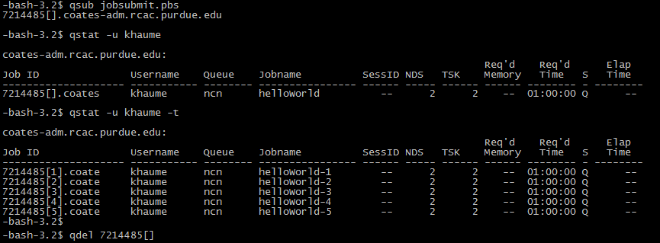
Job array
Submit the job array
#PBS -t
Array jobs have unified IDs with index, like array values in MATLAB
Use qstat with option –t to see the individual jobs
Job ID for the entire job array has to contain empty brackets
To refer to one of the jobs, use the brackets, qstat –f 7214485[1]

Slide 16
Job array
PBS job array extensions
#PBS -t
… | …
4 | A=0,C=2
3 | D=3,C=1
2 | A=4,C=5.4
1 | A=1, B=4.5
…
Job[4]
PBS script
Job[3]
Job[2]
Job[1]
By using a table or certain method or relating the index to a set of parameters, users can have great flexibility in batch job inputs.

Slide 17
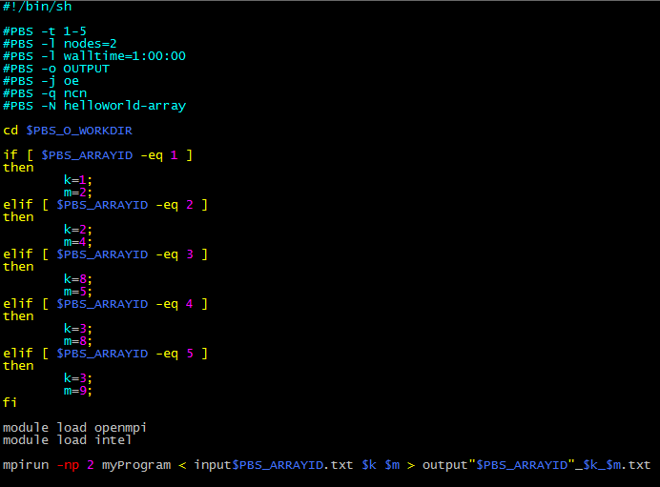
Job array
PBS job array extensions
#PBS -t
An example of relating ARRAYID to job input parameters.
Here myProgram takes an input file and two arguments, all determined by the array ID

Slide 18
Job dependency
Boss: “Post process results from D with E. If D fails, run F.”
How to stage one job’s execution upon the completion of another?
#PBS -W
PBS as a “Batch System” manager has the ability to arrange the execution order of a series of jobs and decide which to run upon the outcome of others. This is called “Job Dependency”.
User can now specify a list of jobs to run with different execution conditions. This allows a user to submit these jobs at once and leave them to PBS.

Slide 19
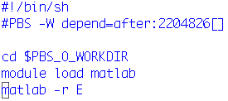
Job dependency
Specify job dependencies
#PBS –W depend
Job dependency specification
submit_E.pbs
“PBS –W depend=“ is the line for specifying dependency.
Immediately following is the dependency condition, which in this case is “after” (after job has begun executing).
Immediately following the condition is the job ID of the depended job. In this case, it is a job array.
For dependency condition of failed execution, “afternotok” is the keyword:
submit_F.pbs

Slide 20
Job dependency
Specify job dependencies
#PBS –W depend
Before D finishes
If condition not yet met, the jobs will initially hold
All jobs with dependencies will start in status of “hold”.
If its dependency condition is met, its status will change to “queued” and start execution as soon as possible.
The job might remain in the queue forever or be removed if its depended job is lost, deleted, or would never satisfy its condition, . You have to be careful with these residues.
After D finishes

Slide 21
Job dependency (after)
Specify job dependencies
#PBS –W depend
With many types of dependency conditions available, the user is able to schedule the execution of jobs upon the outcomes of others, and thus build a complicated network of jobs with deep and nested dependencies.
 | This job may begin…
after | After depended job has started execution
afterok | After depended job has successfully terminated
afternotok | After depended job has terminated with errors
afterany | After depended job has terminated with or without errors

Slide 22
Job dependency: example (after)
Specify job dependencies
#PBS –W depend
Standard output of qsub is the job ID. Let’s use that
Write shell script (here newjob.pbs)
Turn into executable and run it as a batch file

Slide 23
Job dependency (before)
Specify job dependencies
#PBS –W depend
It is also possible to tell a job to run before another job. This can be useful if many jobs should run before a given job.
The commands are like those for after
Example on next slide
 | Depended job may begin…
before | When this job has begun execution
beforeok | When this job has terminated successfully
beforenotok | When this job has terminated with errors
beforeany | When this job has terminated with or without errors

Slide 24
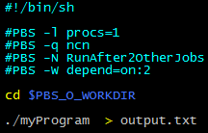
Job dependency: example (before)
Specify job dependencies
#PBS –W depend
The job that should run after a series of jobs must have the command #PBS –W depend=on:count where count is the number of jobs that this job depends on. Submit it and note the ID.
The count other jobs that should run before then get any of the before commands listed on previous slide, together with the Job ID that the depended job returned.

Slide 25
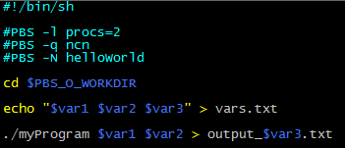
Passing Environment Variables to Job
Passing Environment Variables to Job
qsub -v
With the option –v it is possible to pass variables from the command line.
As with all qsub options, this may also be done in the pbs script
#PBS –v var1=“5”,var2=“1’,var3=“data”

Slide 26
Looking for help
Looking for help
man
If something is not clear or does not work, I encourage you to look up the function, for example man qsub or man qstat
Some websites with examples
https://wikis.nyu.edu/display/NYUHPC/Tutorial+-+Submitting+a+job+using+qsub
http://www.clusterresources.com/torquedocs21/2.1jobsubmission.shtml
http://wiki.ibest.uidaho.edu/index.php/Tutorial:_Submitting_a_job_using_qsub
The guides for the clusters
http://www.rcac.purdue.edu/userinfo/resources/
Your neighbor

