Slide 1
Lecture: Tunnel FET
Mark Cheung
Department of Electrical and Computer Engineering,
University of Virginia, Charlottesville, VA 22904, USA

Slide 2
This lecture will cover:
Field-effect transistor (FET) review
Motivation for TFET
Device design and simulation
Literature review
Simulation results

Slide 3
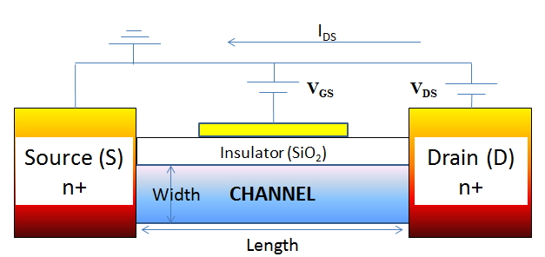
Field-effect transistor (FET) review
Switch
On: I_{D} is high
Off: I_{D} is low
Landauer Formula:
$$I_{D}=\frac{q}{h}\int_{−∞}^{∞}{dED(E−U)(\frac{γ_{1}γ_{2}}{γ_{1}+γ_{2}})[f_{1}\left(E\right)−f_{2}\left(E\right)]}$$

Slide 4
Motivation
"Intel," 2011. Available: http://www.carthrottle.com/why-chemistry-dictates-an-electric-vehicle-future/

Slide 5
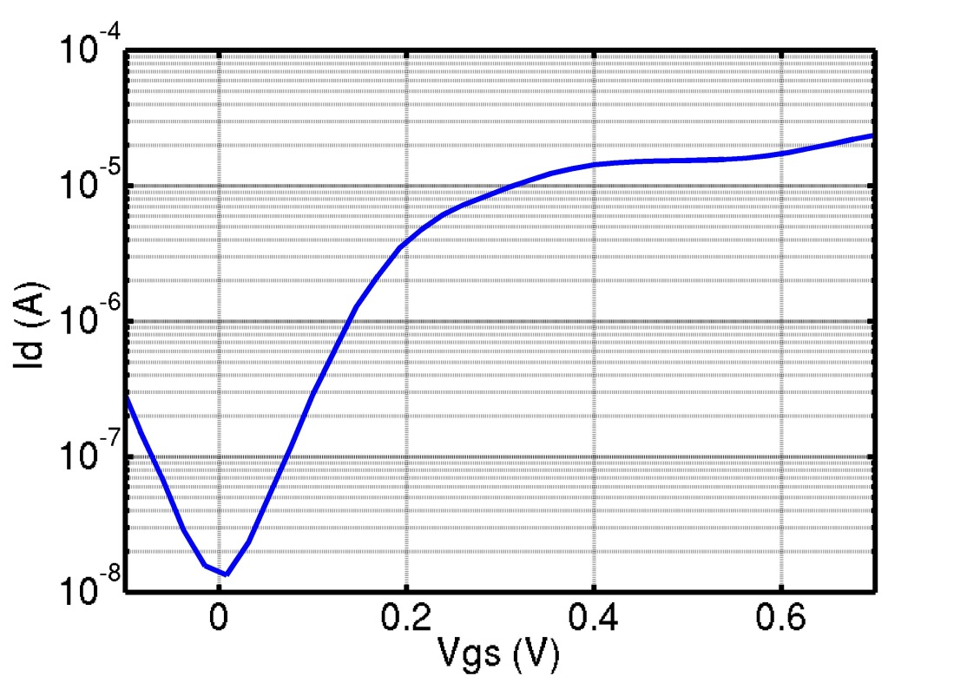
Current-voltage (IV) curve
Subthreshold Swing SS (mV/dec): $\frac{{∂V}_{gs}}{∂{log⁡(I}_{d})}$
Power P=(1/2)C$V_{d}^{2}f$+V_{d}I_{loff}
MOSFET IV Curve
$\frac{{∂V}_{GS}}{∂{log(I}_{D})}={ln\left(10\right)∗(\frac{∂I_{D}}{{∂V}_{GS}}∗\frac{1}{I_{D,on}})}^{−1}$
≈ 60 mV/dec
I_{on}
~60 mV/dec
I_{off}

Slide 6
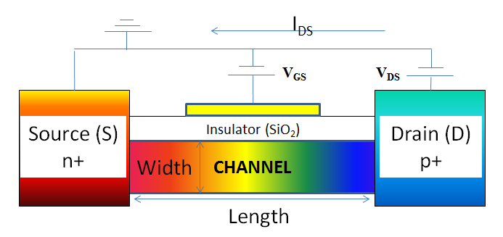
Tunnel Field Effect Transistor (TFET)

Slide 7
Tunnel Field Effect Transistor (TFET)
$$I_{d}=\frac{2e}{h}W\int_{E_{c}^{s}}^{E_{v}^{ch}}{T\left(E−U\right)\left(f_{s}\left(E\right)−f_{d}\left(E\right)\right)dE}$$
λ
On
$$E_{c}$$
q∆$V_{G}$
Off
$$f_{s}\left(E\right)$$
$$E_{v}$$
Source
Channel
Drain

Slide 8
Device design and simulation
Gate
[H]
Source
Drain
$${\text{µ}}_{1}$$
$${[Σ]}_{1}$$
$${\text{µ}}_{2}$$
$${[Σ]}_{2}$$
$$I_{DS}$$
$$V_{DS}$$
$$Green Function: G={(EI−H−{\text{Σ} }_{1}−{\text{Σ} }_{2}) }^{−1}$$

Slide 9
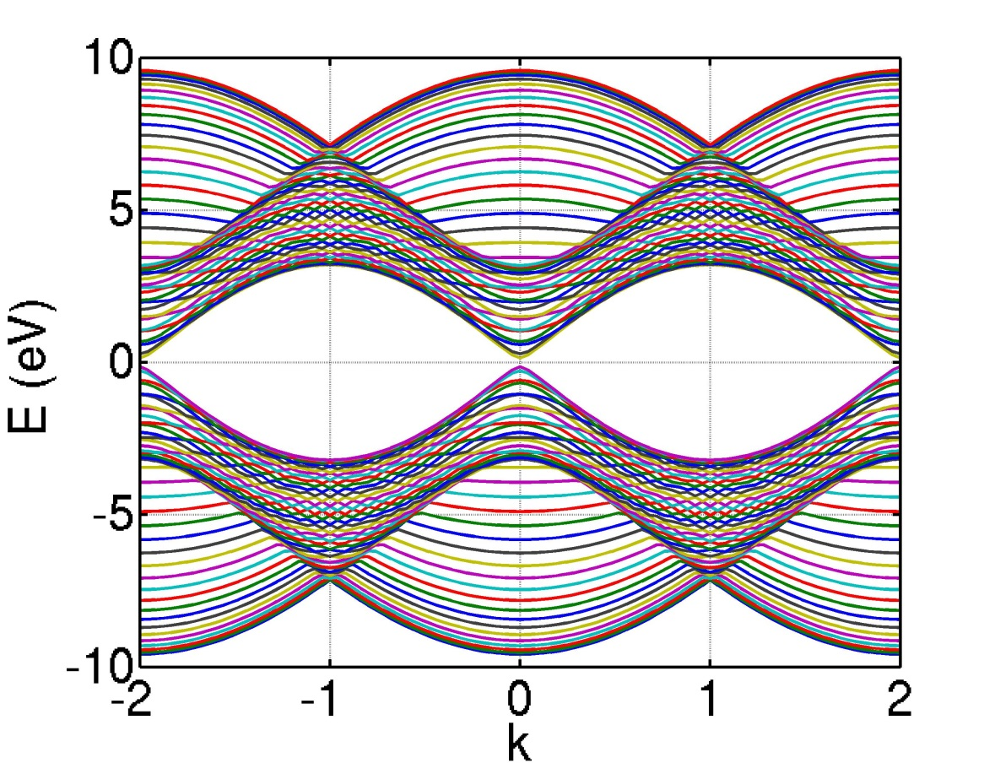
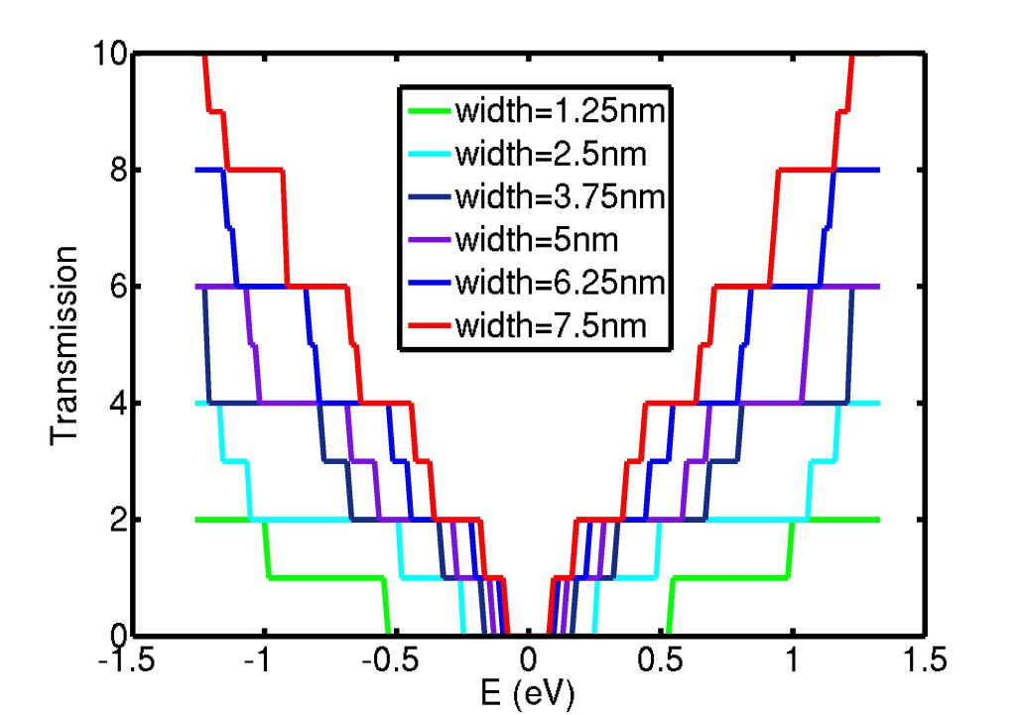
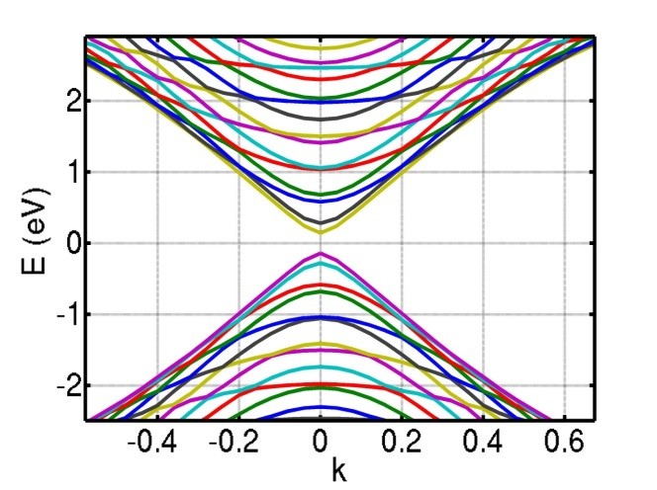
Graphene Nanoribbon (GNR)
Subbands
Transmission

Slide 10
Relevant Functions (analytical)
SS=$\frac{{∂V}_{gs}}{∂{log⁡(I}_{d})}={ln\left(10\right)∗(\frac{∂I_{d}}{{∂V}_{gs}}∗\frac{1}{I_{d,on}})}^{−1}$
$\frac{∂I_{d}}{{∂V}_{gs}}=e\frac{∂I_{d}}{{∂E}_{v}^{ch}}=\frac{2e^{2}}{h}(\frac{∂T_{WKB}}{E_{v}^{ch}}F\left(E_{v}^{ch}\right)+T_{WKB}\frac{∂F(E_{v}^{ch})}{{∂E}_{v}^{ch}})$
$T_{WKB}=e^{−\frac{4Λ\sqrt{2m^{∗}}{E_{g}}^{\frac{3}{2}}}{3h\left(∆φ+E_{g}\right)}}$
$F\left(E_{v}^{ch}\right)=\int_{E_{c}^{s}}^{E_{v}^{ch}}{\left(f_{s}\left(E\right)−f_{d}\left(E\right)\right)dE}$
J. Knoch, S. Mantl and J. Appenzeller, "Impact of dimensionality on the performance of tunneling FETs: Bulk versus one-dimensional devices," ScienceDirect, vol. 51, pp. 572-78, 2007.

Slide 11
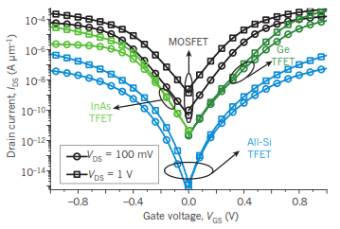
Literature Review: MOSFET/TFET IV of different material system
A. M. Ionescu and H. Riel, "Tunnel field-effect transistors as energy-efficient electronics switches," Nature, vol. 479, pp. 329-337, 2011.

Slide 12
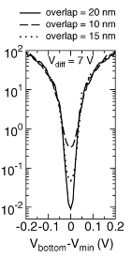
Literature Review: varying gate overlap & differential voltage
Differential voltage between top and bottom gate
for a double gate TFET correlates positively with Ion/Ioff
Gate overlap improves SS
without degrading Ion and Ioff
Fiori, G.; Iannaccone, G., "Ultralow-Voltage Bilayer Graphene Tunnel FET," Electron Device Letters, IEEE , vol.0, no.10, pp.1096,1098, Oct. 2009 doi: 10.1109/LED.2009.2028248
Notes:
Similar physics in bilayer graphene

Slide 13
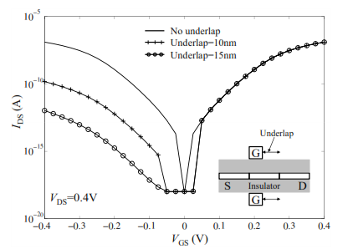
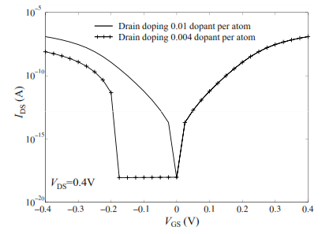
Literature Review: varying drain-side gate underlap & drain doping
X. Yang, J. Chauhan, J. Guo, and K. Mohanram “Graphene tunneling FET and its applications in low-power circuit design,” VLSI, pp. 263-268, 2010
Drain-side gate underlap and drain doping reduce the
ambipolar IV characteristics without sacrificing Ion/Ioff and SS

Slide 14
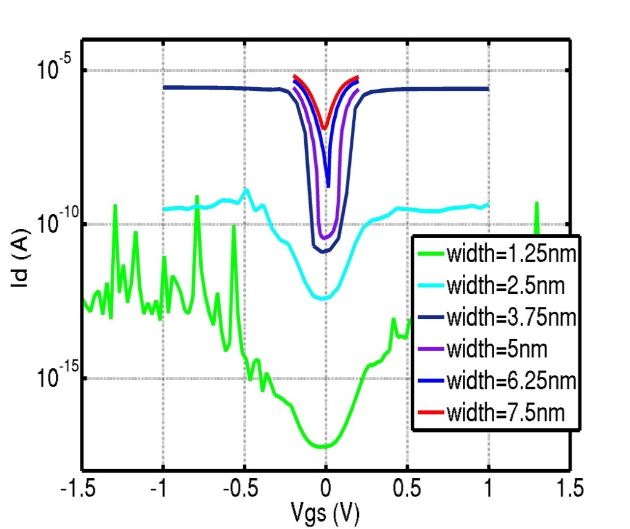
Result: varying channel width
$$I_{d}=\frac{2e}{h}W\int_{E_{c}^{s}}^{E_{v}^{ch}}{T\left(E−U\right)\left(f_{s}\left(E\right)−f_{d}\left(E\right)\right)dE}$$
Channel width varies inversely with SS and correlates negatively (exponential) with Ion/Ioff
Notes:
Transistors of width <3.75nm do not generate enough on-current.

Slide 15
Result: varying channel width
Channel width varies inversely with SS and
correlates negatively (exponential) with Ion/Ioff
Notes:
Transistors of width <3.75nm do not generate enough on-current.

Slide 16
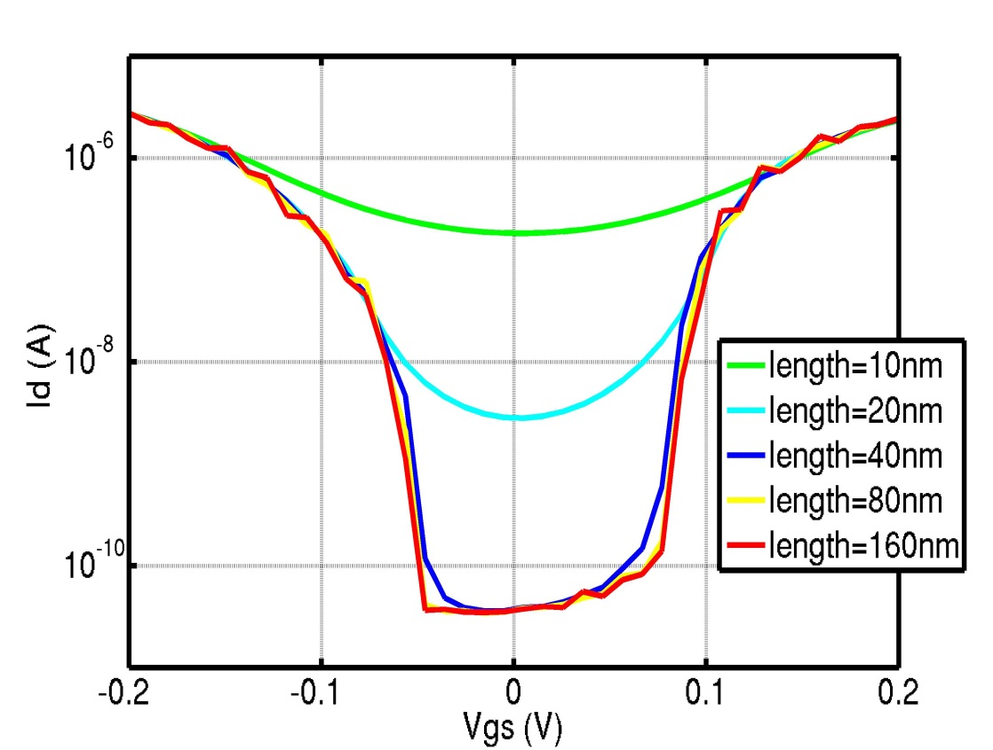
Results: varying channel length
λ
On
$$E_{c}$$
q∆$V_{G}$
Off
$$f_{s}\left(E\right)$$
$$E_{v}$$
Source
Channel
Drain

Slide 17
Results varying channel length
Channel length varies inversely with SS and
correlates positively (logarithmic) with Ion/Ioff

Slide 18
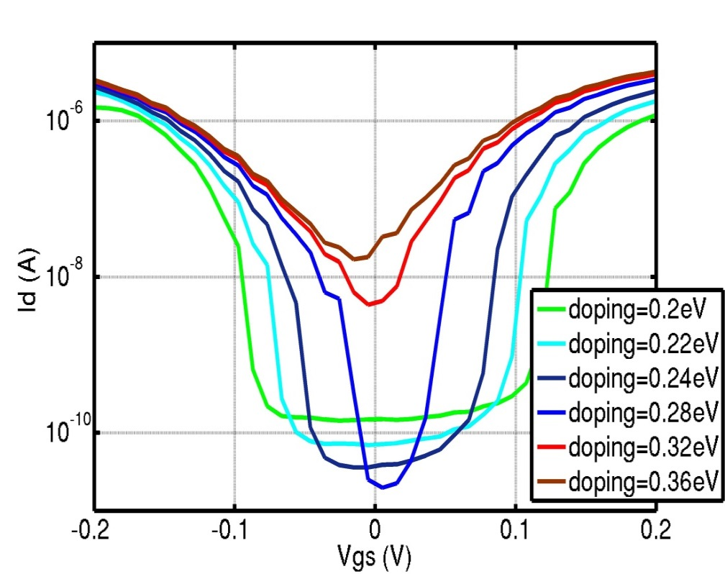
Results: varying doping in contacts
λ
On
$$E_{c}$$
q∆$V_{G}$
Off
$$f_{s}\left(E\right)$$
$$E_{v}$$
Source
Channel
Drain
Channel doping correlates positively with SS (exponential) and
positively with Ion/Ioff (exponential) up until doping of around 0.28eV

Slide 19
Results: varying doping in contacts
Channel doping correlates positively with SS (exponential) and
positively with Ion/Ioff (exponential) up until doping of around 0.28eV

Slide 20
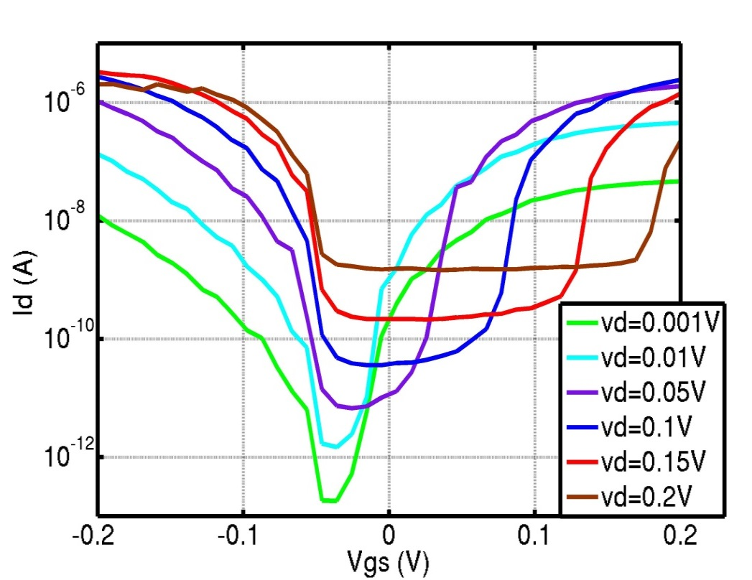
Results: varying drain bias
λ
On
$$E_{c}$$
q∆$V_{G}$
Off
$$f_{s}\left(E\right)$$
$$E_{v}$$
Source
Channel
Drain
Drain bias correlates positively with SS (linear & weak)
and negatively with Ion/Ioff (exponential)

Slide 21
Results: varying drain bias
Drain bias correlates positively with SS (linear & weak)
and negatively with Ion/Ioff (exponential)

Slide 22
Conclusion
SS of 6.4 mV/dec and I_{on}/I_{off} of >25,000 were obtained for length=40nm, width=5nm, vd=0.1 V, and doping=0.24eV.
Further analysis is required to balance the trade-offs among size, power, and performance.
In comparison to a MOSFET, high I_{on}/I_{off} ratio and steep SS over several decades indicate GNR TFET’s superiority for ultra-low-voltage applications.

Slide 23
Future direction
Link experimental results with analytical equations
Adjust simulation to account for experimental challenges
Include scattering (inelastic & elastic)
Alternative TFET designs

Slide 24
Appendix: Simulation Design (continue)
Tight-binding Hamiltonian model
TFET setup:
Channel doping
Tri-gate
Non-equilibrium green function (NEGF)
Assumptions:
Room temperature
ballistic transport
electrodes are infinite electron reservoir
steady state

Slide 25
Appendix: NEGF
$I_{d}=\frac{2e}{h}W\int_{E_{c}^{s}}^{E_{v}^{ch}}{T\left(E−U\right)\left(f_{s}\left(E\right)−f_{d}\left(E\right)\right)dE}$
$G={(EI−H−{\text{Σ} }_{1}−{\text{Σ} }_{2}) }^{−1}$
E : energy matrices from the electronic band structure
H : hamiltonian matrix
${\text{Σ} }_{1,2}$ : self energy matrices from the contacts
${\text{Σ} }_{1}$=${\text{Γ}}_{1}f_{1}$ , ${\text{Σ} }_{2}$=${\text{Γ}}_{2}f_{2}$
$\text{Γ}$: broadening matrices due to coupling with contacts
f: fermi functions describing number of electrons
$G^{n}=G\left({\text{Γ}}_{1}f_{1}+{\text{Γ}}_{2}f_{2}\right)G^{+}$
Electron density per unit energy

Slide 26
Appendix: NEGF (continue)
T(E)=Trace(${\text{Γ}}_{1}G{\text{Γ}}_{2}G^{+}$)
Average transmission at different energy
U=$U_{L}+U_{N}$
Potential energy effecting the DOS , and hence the transmission T
$U_{L}=\frac{C_{G}}{C_{E}}(−qV_{G}$)+$\frac{C_{D}}{C_{E}}(−qV_{D}$)
$U_{N}=\frac{q^{2}}{C_{e}}∆N$
$f(E)=\frac{1}{1+e^{\frac{E−µ}{kT}}}$
Probability that an electron will be at an energy state E given the fermi level $µ$, and temperature T
$I_{d}=\frac{2e}{h}W\int_{E_{c}^{s}}^{E_{v}^{ch}}{T\left(E−U\right)\left(f_{s}\left(E\right)−f_{d}\left(E\right)\right)dE}$

Slide 27
Appendix: Relevant functions (continue)
SS=$\frac{{∂V}_{gs}}{∂{log⁡(I}_{d})}={ln\left(10\right)∗(\frac{∂I_{d}}{{∂V}_{gs}}∗\frac{1}{I_{d,on}})}^{−1}$
$\frac{∂I_{d}}{{∂V}_{gs}}=e\frac{∂I_{d}}{{∂E}_{v}^{ch}}=\frac{2e^{2}}{h}(\frac{∂T_{WKB}}{E_{v}^{ch}}F\left(E_{v}^{ch}\right)+T_{WKB}\frac{∂F(E_{v}^{ch})}{{∂E}_{v}^{ch}})$
$T\left(E\right)=e^{−2\int_{0}^{Λ}{\sqrt{\frac{2m^{∗}}{h^{2}}\left(qξx\right)}dx}}$
$T\left(E_{v}^{ch}\right)=T_{WKB}=e^{−\frac{4Λ\sqrt{2m^{∗}}{E_{g}}^{\frac{3}{2}}}{3h\left(∆φ+E_{g}\right)}}$
$∆φ=E_{v}^{ch}−E_{c}^{s}$
$U=E_{v}^{ch}+E_{g}$
$U−E_{c}^{s}=−qξx$
$F\left(E_{v}^{ch}\right)=\int_{E_{c}^{s}}^{E_{v}^{ch}}{\left(f_{s}\left(E\right)−f_{d}\left(E\right)\right)dE}$
J. Knoch, S. Mantl and J. Appenzeller, "Impact of dimensionality on the performance of tunneling FETs: Bulk versus one-dimensional devices," ScienceDirect, vol. 51, pp. 572-78, 2007.

