Slide 1
Online simulations via nanoHUB: The O2 molecule and spin
In this tutorial:
Setup DFT simulation for an oxygen molecule (O₂)
Minimize energy to find equilibrium structure
Compare spin 1 and 0 states, quantify exchange energy
Nicolas Onofrio and Ale Strachan
strachan@purdue.edu
School of Materials Engineering & Birck Nanotechnology Center
Purdue University
West Lafayette, Indiana USA

Slide 2
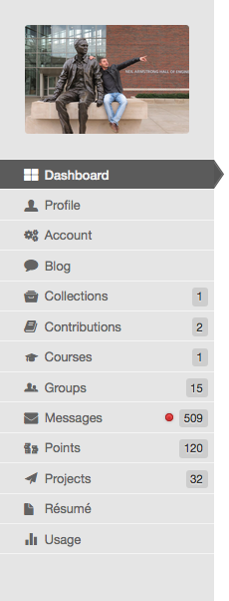
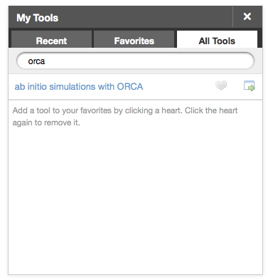
STEP 1: launch the ORCAtool
From your My dashboard page launch ORCAtool
From All Tools find:
orca
Launch tool by clicking on:
OR open the tool’s main page and launch the tool by clicking on:

Slide 3
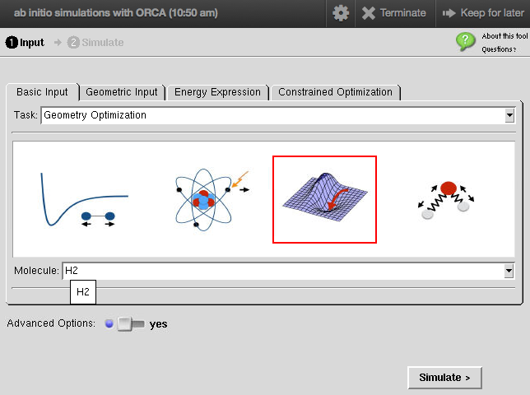
STEP 2: setup the basic input
Start from the pre-built H2 molecule
We will select a geometry optimization with the H2 molecule pre-build case and modify it
Turn ON the advanced Options in order to have access to the simulation details

Slide 4
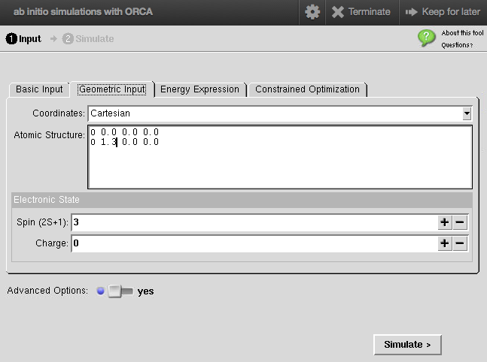
STEP 3: setup the geometry and spin state
From the Geometric Input tab
Select Cartesian coordinates
We have 2 Oxygen atoms separated by 1.3A
For the Spin 1 (triplet):
total spin S = 1, here you input the spin as 2*S + 1 = 3
For the Spin 0 (singlet):
total spin S = 0, 2*S + 1 = 1

Slide 5
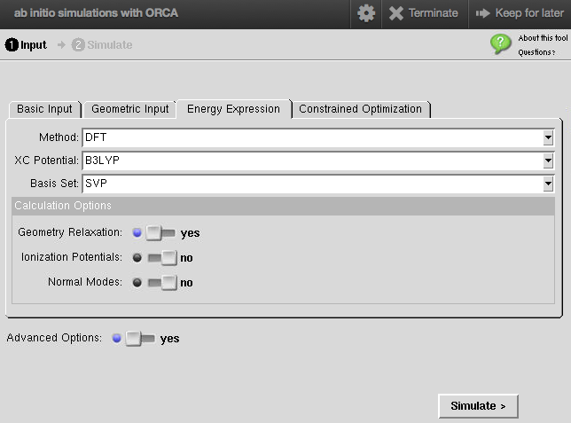
STEP 4: setup the simulation details and run!
From the Energy Expression tab
Select density functional theory method (DFT) with the exchange correlation potential B3LYP and the basis set SVP
We ask the code to relax the atomic structure
Click simulate
And wait for the results (a minute or so)

Slide 6
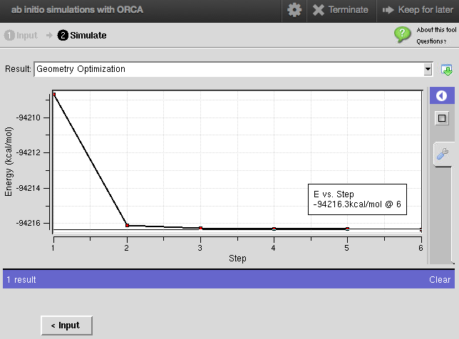
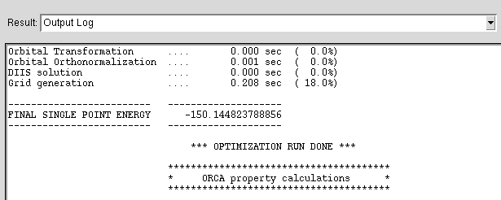
STEP 5: analyze total energy
Select Total Converged Energy from the output drop-down menu
The plot show the energy function of ionic steps
The total energy is:
-94216.3 kcal/mol
OR from the Output Log, scroll down to the end you will find the total energy under FINAL SINGLE POINT ENERGY (Hartree)

Slide 7
STEP 6: Assignment
What is the energy difference between the spin 1 and spin 0 states? This is the so called exchange interaction.
How large is this compared to a bond energy or the electron binding energy in hydrogen?
Explain the physics behind the energy difference

