Slide 1
Nanocrystalline Solar Cells
Train the NanoTeacher Workshop July 17, 2014

Slide 2
Electricity
Conductive materials allow the flow of electrons
Energy is produced as electrons flow through the material
From a Negative electrode (Negative charge – free electrons)
To a Positive electrode (Positive charge – needs electrons)
Complete circuit
2

Slide 3
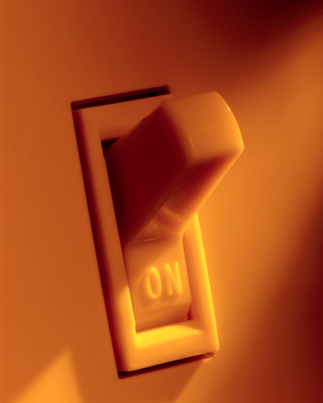
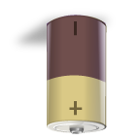
Closed Circuit
3

Slide 4
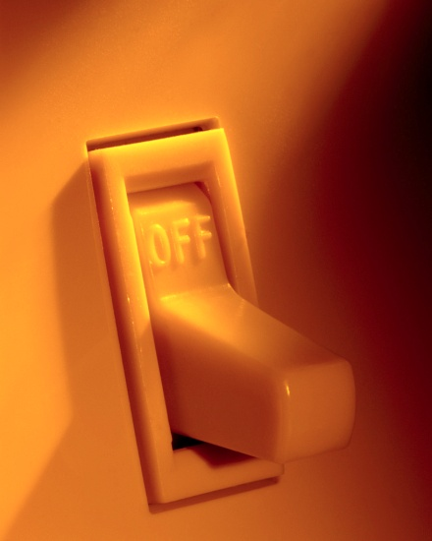
Open Circuit
4

Slide 5
Solar Cells
Light, photons from the sun
Converts to free electrons
Flow through a circuit
5

Slide 6
Commercial Solar Panels
Lightweight Thin Films
Source: Smart Home Shack
Renewable Energy Production
Source: Nanosys
6

Slide 7
Solar land requirements
3 TW
7
(N. Lewis, 2007)

Slide 8
Solar Cell Components
Dye
Absorbs photons - loses electrons
Semiconductor
Electrons flow through from dye to electrode
Electrode
Negative lead – passes electrons to load
Load -
Counter Electrode
Positive lead – electrons pass from the load back to the electrolyte
Electrolyte
Replaces lost electrons in dye
Catalyst
Increases the rate of reaction
8

Slide 9
Parts of the Solar Cell
Glass slide
SnO₂ Coating
TiO₂
Nanolayer
Dye
Carbon coating
(catalyst)
Electrolyte
SnO₂ Coating
Glass slide
9

Slide 10
Nanocrystalline Structure
Dye absorbs into TiO₂ coating
Nanostructure of TiO₂
Increased surface area of TiO₂
Increase in dye absorbed
Increase in efficiency
10

Slide 11
Load
11

Slide 12
Solar Panel
To increase output of the solar cell cells can be put together to create panel
-
-
+
+
+
Load
12

Slide 13
If the solar cell isn’t working
Make sure there is enough electrolyte
Ensure that all of the electrolyte its wiped of the exposed edges of the glass slide
Check that the SnO₂ coated side of the glass plate is not on the outside of the cell
Check that enough of the berry stained TiO₂ is on the slide and exposed
13

Slide 14
Reusing the kit
Make sure the TiO₂ slide and carbon coated slide are reused for the same application
Photosynthesis
Chlorophyll dye instead of berries
Different colors of leaves
14

Slide 15
References
Slide 6 | Thin film solar panel. [Online image]. 10 July. 2013. <http://news.thomasnet.com/green_clean/2012/06/05/thin-film-photovoltaics-market-aims-to-convert-on-huge-potential/>.
Slide 6 | Roof solar panel. [Online image]. 10 July. 2013. <http://smarthomeshack.com/wp-content/uploads/2011/02/0123-solar-panel-roof.jpg>.
Slide 7 | Lewis, Nate. The Future of Power and Energy in the World UC Santa Barbara Kavli Institute, December 2007 http://online.kitp.ucsb.edu/online/colloq/lewis1/oh/33.html downloaded July 9, 2013.
15

