Slide 1
Summer School for Integrated Computational Materials Education 2016
Introduction to Computation & Fundamentals of Simulations
Katsuyo Thornton
Materials Science & Engineering
University of Michigan

Slide 2
THIS LECTURE WILL COVER
Approach to Computational Modeling
Numerical Method (Example)
Errors & Uncertainties
Validation and Verification
Programming Practice

Slide 3
1. Introduction: Approach to Computational Modeling

Slide 4
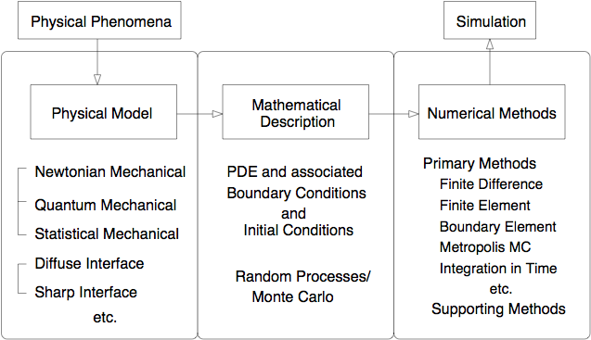
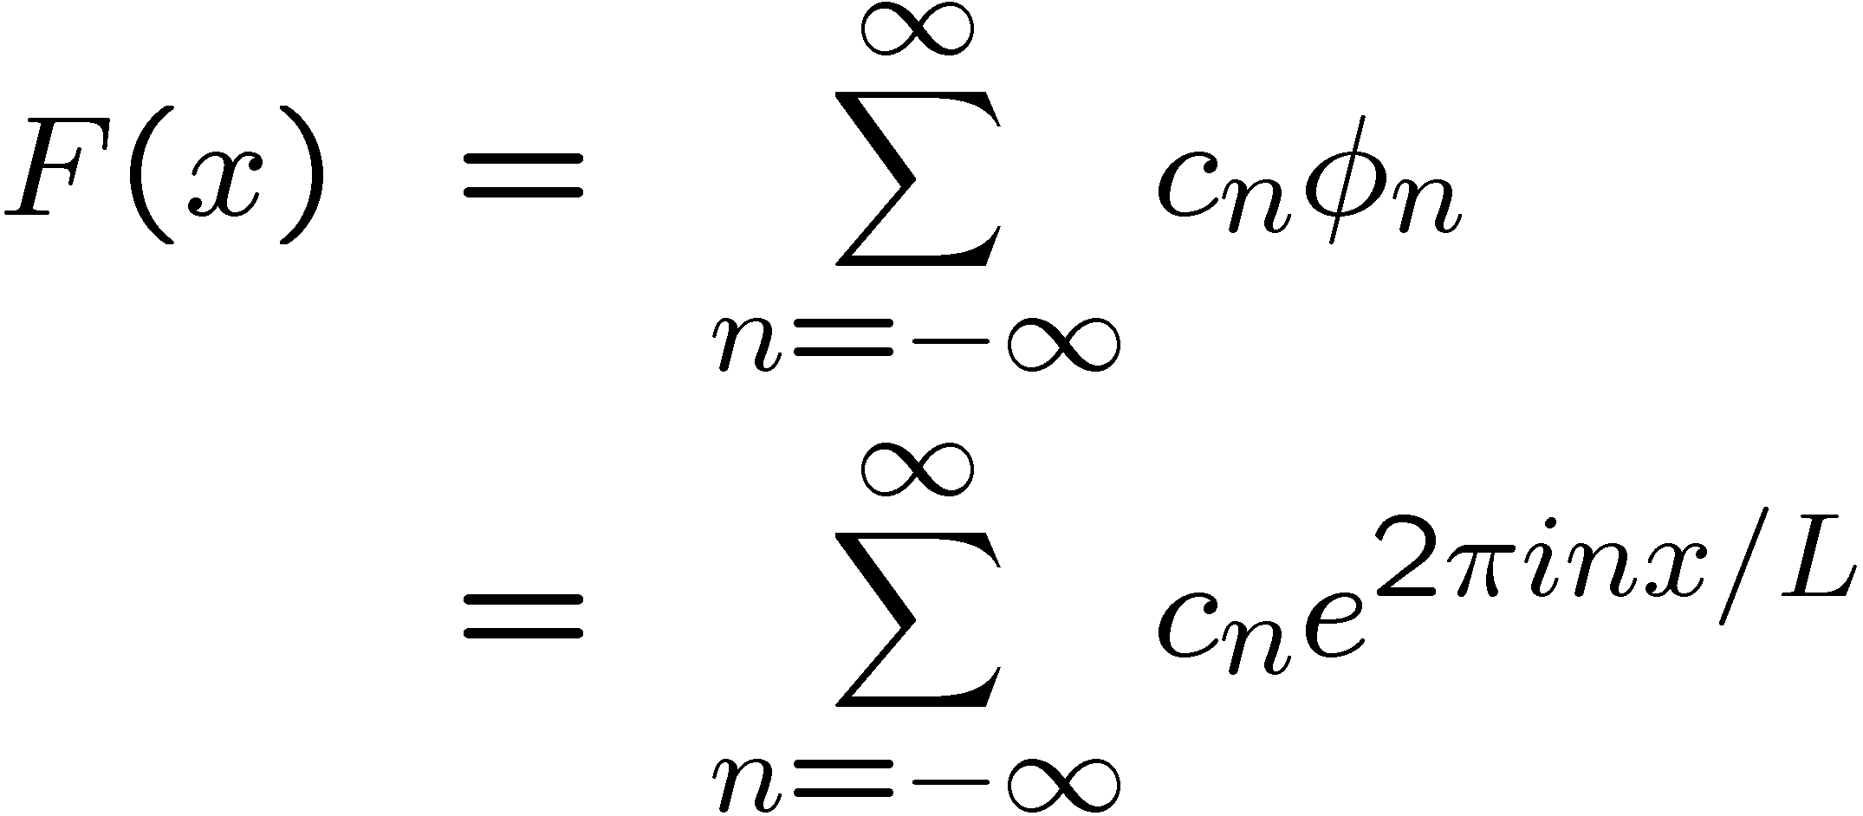
Approaches to Computational Modeling
1
2
3,4

Slide 5
Fundamentals of Simulation
INGREDIENTS OF NUMERICAL SIMULATIONS
A simulation of a complex physical system often requires a
combination of powerful numerical methods. There are several
layers in a complete simulation.
    1a. Physical Model
      Quantum Models (solving Schrödinger equation)
      Atomistic Models (Monte Carlo, Molecular Dynamics, etc.)
      Continuum Models (e.g., Diffuse & Sharp Interface Models)
    1b. Time Dependence
      Dynamics (explicit/implicit time evolution)
      Steady State (relaxation to an equilibrium or self-similar state)

Slide 6
INGREDIENTS OF NUMERICAL SIMULATIONS (CONTINUED)
    2. Mathematical Description: E.g., PDE
      Eulerian vs. Lagrangian (E.g., in MD)
    3. Numerical Method: E.g., Discretization of the Physical Domain and/or Solving PDE
      Finite Difference Method
      Finite Element Method
      Boundary Integral Method
    4. Supporting Numerical Methods
      Fast Fourier Transform
      Multigrid Method

Slide 7
Comput. Approaches in The Summer School
Atomistic models
Ab inito methods (Mark Asta)
Molecular dynamics (Mark Asta)
Monte Carlo method (Mark Asta)
Kinetic Monte Carlo method (Mark Asta)
Microstructure-level simulations
  Phase-field models (Jon Guyer)
  Computational mechanics (Edwin Garcia)
Computational Thermodynamics (Paul Mason)

Slide 8
Comput. Approaches in The Summer School
Ab inito methods (Mark Asta)
Molecular dynamics (Mark Asta)
Monte Carlo method (Mark Asta)
Kinetic Monte Carlo method (Mark Asta)
Microstructure-level simulations
  Phase-field models (Jon Guyer)
  Computational mechanics (Edwin Garcia)
Computational Thermodynamics (Paul Mason)
Continuum models

Slide 9
3. Numerical Methods
Example: Finite Difference Method

Slide 10
DISCRETE REPRESENTATION OF A CONTINUOUS VARIABLE
Consider an independent continuous variable x ∈ [X₁,X₂]. We take the discrete representation, x_{i}, of x to be
Given a dependent function f(x) defined on the domain, a discrete approximation of f(x) is given by
Similarly, given a differential equation on the domain, you can find a discrete representation of the equation. Such representation is called the difference equation.

Slide 11
QUALITY OF DISCRETE REPRESENTATION
The quality of the discrete representation depends on the resolution and the behavior of the discretized object.
Ensure adequate resolution by representing the smallest features by at least several points.

Slide 12
WHAT ARE FINITE DIFFERENCE METHODS?
Used to solve ODE or PDE.
Based on the Taylor expansion.
Probably the most simple method to understand.
Discretization:
  Spatial: Divide space x ∈ [0,L] into N segments, Δx = L/N. Calculate derivatives of a function to use in solving a differential equation. Fix spatial coordinates (the Eulerian description).
  Temporal: Set a time step of size Δt, and calculate the new value of a function at t + Δt.
  There are many ways to discretize an equation; accuracy and stability depends on it.
We will focus on a basic fixed mesh, equally spaced in spatial domain (1D, 2D, or 3D).

Slide 14
CHARACTERIZATION OF DISCRETIZATION ACCURACY
An approximation to a quantity is nth order accurate if nth order term in the Taylor expansion of the quantity is correctly reproduced.
Example: First Derivative of f(x)
The Taylor expansion of f(x) around x_{i} gives f'(x), f''(x), etc.
Method 1. One-sided (forward) differencing on x

Slide 15
Method 2. One-sided (backward) differencing on x
Method 3. Center differencing on x

Slide 16
4. Errors & Uncertainties

Slide 17
SOURCES OF ERRORS
Model Error: Differences between the physical system and the
    “equivalent” as described by governing equations, initial
    condition and boundary conditions.
Truncation or Discretization Error: This error results from
    converting the analytical form of equations to a discretized
    form that can be solved numerically. Error analysis gives you
    an estimate of error. Accuracy depends on the resolution (in
    both spatial and time coordinates).
Rounding Error: This error results from floating operations in
    digital equipment. Accuracy of computational operations
    generally receives little attention. Often, carrying enough
    precision provides sufficient accuracy. However, in special
    cases, care must be taken.

Slide 18
MODELS
This is probably the most difficult issue to address and examine.
Questions:
    What approximations are made in deriving the governing equations? (E.g., sharp interface model). How good or bad are they?
    What effects excluded in the model are there, and what are the magnitude of the effects?
    Are you using physically consistent parameters? If not, what are the effects? (E.g., gradient coefficient)
    If there are input parameter/function to a model, how good are they? What are the range of errors, and how sensitive is your model to the changes in the input? (E.g., free energy, potential, etc.)

Slide 19
DISCRETIZATION ERROR
The magnitude and behavior of error can be estimated by error analysis.
Ex. Verlet algorithm (for MD calculation)
As MD is a Lagrangian formulation (i.e., we follow the location of mass), the location of an atom needs to be evolved in time as prescribed by the force field. Given f (t) on the mass m at r(t), Verlet method gives the updated location by
      r(t + ∆t) ≈ 2r(t) − r(t − ∆t) + (f (t)/m)∆t²
How much error is there in this approximation?

Slide 20
Taylor expansion (on board):

Slide 22
So, the Verlet algorithm is accurate up to O(∆t³).
There are in fact many ways to discretize a single equation. The
accuracy (and stability) must be checked for each method-equation
combination.

Slide 23

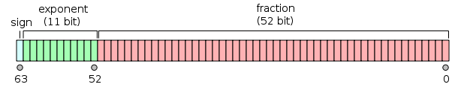
ROUNDING ERROR
Computers represent numbers in binary
Single precision binary floating-point format (in a 32bit machine)
From Wikipedia
Double precision binary floating-point format
Each has specific maximum and minimum numbers & rounding error

Slide 24
ROUNDING ERROR
Can be important!
Dynamical evolution or iteration not associated with minimization of residual error

Slide 25
5. Validation & Verification

Slide 26
Validation & Verification: Why?
Why is it important? A simulation tool can become a black box.
Black box
- Dictionary definition: a usually complicated electronic device that functions and is packaged as a unit and whose internal mechanism is usually hidden from or mysterious to the user; broadly : anything that has mysterious or unknown internal functions or mechanisms
- As simulation codes get complex, it can become a black box. The input may be of good quality, but it does not guarantee good output quality.

Slide 27
Validation & Verification (V&V)

Slide 28
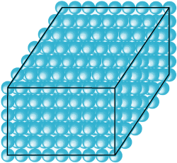
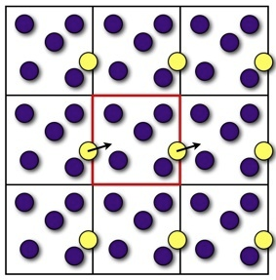
Validation & Verification (Continued)
3. System Size System size is often limited by the computational
resources. Most physical systems have a much larger system size than those that can be simulated.
a. Edge Effect
• A simple cubic crystal of 1000 atoms has 49% (in 3D) of them on the surface, and the edge effect becomes important.
• Consider using periodic boundary conditions at the cell edges.
~500 atoms

Slide 29
Validation & Verification (Continued)
b. Size Effect
• If the periodic unit cell is too small compared to the feature within it, or if a point can see its own image, the results become influenced by the system size.
• This manifests as domination and damping of features with certain wavelengths as any fluctuation must be compatible with the imposed periodicity.
• Unless the size of the lattice is physically consistent, it may lead to unphysical effects, such as an artificial ordering.
• Verification: Study the effects of limited system size by using a smaller or (preferably) larger system and compare.

Slide 30
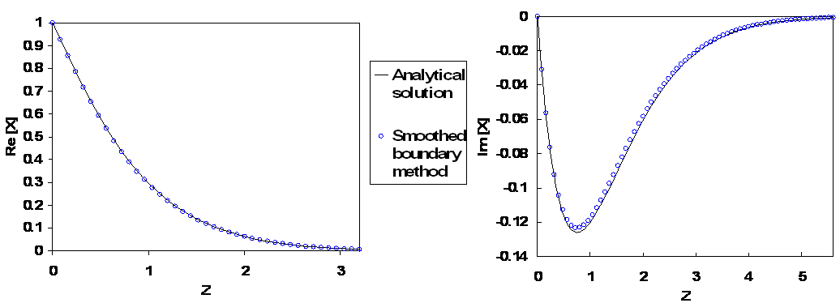
Validation & Verification (Continued)
4. Code/method verification It is difficult to write a bug-free code! Test runs can often give indications for bugs.
a. Using analytical solutions
• Set up simulations that corresponds to setups that have
analytical solutions (Ex. Reaction-diffusion in cylinder); more later.
b. Using your physical intuition
• Always think about what you would
expect to see from a simulation.
Does the result make sense?
c. Unit tests
• Test piece by piece.

Slide 31
Validation & Verification (Continued)
4. Code/method verification (continued)
d. Method of Manufactured Solutions
• For the given PDE, add a forcing term and assume an analytical solution. Obtain the analytical form of the forcing function.
e. Debugging
• Always start with small calculations!!
• Use debugger & check points
• Be detailed

Slide 32
Use of Analytical Methods
Even if your goal is to study a system that is very complicated, it is always a good idea to simplify the problem and study it analytically.
The results can be used to validate your code, as it is always easy to set up a simple case in robust numerical simulation. This is important as it is not very difficult to leave a bug in a big codes.
It also gives you an appreciation and understanding of the physical problem at a higher level. You may learn something new and get an extra publication on the side.

Slide 33
6. Programming
Good coding practice
Efficiency

Slide 34
Pointers on Programming (Discussion)
Key: Break down the task into smaller pieces
  - Outlines are helpful in doing this
Identify repeated tasks and make a subroutine or function
Stream-line the tasks by looking from the bird’s eye view (for the big picture)
Get the details right by being meticulous
Make the variable names something anyone can understand
Write in comments
Use version control software
Learn to use debugger
Know how to check your solutions

Slide 36
Efficiency in Computation
• CPU time efficiency
• Storage efficiency
• Programming efficiency (human time)
Ask:
1. How long would a calculation take?
2. How much memory/storage does it take? (Use 8 byte per
double precision)
3. How much time do I want to spend programming?
Find the limiting factor. If the computation takes too long using a
simple method, you would have to pay more attention to this
issue and compromise on others.

