Slide 1
Data science for Materials Science & Engineering
Data Querying, Organization, Filtering
In this module
Introduction to data repositories and APIs
Hands on tutorial using nanoHUB: data querying for oxides
Hands on tutorial using nanoHUB: performing your own tailored queries and data filtering
Homework assignments
Zachary McClure and Alejandro Strachan
zmcclure@purdue.edu || strachan@purdue.edu
School of Materials Engineering & Birck Nanotechnology Center
Purdue University
West Lafayette, Indiana USA

Slide 2
Learning objectives and prerequisites
After completing this lecture you will:
Learn about and query data repositories
Manage data through efficient Pandas dataframes
Parsing
Logic operations
Data visualization and selection
Type management
Perform tailored queries specific to user application
Pre-requisites:
Basic Python programming

Slide 3
Launching a Jupyter tool in nanoHUB
Querying Data Repositories
From your browser go to link: https://nanohub.org/tools/matdatarepo/
Click on Launch Tool to begin

Slide 4
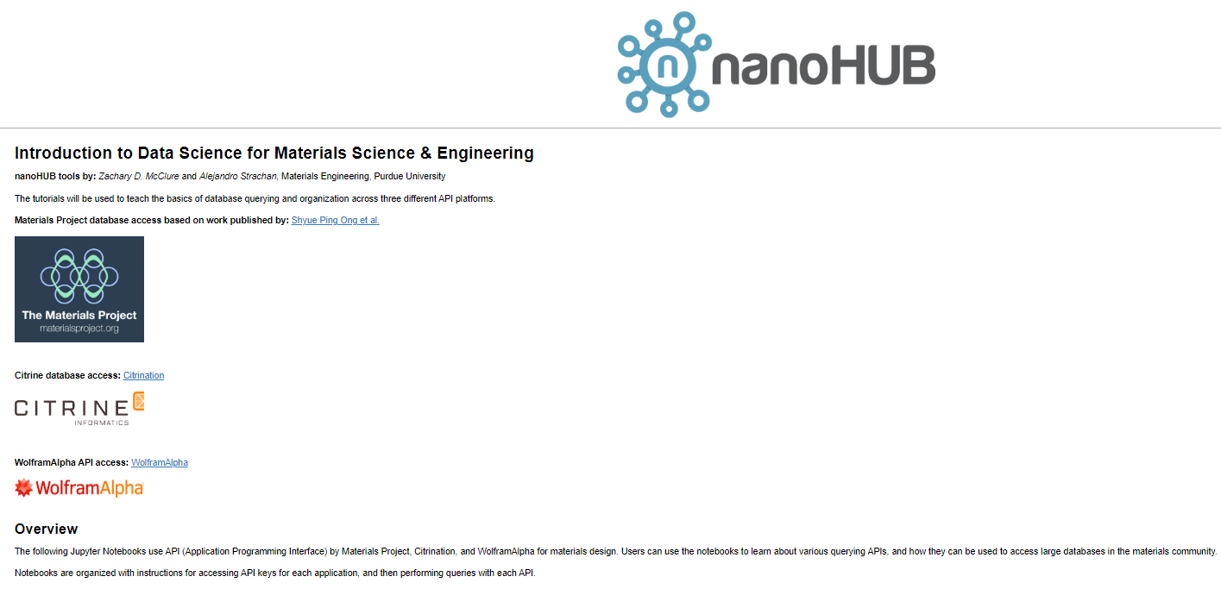
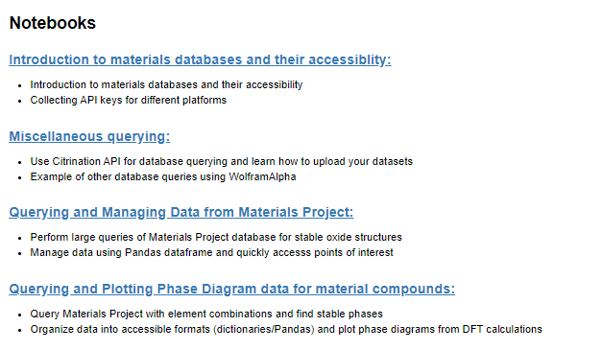
Step 1: Landing Page – Notebook: Querying Data
Read through overview
Navigate to “Introduction to materials databases and their accessibility” first
This will provide you information on how to get access to each of these repositories
1.
2.
Introduction to querying
3.
4.
4

Slide 5
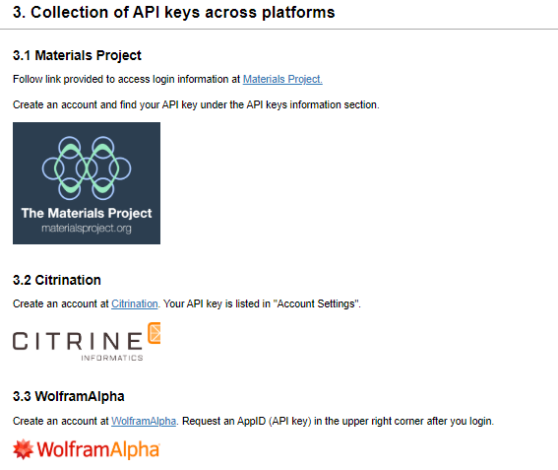
STEP 1: get API keys for MP
Keep these API keys private! They are linked to your personal accounts and should not be distributed freely. Account access may be revoked by client if terms of use are broken.
Introduction to querying:
Follow the links included in steps 3.1 to get an API key for Materials Project
5

Slide 6
Querying and managing data
Tasks
Perform large queries to database repository
Filter results
Convert between types of data
Plot results & find correlations
Assess the scale of your data
Advanced images with Plotly
6

Slide 7
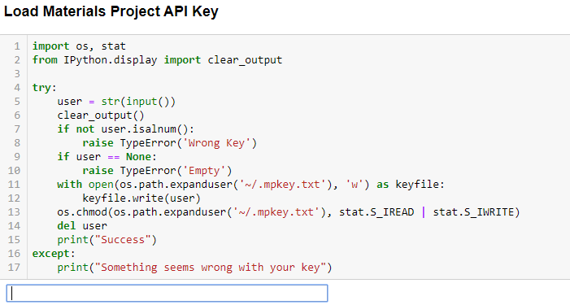
Querying the Materials Project & managing data
Load API keys – press ‘Enter’ after. A message displays if your key has been stored
Introduction to querying:
Run through the cells in the Jupyter notebook (Shift+Enter)
Filter and parse data cell by cell to reduce load of queried data
Enter
7

Slide 8
Querying the Materials Project & managing data
You can change the number of properties queried by editing the property requests in the rester.query().
Problem 1: Add piezoelectric data to the oxide query
Filter and parse data cell by cell to reduce load of queried data
See Pymatgen documentation for more info:
https://pymatgen.org/usage.html
8

Slide 9
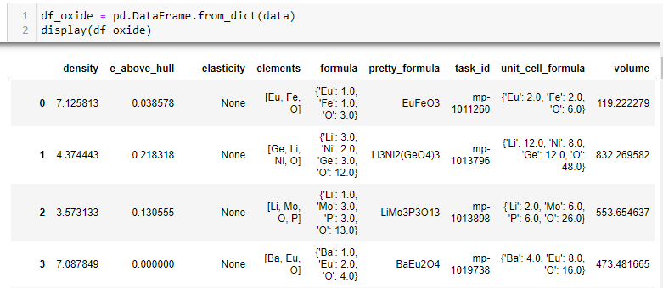
Querying the Materials Project & managing data
Convert data into accessible pandas dataframe
Filter database based on structure stability
1. Only structures with energy within 1 meV of the ground state are kept
9

Slide 10
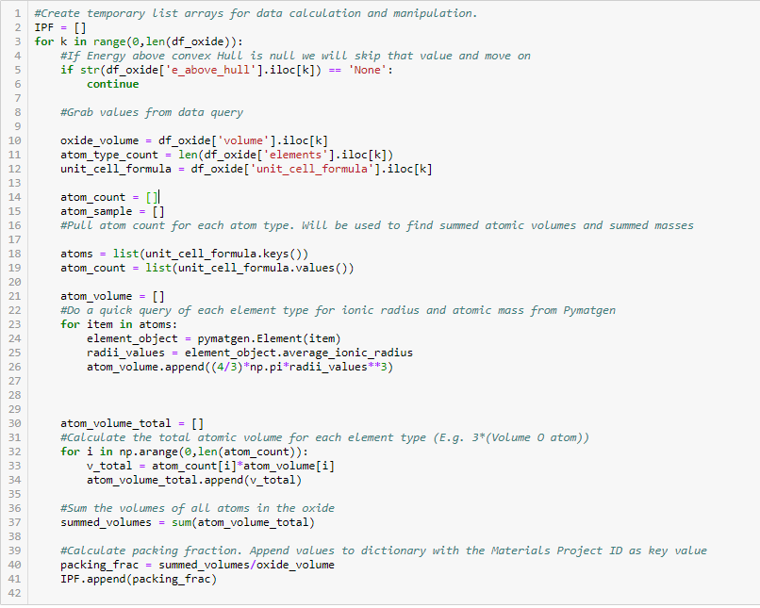
Querying the Materials Project & managing data
Perform our own calculations on the data
For each oxide:
calculate the ionic packing fraction
append result to dictionary
10

Slide 11
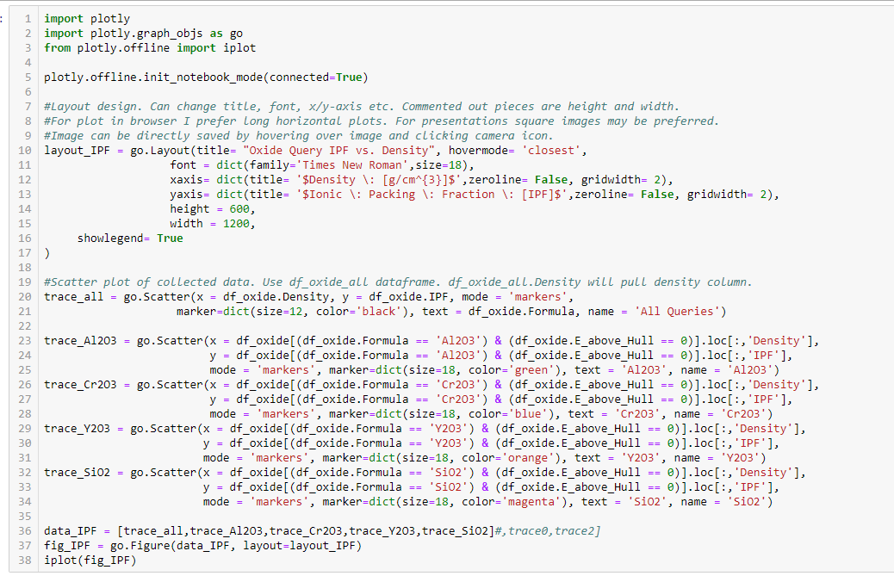
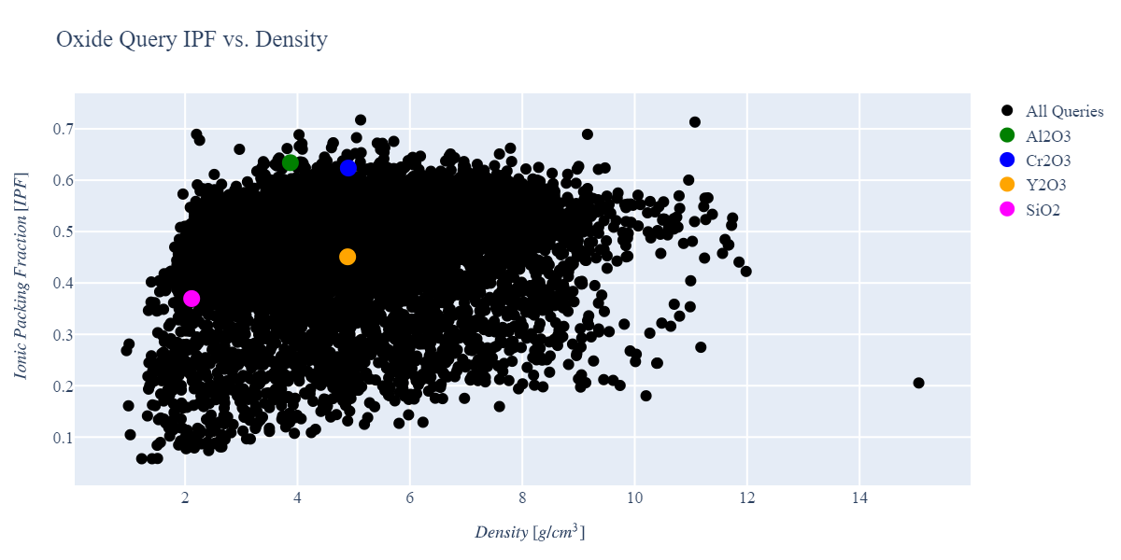
Querying the Materials Project & managing data
Plot the query results with Plotly
11

Slide 12
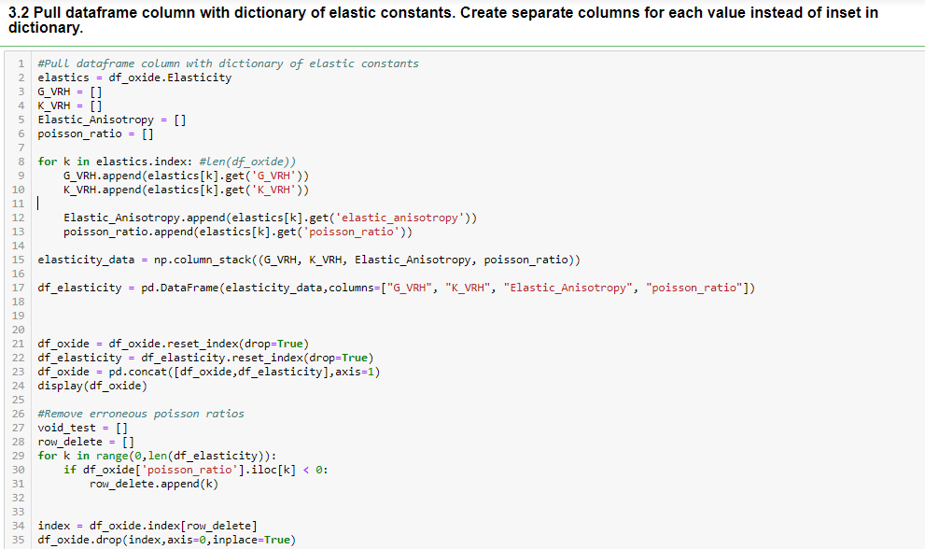
Querying the Materials Project & managing data
Filter results that do not have elastic constants
Expand elastic constant dictionary
12

Slide 13
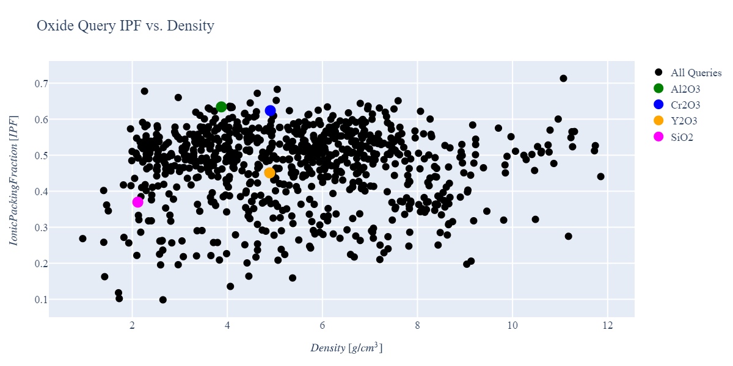
Querying the Materials Project & managing data
Stable oxides
Stable oxides + elasticity data filtered
13

Slide 14
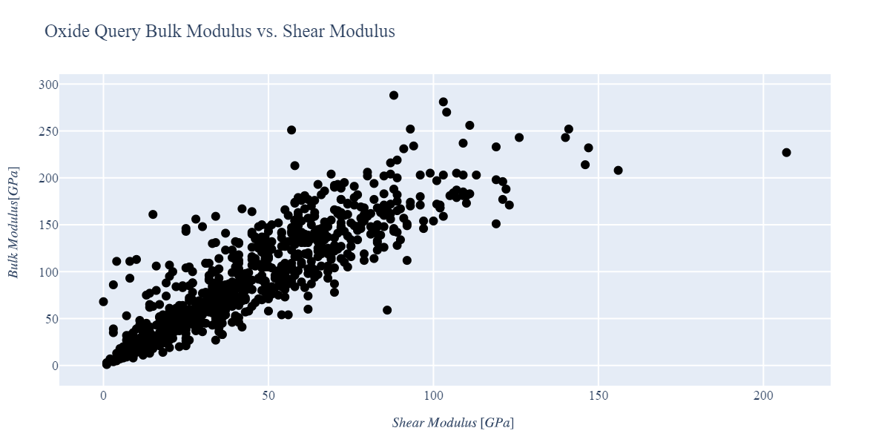
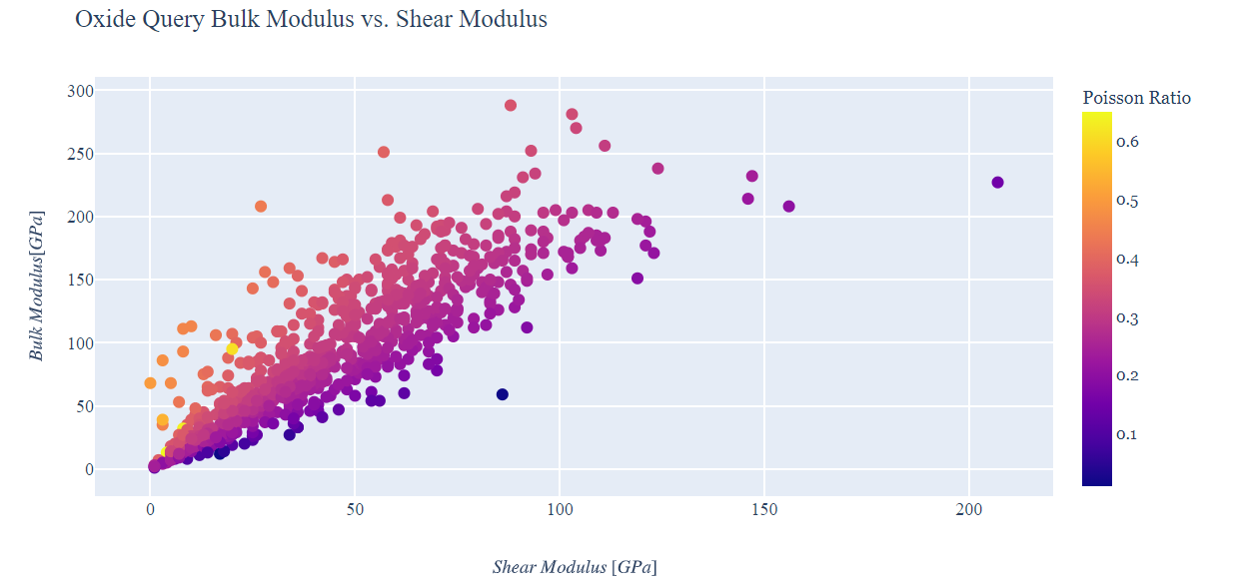
Querying the Materials Project & managing data
Advanced plotting & property correlation
14

Slide 15
Summary
Easily queryable databases offer researches access to data that can be useful for initial material searches, or for creating rapid sets of descriptors for machine learning models
Management of these queried datasets can be easily done using pandas dataframes
The code in https://nanohub.org/tools/matdatarepo can be easily modified to meet needs in a wide range of problems

Slide 16
Next steps
Homework assignment: to reinforce concepts and help students modify the workflow and adapt it for their needs

